Slide 1

Purchasing Managers’ IndexTM (PMI®)
Chris Williamson
Chief Business Economist
S&P Global Market Intelligence
The Economic Compass for Investors
October 14, 2025

Slide 2
Dealing with data uncertainty

Slide 3
Dealing with data uncertainty

Slide 4
Dealing with data uncertainty

Slide 5
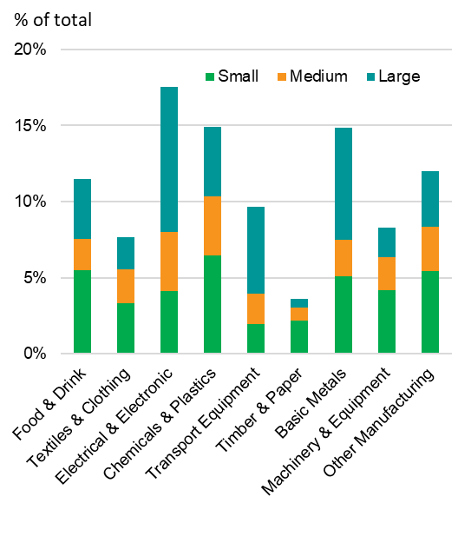
A need for better data: PMIs Criteria:
Example PMI panel: China manufacturing
Rapid publication
Not revised
Hard data, not sentiment
Knowledgeable, representative respondents, low ‘churn’
Broad coverage of the economy
Internationally comparable
Source: NBS.

Slide 6
A need for better data: PMIs Criteria:
PMI questions
Output
New orders
New export orders
Backlogs of work
Employment
Input prices
Output prices
Quantity of purchases
Suppliers’ delivery times
Stocks of purchases
Stocks of finished goods
* Future expectations
Headline PMI components
Rapid publication
Not revised
Hard data, not sentiment*
Knowledgeable, representative respondents, low ‘churn’
Broad coverage of the economy
Internationally comparable
“Filling the data void in the vast services economy”

Slide 7

A need for better data: PMIs Criteria:
PMI data collection and publishing
Data collection usually commences around the 12th of each month and ends a few days prior to the end of each month
Rapid publication
Not revised
Hard data, not sentiment
Knowledgeable, representative respondents, low ‘churn’
Broad coverage of the economy
Internationally comparable
Early ‘flash’ results
Final survey results published on 1st working day for manufacturing and the 3rd working day for services

Slide 8
Dealing with data uncertainty

Slide 9
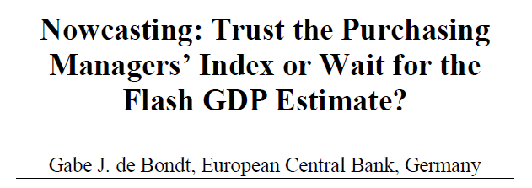
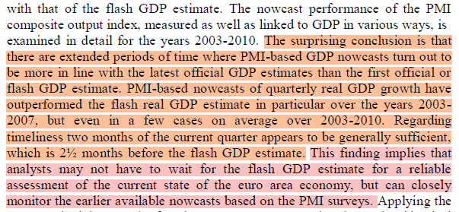

Slide 10
Dealing with data uncertainty

Slide 11
US equities and macroeconomics: PMI outperforms GDP as gauge of corporate performance

Slide 12
US earnings growth
US PMI-based earnings growth indicator components:
Total order book situation: a blended index of the composite new orders and backlogs of orders questions providing an overall indication of sales growth Output prices: based on the composite PMI average prices charged index, providing an indication of pricing power among goods producers and services providers Backlogs of work: the composite survey index covering work received but not yet completed, helps indicate the extent to which demand is running ahead of capacity and therefore acts as a further guide to both sales and pricing power Productivity: the ration between composite PMI output and employment indicators which provides an insight into labour productivity, itself a key determinant of profitability Suppliers' delivery times: a key gauge of capacity constraints and pricing power

Slide 13

PMI Data:
How to use it

Slide 14
Global PMI signals accelerating GDP growth

Slide 15
Country growth rankings

Slide 16
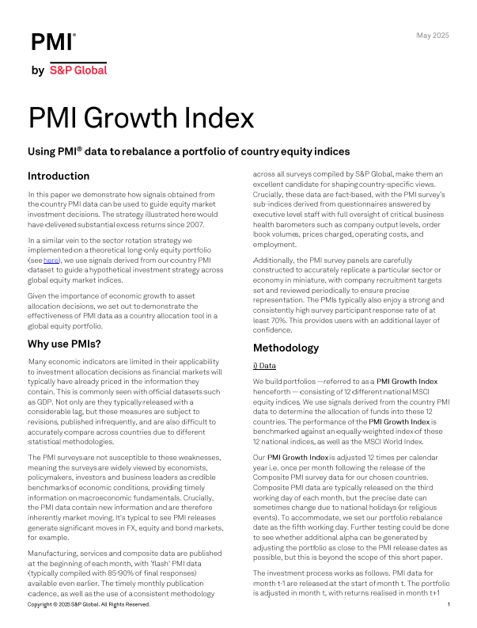
Country PMIs as a tool for equity portfolio adjustment

Slide 17
Manufacturing disrupted by tariffs

Slide 18
Higher US inventories of inputs from tariff front-running are being used to make more goods

Slide 19
Sustained but slower global growth seen in both manufacturing and services

Slide 20
Consumer services join tech and financials in driving global expansion

Slide 21
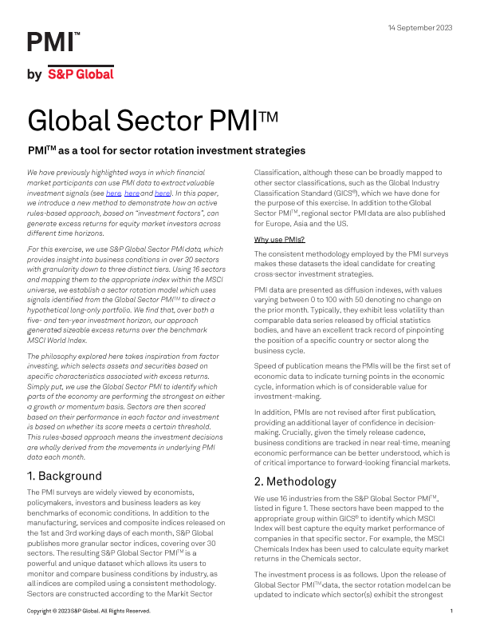
Sector PMIs as a tool for equity portfolio adjustment

Slide 22
PMI and inflation

Slide 23
PMI data and short dated government bonds
Data compiled September 23, 2025.
PMI covers manufacturing & services output.
Source: S&P Global PMI,S&P Global Market Intelligence.
© 2025 S&P Global.

Slide 24
PMI indicators (output, prices, employment) and central bank policy
Data compiled September 23, 2025.
PMI covers manufacturing & services output.
Source: S&P Global PMI,S&P Global Market Intelligence.
© 2025 S&P Global.

Slide 25
What next for the global economy?

Slide 26

Further information
Follow our PMI news and further commentary at PMI | S&P Global (spglobal.com)
Primary contact
Chris Williamson Chris.Williamson@spglobal.com
Contact us
Americas +1 800 447 2273
Japan +81 3 6262 1887
Asia-Pacific +60 4 291 3600
Europe, Middle East, Africa +44 (0) 134 432 8300
www.spglobal.com/en/enterprise/about/contact-us.html
www.spglobal.com
© 2025 S&P Global.
26

Slide 27
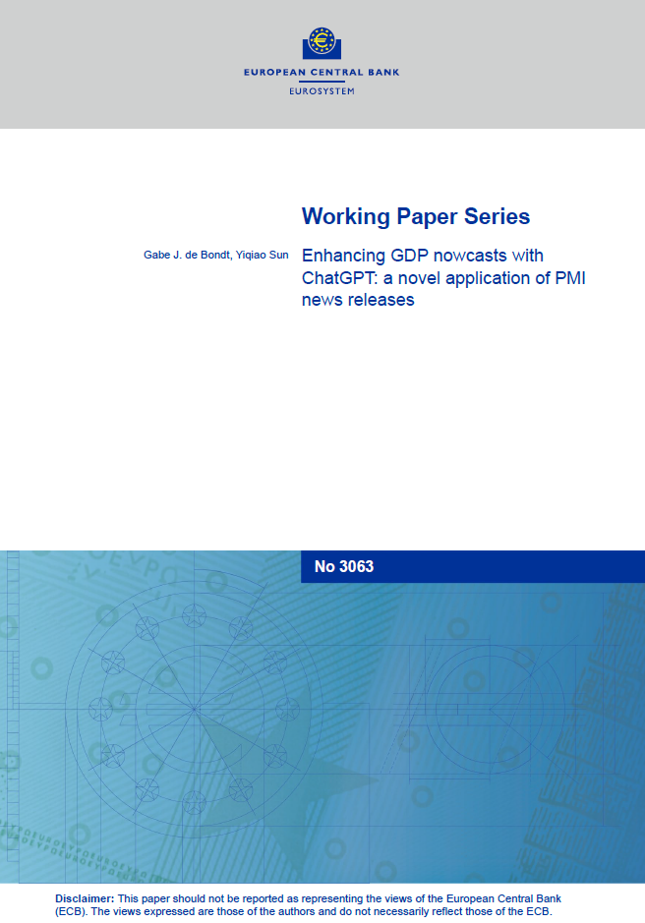
Using text-score analysis to improve GDP nowcasts
FRANKFURT, June 26 (Reuters) - A ChatGPT analysis of qualitative commentary in PMI releases can significantly improve GDP forecasting, a paper published by the European Central Bank of Thursday showed.
This new study found that even relatively little text associated with PMI releases can provide meaningful guidance on economic developments, improving its ability to assess activity in real time.
"What makes this study unique is its focus on the narrative, tone, and anecdotes reported in PMI news releases," the working paper argued.
Economists used ChatGPT to generate activity sentiment scores based on the narratives and anecdotes of PMI news releases, then integrated these scores into forecasts of growth in the current quarter, or nowcasts.
"The main compelling result is that the enhancement of the PMI text scores to the two GDP nowcast benchmarks significantly improves the accuracy of GDP nowcasts," the authors argued.
"Only two pages of text rather than for example millions of newspapers articles can be sufficient to enhance existing hard-to-beat benchmarks," they added.

Slide 28
Disclaimer

Slide 29
Global PMI coverage
 | Manufacturing | Services | Whole Economy
Asia pacific:
Australia | ✓ | ✓
China (mainland) | ✓ | ✓
Hong Kong SAR |  |  | ✓
India | ✓ | ✓
Indonesia | ✓
Japan | ✓ | ✓
Kazakhstan | ✓ | ✓
Malaysia | ✓
Myanmar | ✓
Philippines | ✓
Singapore |  |  | ✓
South Korea | ✓
Taiwan | ✓
Thailand | ✓
Vietnam | ✓
ASEAN | ✓
 | Manufacturing | Services | Whole Economy
Africa/middle east
Egypt |  |  | ✓
Ghana |  |  | ✓
Kenya |  |  | ✓
Lebanon |  |  | ✓
Nigeria |  |  | ✓
Mozambique |  |  | ✓
Qatar |  |  | ✓
Saudi Arabia |  |  | ✓
South Africa |  |  | ✓
Uganda |  |  | ✓
UAE |  |  | ✓
Zambia |  |  | ✓
Americas:
Brazil | ✓ | ✓
Canada | ✓ | ✓
Colombia | ✓
Mexico | ✓
United States | ✓ | ✓
 | Manufacturing | Services | Whole Economy
Europe
Austria | ✓
Czech Republic | ✓
Eurozone | ✓ | ✓
France | ✓ | ✓
Germany | ✓ | ✓
Greece | ✓
Ireland | ✓ | ✓
Italy | ✓ | ✓
Netherlands | ✓
Poland | ✓
Spain | ✓ | ✓
United Kingdom | ✓ | ✓
Other:
Russia | ✓ | ✓
Turkey | ✓

Slide 30
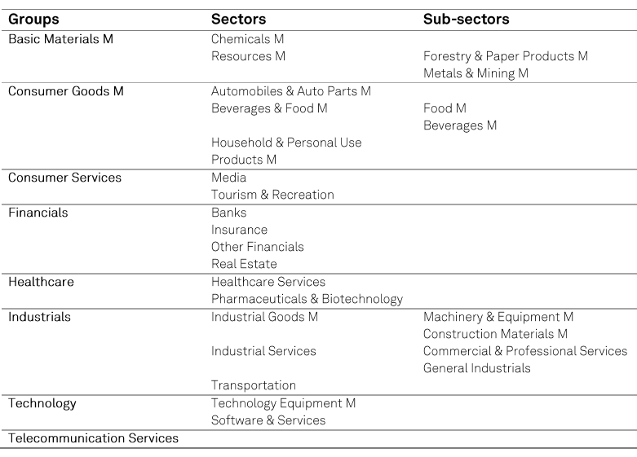
PMI sector coverage
Global
Asia
Europe
US (groups only)
Other national sector data on request

Slide 31
Global business confidence

Slide 32
How are the surveys compiled?
% higher x 1.0
% same x 0.5
% lower x 0.0
The PMIs are based on questionnaire surveys with the following questions asked:
e.g. “Is your output (in units) higher, the same or lower than one month ago?”
Please state any reason for change……………………………………………….
= Diffusion Index
Faster rate of improvement
Slower rate of improvement
Faster rate of deterioration
Slower rate of deterioration

