Slide 1
Plenty of Peril, Priced for Perfection
UK Labour Market already in recession. Inflation to cool. Rates to be cut further than priced.
Rise of Reform.
2. Germany and France struggling. Uncompetitive (energy, tech, manufacturing).
Make France Great Again.
3. US supported by AI spend but labour market is weakening. Recession risk higher than is priced.

Slide 2
The UK private sector is already in a jobs recession
UK employment, private sector ex admin, change month on month in thousands (excluding self employed)
Source: ONS, HMRC PAYE, data as of end of August 2025.

Slide 3
There is a broad-based decline in payrolls across key private cyclical industries
UK employment in selected cyclical sectors, change month on month in thousands (excluding self employed)
Source: ONS, HMRC PAYE, data as of end of August 2025.

Slide 4
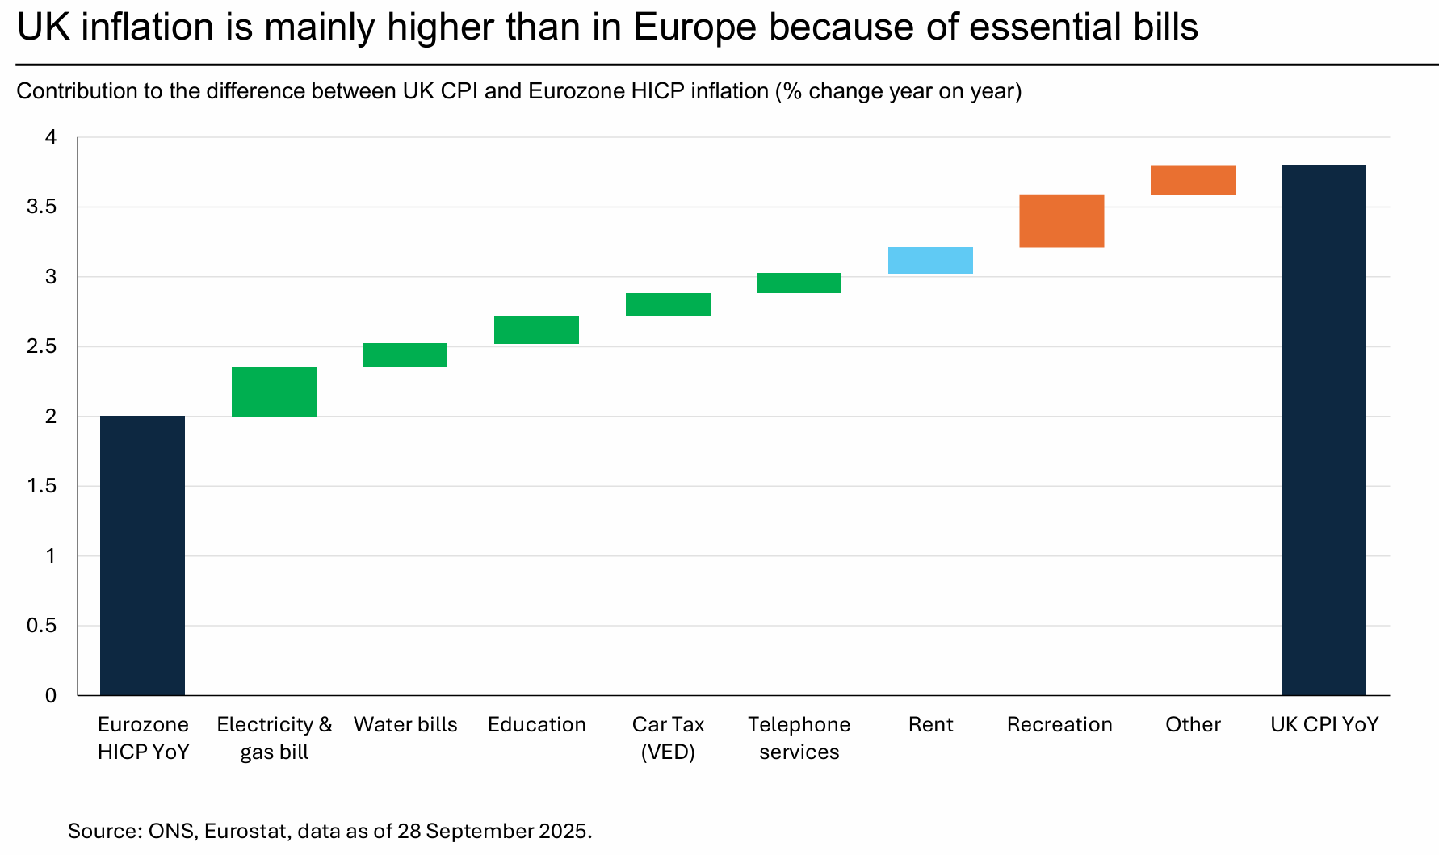
Payrolls are declining across key private cyclical industries
UK employment in selected cyclical sectors, change month on month in thousands (excluding self employed)
Source: ONS, HMRC PAYE, data as of end of August 2025.

Slide 5
Most of the recent increase in inflation is down to energy and water bills
Detailed breakdown of the drivers of the increase in UK year on year inflation since September 2024
Source: ONS, Data latest available as of 3 October 2025.

Slide 6
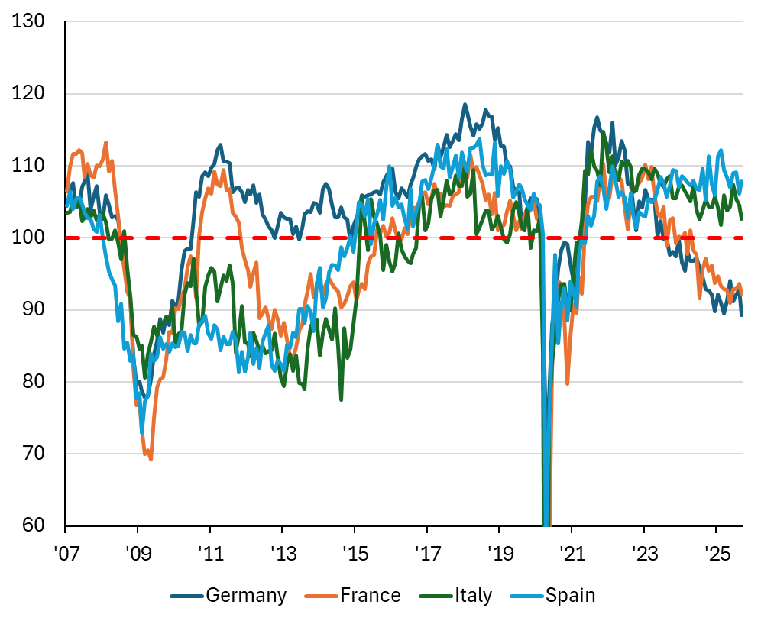
France and Germany are struggling
Employment expectations
Source: Eurostat, EC employment expectations indicator. Data as of September 30.

Slide 7
German industrial production is very weak
German industrial production, seasonally adjusted
Source: Destatis, data is real and as of end of August 2025.

Slide 8
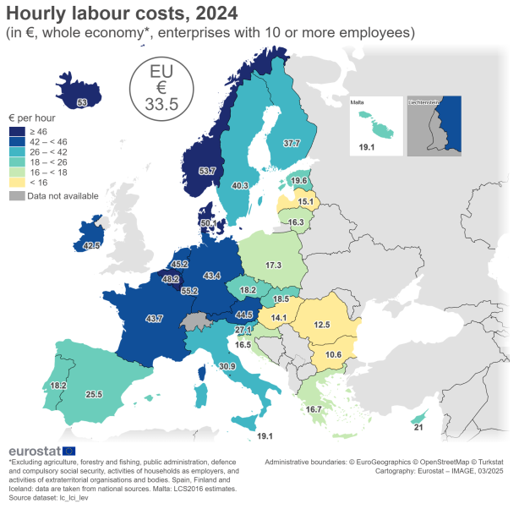
Spain and Italy have done better than France and Germany because of cheaper labour following internal devaluation
Labour costs as % of EU average
Source: Eurostat. Data as of end of 2024.

Slide 9
Excluding healthcare, the US is now seeing job cuts too
US non-farm payrolls excluding healthcare and social assistance, change month on month, thousands
\
Source: BLS. Data as of end of August 2025. Seasonally adjusted.

Slide 10
ISM services survey points to weak new orders and falling employment
Recession
Source: ISM, numbers below 50 indicate contraction and above 50 indicate expansion. Data as of 3 October 25.

Slide 11
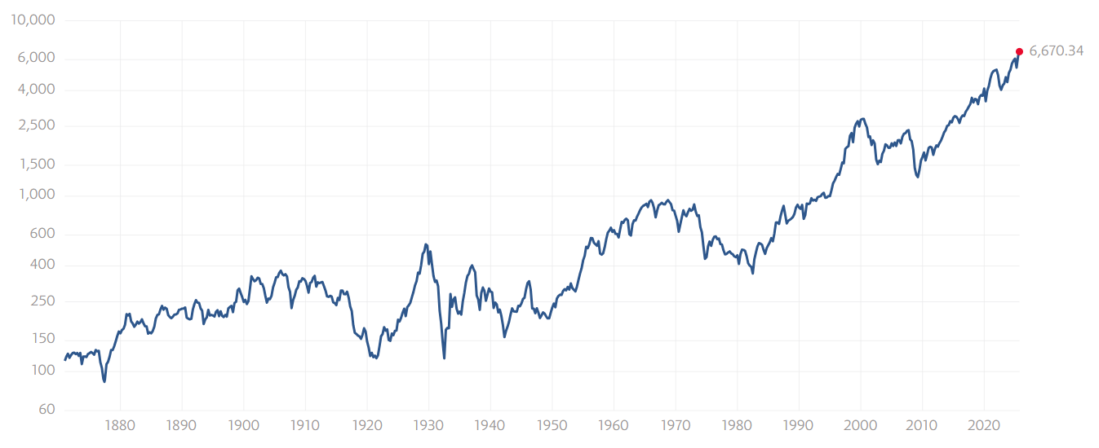
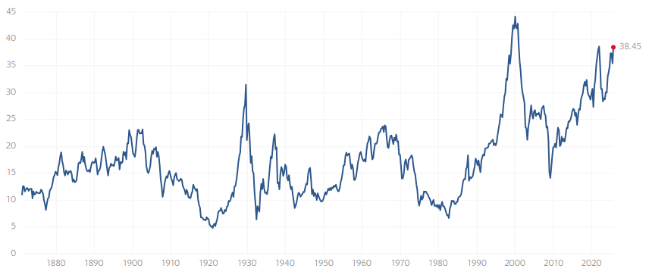
Very High US Equity valuations
US equities adjusted for inflation (top chart) vs Shiller cyclically adjusted PE ratio (CAPE) ratio (bottom chart)
15 years
22 years
26 years
22 years
Source: Robert Shiller, https://www.multpl.com. Data as of September 2025.

Slide 12
Real yields need to fall for debt to be sustainable
30 year government bond yield (%)
Data as of September 2025.

Slide 13
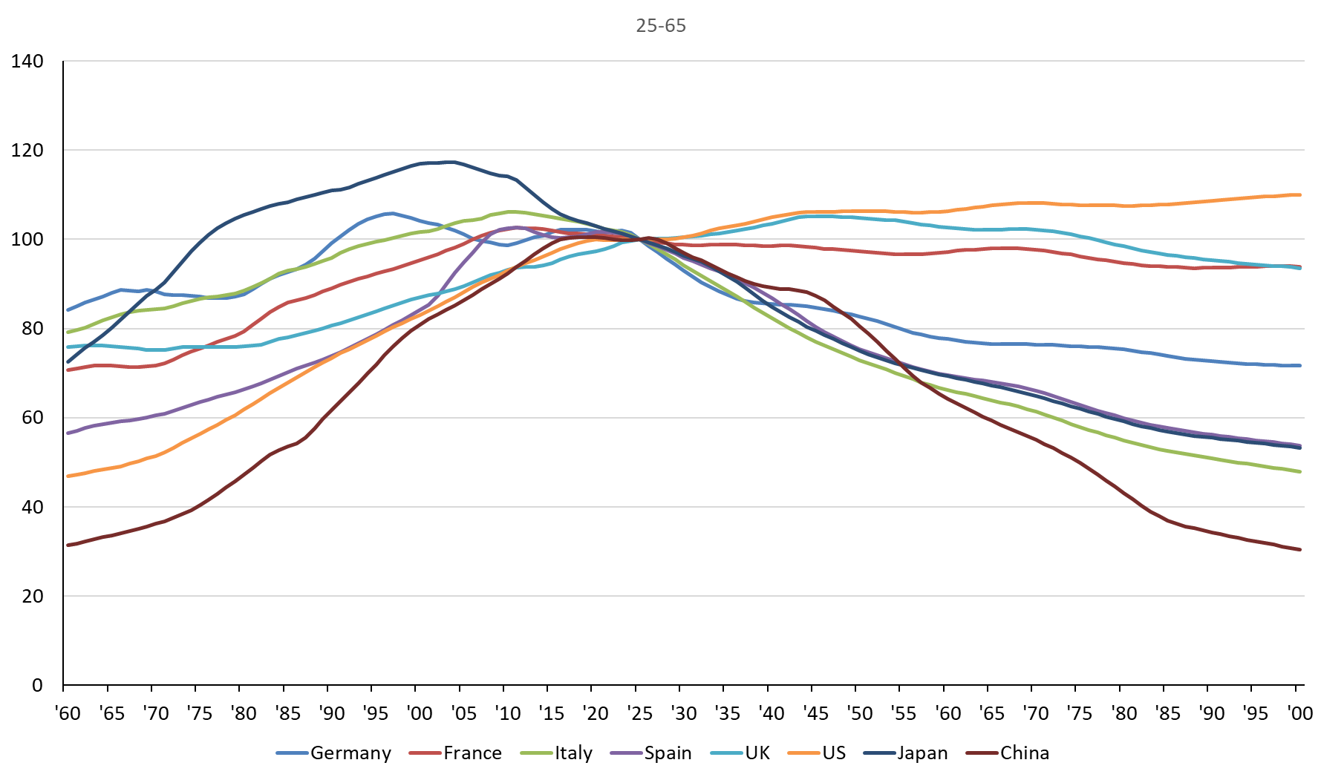
Shrinking working age populations in many countries
Population aged 25-65
Source: UN. Data as of September 30

Slide 14
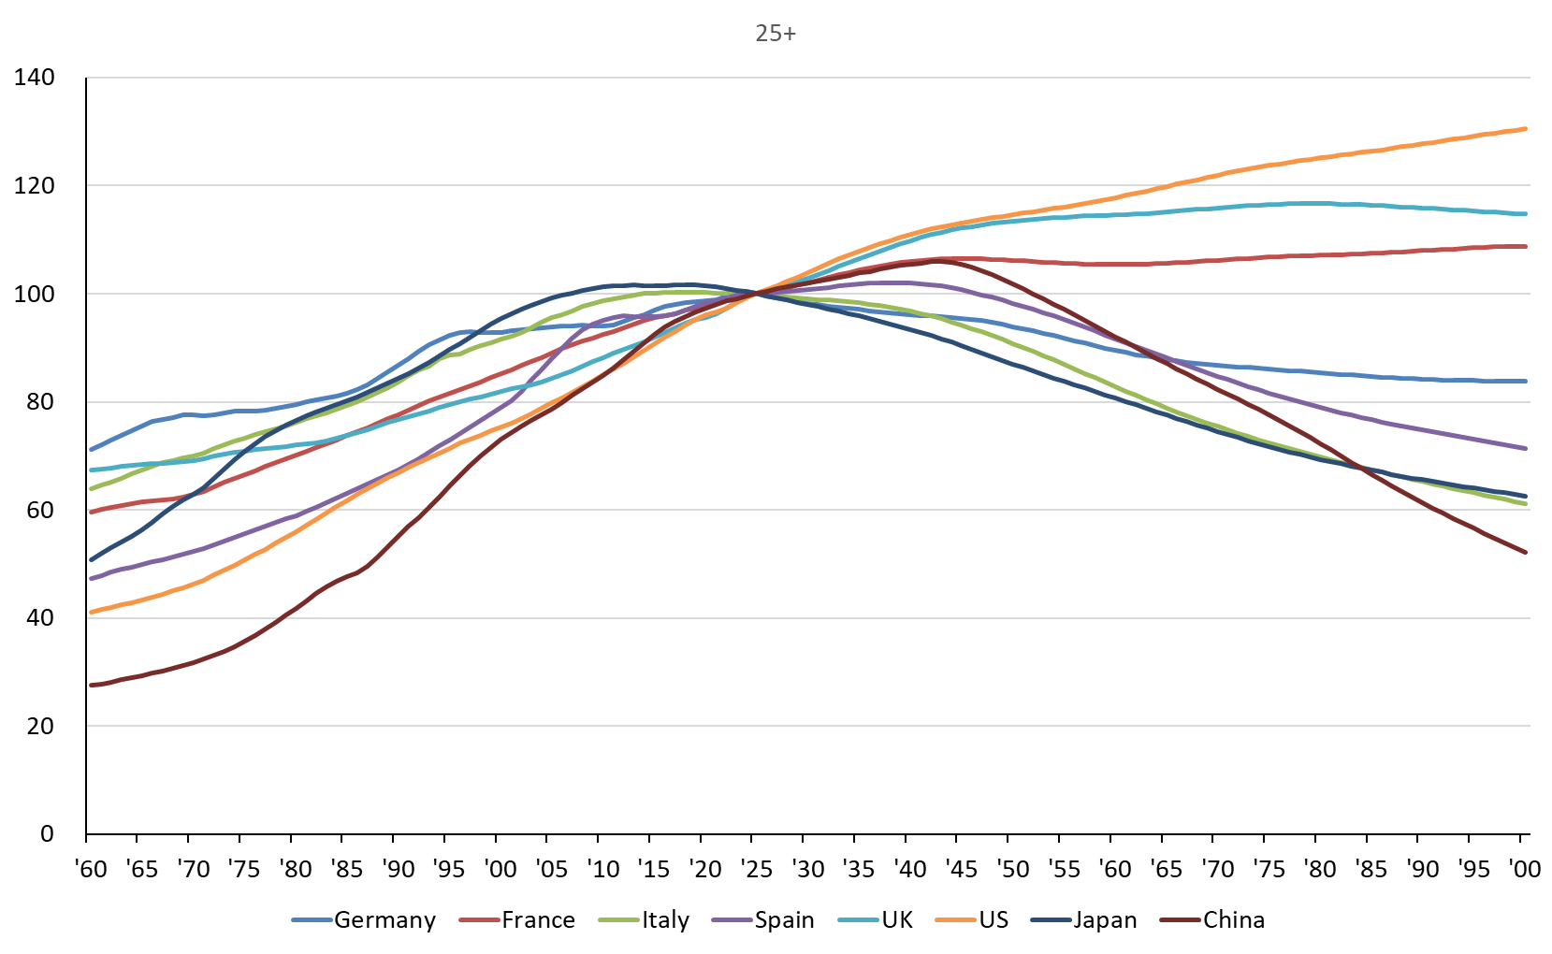
Some countries’ adult populations are set to decline
Population aged 25 or over
Source: UN. Data as of September 30

Slide 15
Plenty of Peril
Near term risks:
Recession, Equity bubbles, Bond Market Crises
Long term:
Debt / currency devaluation
Demographics
Deglobalisation
Redistribution

