Slide 1
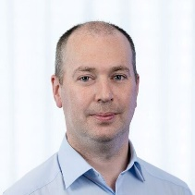
Where Should Your Models Live? Cloud, On-Prem, or Both?
Barry Fitzgerald
Co-Head of Systematic Technology, Man Group
14th October 2025
For investment professionals only. Not for public distribution. Opinions expressed are those of the Speaker as the date of the conference and are subject to change. The content is not intended to constitute advice nor a recommendation or opinion regarding any investment or strategy. Views concerning outlook or other non-historical matters are based on current indicators and expectations at the date of the conference and are subject to risks and uncertainties that may cause actual results to differ materially.
Notes:
TP
Introduction
My name's Tom Price and I'm the CTO of our Core Technology department at Man. Core Technology is what we call everything from the infrastructure in our data centres, our end user platforms and support, and our corporate and Finance systems.
And I'm James Blackburn CTO of the Alpha Platform team. We build all the front office platform technology including the Python platform used across Man and the Data components needed by the hedge funds.

Slide 2

Where are you on your Cloud journey?
1
Notes:
https://stockcake.com/i/mountaintop-castle-dreams_1810718_1268849

Slide 3
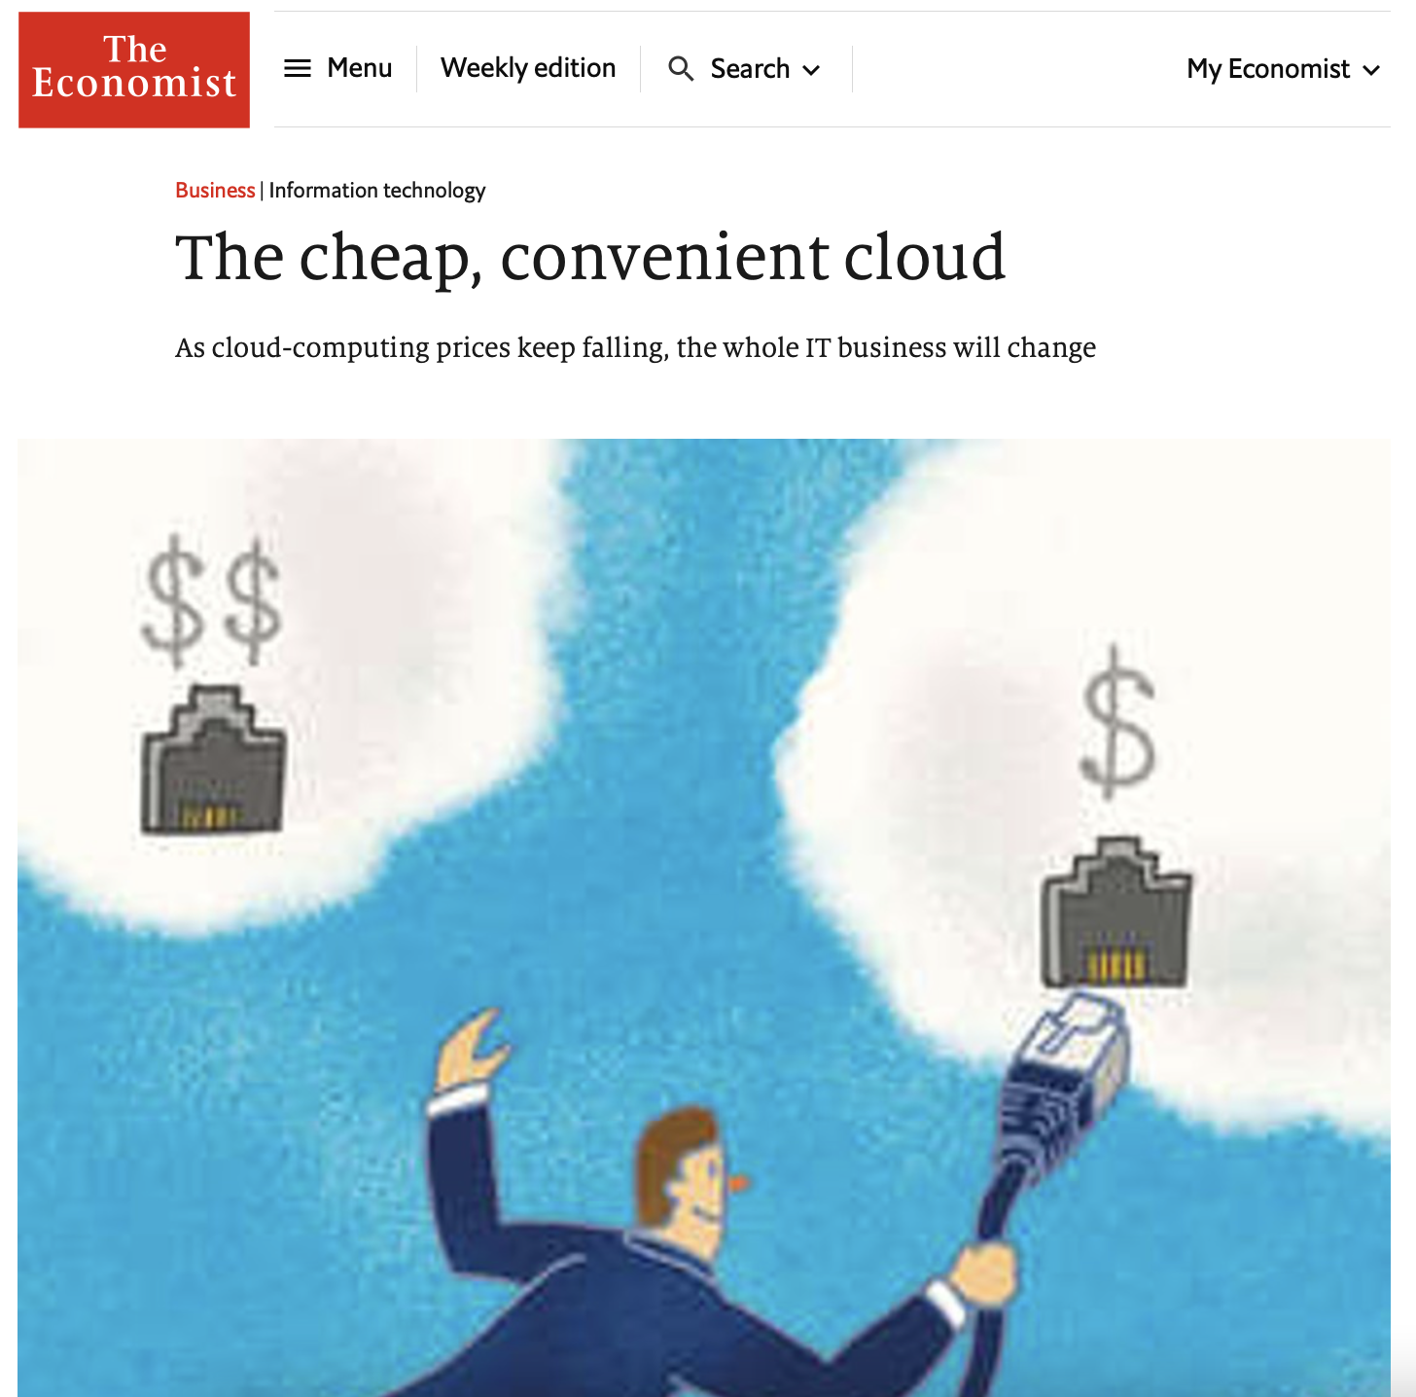
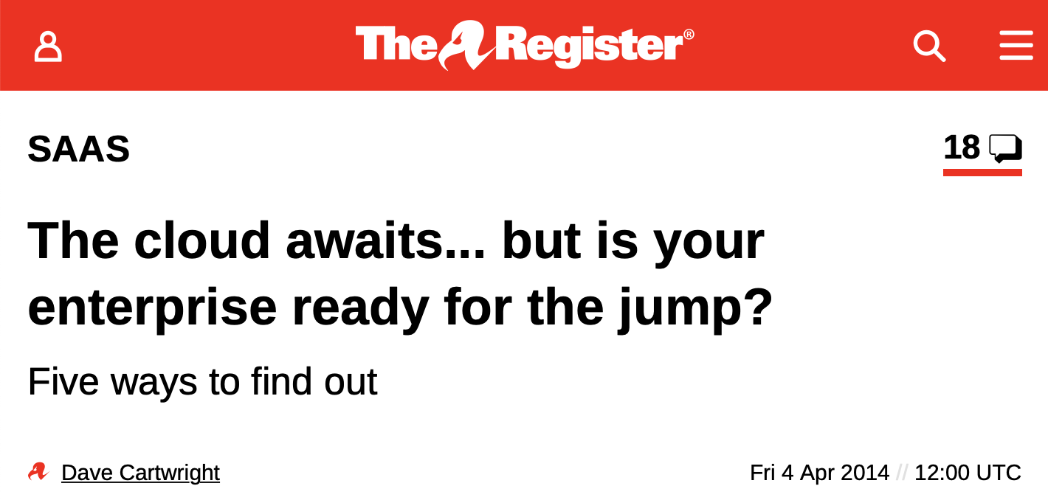

Cloud Hype
FOMO in the data centre
“
90 percent of all enterprise technology spending will take place outside of IT departments by 2020.”
Gartner (2014)
Notes:
JB
Let’s go back 8 years.
Start of Hype Cycle that has been going on for best part of a decade.
Economist 2015: The Cheap Convenient cloud; The Register is your enterprise ready?
TheRegister: Every year we see headlines about everyone moving to the cloud. Why aren’t you on the band-wagon?
Gartner 2015: 90% of cloud spending outside of IT departments by 2020
Revised Gartner 2022 Gartner Says More Than 1/2 of Enterprise IT Spending in Key Market Segments Will Shift to the Cloud by 2025

Slide 4



Why Cloud?
Faster
delivery time
'Infinitely’
scalable & flexible
‘Focus on what
you do best’
Flexible
cost options
£
Notes:
TP
Cloud Benefits
We're going spend a few slides talking about what makes Cloud such an attractive proposition:
Faster delivery time - you can type in your credit card details and get something up and running in 5 minutes
'Infinitely' scalable - you'll probably run out of money before AWS runs out of stuff to sell us
Cloud allows firms to focus on what they do best
Finally cloud offers flexible cost models and therefore opens up different operating models

Slide 5
Cloud Growth
1,000
881.90
796.00
800
707.80
617.00
600
525.60
US$bn
414.89
400
342.56
267.58
172.84
214.36
200
130.97
95.00
2016
2017
2018
2019
2020
2021
2022
2023
2024
2025
2026
2027
Infrastructure as a service
Platform as a service
Software as a service
Notes:
JB
Cloud growth: Growth continue to accelerate
Graph shows:
$100B => $500B 5x growth
Infra as a Serivce in Blue … Renting Servers
Platform as a Service: Google Cloud, higher level databases
5x since 2016 from 100B in 2016 to 500B this year.
SaaS and IaaS are showing equal split
2022 - 2023 increment is larger than initial period in 2016
Infrastructure spend will continue to balloon, why is this?
IDC: said that in 2020 Cloud infrastructure spend annually overtook in data center spending
Gartner: Traditional IT growth has been flat over 5 years: +30B a year.
Cloud has been accelerating: 2019: +66B; 2023 + 124B
Gartner: 2025 total revenue of cloud overtakes traditional IT ~$1B / year
In the data

Slide 6
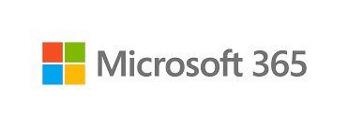

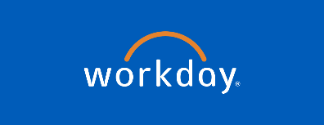

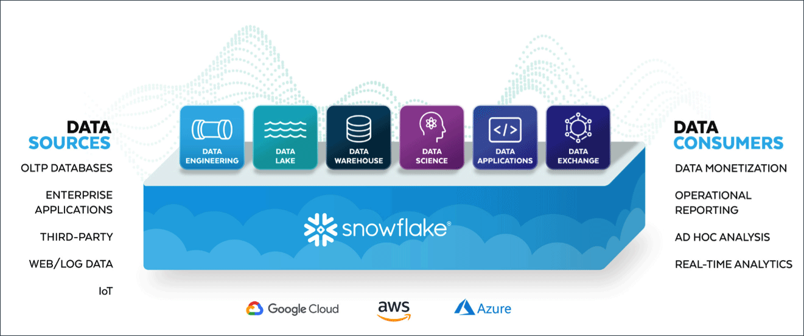
Why Cloud?
Amazing commodity platforms
.
5
Notes:
TP
We don't want to buy software and then have to provide the infrastructure, we want a 3rd party to run it themselves. None of us gain any competitive advantage from our Sales, HR, Finance and email systems - so let's give those commodity platforms to someone else to run. Tools like M365, Slack, Workday or Zoom.
Not only do you get the benefit of not having to run the infrastructure behind it, you also get other Cloud benefits like interoperability, up-to-date mobile apps, tools that are designed for the web.
Those Cloud benefits extend to platform services like Snowflake. By being in the Cloud rather than in your data centre you get big benefits in terms of interoperability with other services and integration with data vendors.
So lots of great benefits of Cloud, who wouldn't want all of that for their firm?
James will take about one of the biggest challenges > cost.

Slide 7

Cloud vs On-Premises for Quant Research?
“I need to run a suite of backtests on 10k US Equities with 1000 cores and 24 Terabytes of RAM.”
IP Safety?
Scalability & Flexibility?
Cost?
£
6
Notes:
TP
Cloud Benefits
We're going spend a few slides talking about what makes Cloud such an attractive proposition:
Faster delivery time - you can type in your credit card details and get something up and running in 5 minutes
'Infinitely' scalable - you'll probably run out of money before AWS runs out of stuff to sell us
Cloud allows firms to focus on what they do best
Finally cloud offers flexible cost models and therefore opens up different operating models

Slide 8



Are Your Models Safe in the Cloud?
IP Safety Pros & cons!
On-Prem
Cloud
Simpler architecture
World class infosec teams & processes
Can strictly limit external access
Complex architecture and potentially wide access
Lots of toil – patching etc.
How good is your infosec team & processes?
Significant Risk of misconfiguration
7

Slide 9
How Much Compute Can I Get? How Fast Can I Get It?
Speed of delivery
Scalability
No finance or procurement delays
'Infinitely’ scalable
No delivery or install wait
Grow with demand
Wide variety of services
Minimise up-front cost
Global reach
Always on latest version
8
Notes:
TP
Why cloud?
First main benefit is faster delivery time - we want to get new features built and in the hands of our users as quickly as possible. How does Cloud help deliver that?
Well
No quoting, no negotiation, no procurement or finance delays
No physical delivery times, no need to handle exports into places like HK
No need to wait for servers to be racked, OS’s installed, cables purchased
No need to wait for Infrastructure or platform teams to investigate or build platforms – want to try k8s? Click a button!
No need to build a data centre in every region you want to enter, or to integrate a new acquisition
No waiting for upgrades, for all the app teams to migrate, everything always available on the current version

Slide 10
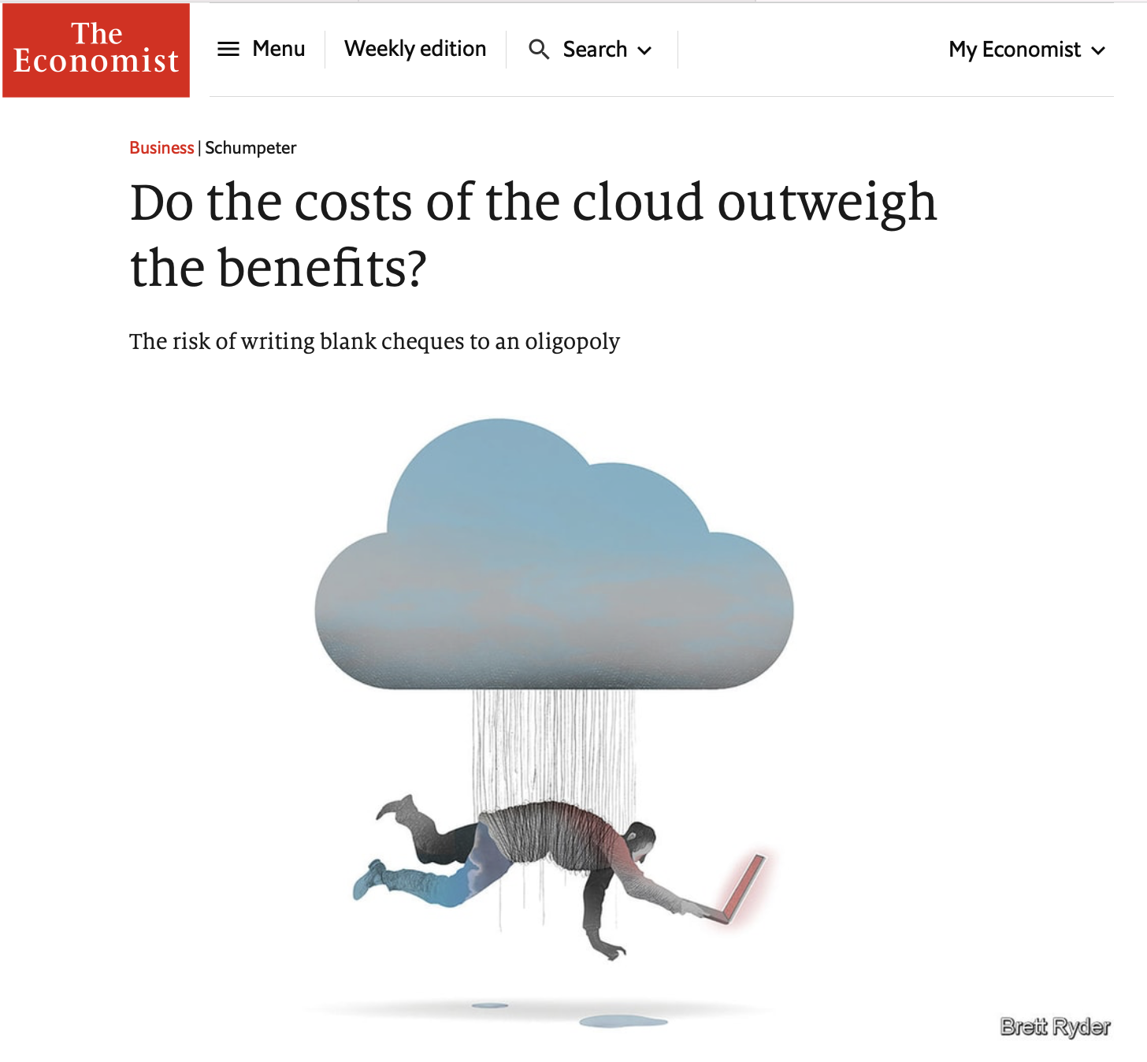

What about Costs?
£
Cost?
9

Slide 11
Over 10X Cost When You Look at Cost of Compute Only
Backtests on 10k US Equities with 1000 cores and 24 Terabytes of RAM
Spot instances in AWS:
$768k / year
(*Excludes network egress charges)
10 top of the line servers on-prem:
$80k / year
(*Capex. Assumes 5-year replacement)
£
Notes:
JB
Cost here is significant 10x.
– and how much control do you have over the underpinnings?
For example Networking speeds.
Man Networks:
5x faster as standard: Man has been using 25Gb/s networking for fast data processing for more than 5 years. AWS is 5Gb/s standard or 10Gb/s with ‘special nodes’. (https://docs.aws.amazon.com/AWSEC2/latest/UserGuide/ec2-instance-network-bandwidth.html, https://docs.aws.amazon.com/AWSEC2/latest/UserGuide/general-purpose-instances.html#general-purpose-network-performance)
Dell 2U R7725 rackmount servers with dual processors. We get the latest AMD EPYC processors, such as the 9734 or 9754, giving use 448 or 512 threads per CPU. To be cost-effective but gain high RAM density, we get 96G DIMMs, which gives us 2.3TB of RAM per host and 4+G of RAM per thread. $40k. This over provisions CPU a lot
Power: Roughly $2 per hour at 100% for all 10, 500W-1.5kW unit cost of 23p per hour
24 boxes at 1Tb each
Cloud is “someone else’s computer”
Atlassian outage for >1 week leaves multiple customers without Confluence, Jira etc.: https://www.theregister.com/2022/04/11/atlassian_still_down/
AWS has 3 outages at end of 2021: https://www.theverge.com/2021/12/22/22849780/amazon-aws-is-down-outage-slack-imgur-hulu-asana-epic
Azure Active Directory Outages: https://www.theregister.com/2020/09/29/onedrive_azure_active_directory_outage/ https://www.theregister.com/2021/03/15/microsoft_azure_outage/
https://azure.microsoft.com/en-gb/pricing/details/kubernetes-service/

Slide 12
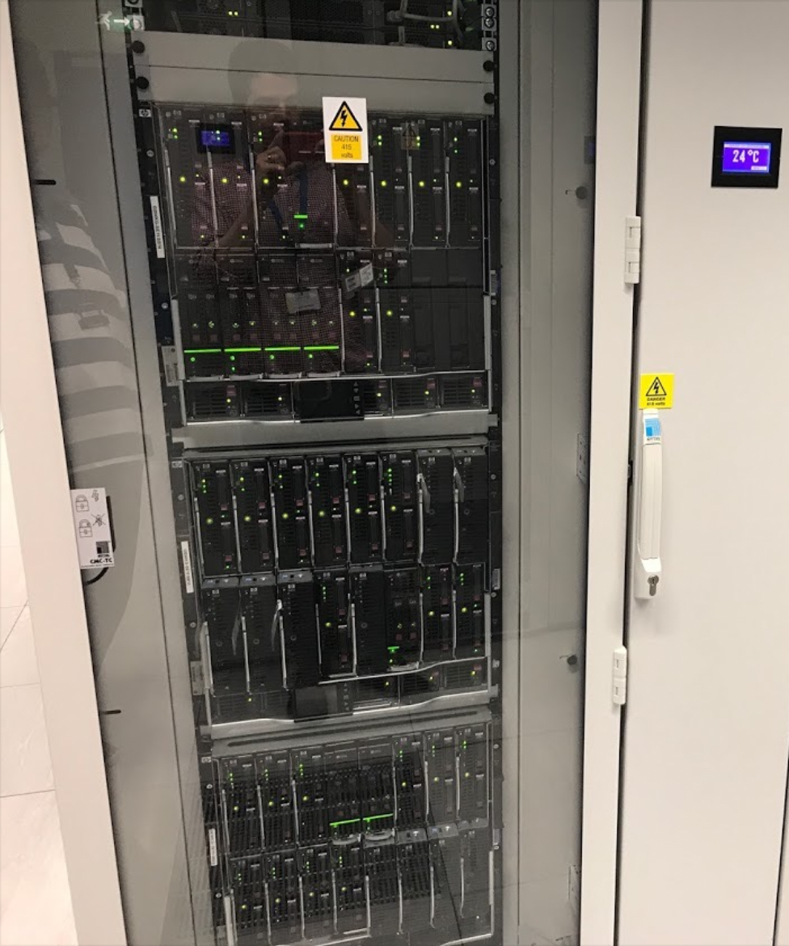


Cost
What is the true cost of your current infrastructure?
Data centres
People
£
Incremental costs
£
Financing costs
£
11
Notes:
TP
Cost (scaling up)
James's simple k8s compute example on the previous slide obviously doesn't cover a range of internal costs like data centres and resourcing but can you explain away the $100k difference?
If you dig into your infrastructure and platform costs, and work out what you'd expect to save from a cloud migration, you'll find they're not always a huge component of the total.
I think pretty much all of us will have outsourced our data centres to a third party to build and maintain already. I expect most of your engineers are rarely ever on site, its all done remotely in a world of virtualisation and containerisation.
Assuming you're not regularly moving data centres then the fixed costs per cabinet are probably around £8000 a year , a fraction of the value of the hardware in that cabinet. – 10 of previous boxes
People costs are probably one of the bigger costs, if not the biggest cost
Talked about focus on what you do best and we talked about having the developers focus on what they do best - do you want them learning how to tune linux kernels or setup load balancers?
Linux and Network engineers are skillsets that can offer you real value in both a Cloud or on-prem infrastructure.
Once you have those established data centres, those sunk costs, then assuming you have a 5 year requirement for a server its going to be cheaper to buy and run it, not rent it from Amazon.
Lastly, don't forget migration costs - both real and opportunity. Is moving all your infrastructure your top priority? What you want to focus on?

Slide 13
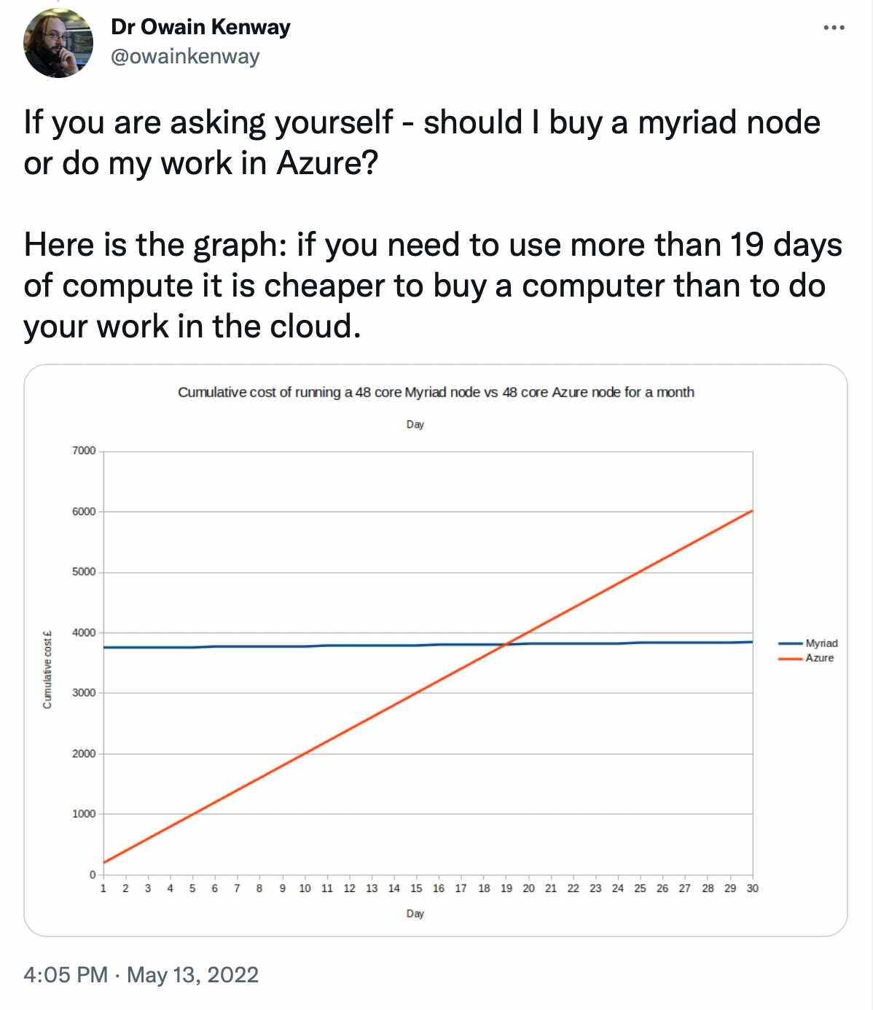
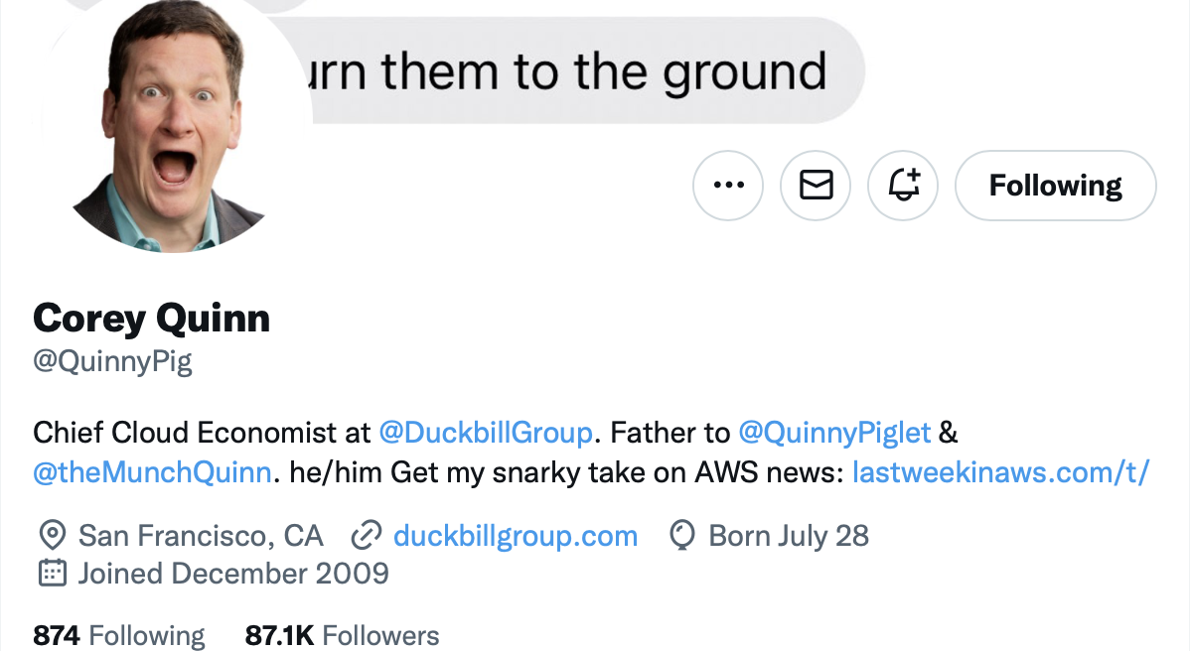
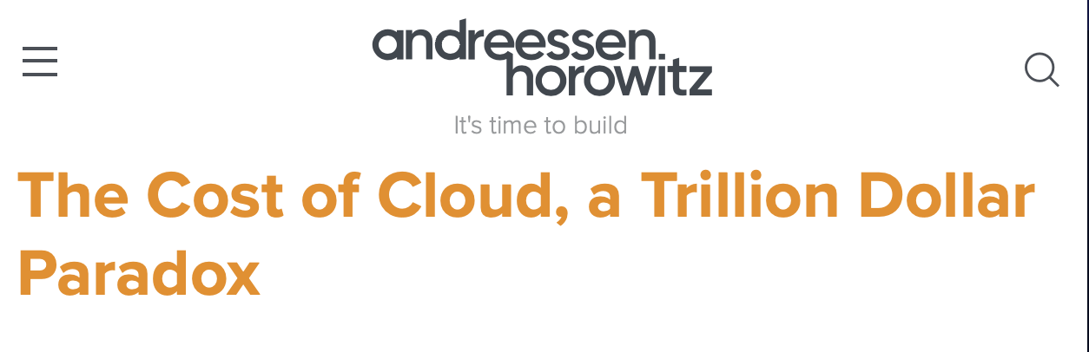
Cost
Other evidence points the same way
“
We have found that certain features of the UK cloud services markets lead to adverse effects on competition…
We think outcomes for customers would be better if cloud markets were more competitive”
CMA - CLOUD SERVICES MARKET INVESTIGATION
Notes:
https://twitter.com/owainkenway/status/1525130034863816705?s=20&t=VkU3VyOxGaxbwb1Vd9DS8A
https://twitter.com/QuinnyPig/status/1435324526938628096?s=20&t=dbeEFZz-uhYGAHbvAx9muA
https://a16z.com/2021/05/27/cost-of-cloud-paradox-market-cap-cloud-lifecycle-scale-growth-repatriation-optimization/

Slide 14
Why Cloud for Quant Research?
“I need to run a suite of backtests on 10k US Equities with 1000 cores and 50 Terabytes of RAM.”
IP safety?
Draw?
Speed of Delivery &
Scalability?
Some Cloud Advantages
Cost?
Some On-Prem Advantages
£
13
Notes:
TP
Cloud Benefits
We're going spend a few slides talking about what makes Cloud such an attractive proposition:
Faster delivery time - you can type in your credit card details and get something up and running in 5 minutes
'Infinitely' scalable - you'll probably run out of money before AWS runs out of stuff to sell us
Cloud allows firms to focus on what they do best
Finally cloud offers flexible cost models and therefore opens up different operating models

Slide 15


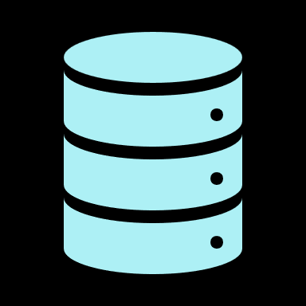
More Niche Use Cases & Solutions?
Gen-AI
Multi-Cloud?
HFT
Hybrid?
ML
14

Slide 16

Where Are You On Your Cloud Journey? What’s Your Destination?
15
Notes:
So remember: there is no magic - the cloud is just “Someone else’s computer”
Image sourced from Stockcake– AI generated. Photo by Denys Nevozhai on Unsplash

Slide 17
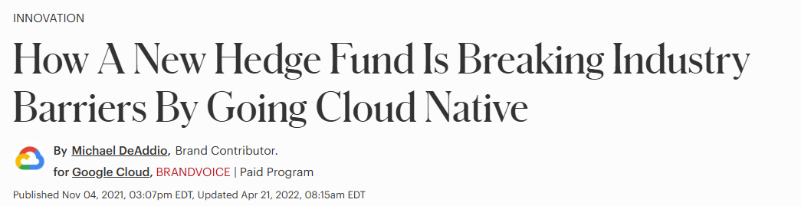
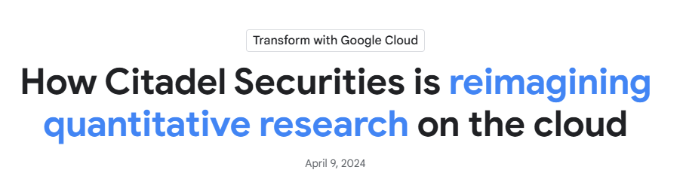
We See This In Actions Of Other Investment Firms
“
At any appreciable scale On-Prem is by far the more cost-effective solution. Despite what you see in marketing releases the big hedge fund players are making huge investments in their own datacentres at a scale that we haven't seen before”
Daniel Goodman BSI
16
Notes:
JB
1 … 2 … 3 … 4
So remember: there is no magic - the cloud is just “Someone else’s computer”
Consider writing new systems for PaaS, don’t lift and shift existing systems to IaaS
Invest in internal Cloud platforms, automation and your development pipelines
Implement modern governance practices – GitOps / Governance as Code
Keep your high performance applications & base load in your data centre
Extend your network & identity perimeters into Cloud
* Multi-cloud is not a pancea – costs of transferring data in and out of cloud.

Slide 18
Man’s Cloud Strategy
Internal cloud first
Cloud platforms for commodity services
1
“Cloud Native” application development
2
Base-load infrastructure on-premises
3
Public cloud optionality and experimentation
4
Notes:
JB
1 … 2 … 3 … 4
So remember: there is no magic - the cloud is just “Someone else’s computer”
Consider writing new systems for PaaS, don’t lift and shift existing systems to IaaS
Invest in internal Cloud platforms, automation and your development pipelines
Implement modern governance practices – GitOps / Governance as Code
Keep your high performance applications & base load in your data centre
Extend your network & identity perimeters into Cloud
* Multi-cloud is not a pancea – costs of transferring data in and out of cloud.

Slide 19
Questions
18

Slide 20
Important Information
This material is of a promotional nature.
This information is communicated and/or distributed by the relevant Man entity identified below (collectively the “Company”) subject to the following conditions and restriction in their respective jurisdictions.
The value of an investment and any income derived from it can go down as well as up and investors may not get back their original amount invested. Alternative investments can involve significant additional risks.
Technology and operational systems are subject to various risks including system failures, cyber security threats, and business continuity disruptions that could impact investment operations and client services.
Opinions expressed are those of the author and may not be shared by all personnel of Man Group plc (‘Man’). These opinions are subject to change without notice, are for information purposes only and do not constitute an offer or invitation to make an investment in any financial instrument or in any product to which the Company and/or its affiliates provides investment advisory or any other financial services. Any organisations, financial instrument or products described in this material are mentioned for reference purposes only which should not be considered a recommendation for their purchase or sale. Neither the Company nor the authors shall be liable to any person for any action taken on the basis of the information provided. Some statements contained in this material concerning goals, strategies, outlook or other non-historical matters may be forward-looking statements and are based on current indicators and expectations. These forward-looking statements speak only as of the date on which they are made, and the Company undertakes no obligation to update or revise any forward-looking statements. These forward-looking statements are subject to risks and uncertainties that may cause actual results to differ materially from those contained in the statements. The Company and/or its affiliates may or may not have a position in any financial instrument mentioned and may or may not be actively trading in any such securities. Unless stated otherwise all information is provided by the Company. Past performance is not indicative of future results.
Unless stated otherwise this information is communicated by the relevant entity listed below.
United Kingdom: Unless indicated otherwise this material is communicated in the United Kingdom by Man Solutions Limited (‘MSL’) which is an investment company as defined in section 833 of the Companies Act 2006. MSL is registered in England and Wales under number 3385362 and has its registered office at Riverbank House, 2 Swan Lane, London, EC4R 3AD, United Kingdom. MSL is authorised and regulated by the UK Financial Conduct Authority (the ‘FCA’) under number 185637.
This material is proprietary information and may not be reproduced or otherwise disseminated in whole or in part without prior written consent. Any data services and information available from public sources used in the creation of this material are believed to be reliable. However accuracy is not warranted or guaranteed. © Man 2025

