Slide 1
Deep Dive into “Lenses” – an Algo Performance Framework
Equities Execution
Gabriel H. Tucci,
Managing Director
Global Head of Equities Cash Quantitative Analysis
QuantStrats Conference, London, 2025

Slide 2
Agenda
Review of what is an Execution Algo?
Main drivers of Algo Performance
Key components of the “Smarts” of an Execution Algo
Introduction to the Concept of “Lenses” Framework
Multiple examples of Lenses
Utility Based Routing
Appendix - Examples of recent Algo Enhancements and Products

Slide 3
Review of Execution Algos
What is an execution algo?
Client Specific Customizations
Other Settings
Market Data
Duration/Start/End
Optimal Schedule or Inst p-rate
Child order placement
*Order Instructions
Algo to be used
Style (e.g.: passive/aggressive, there are 5 flavors of Dagger)
Benchmark
Customizations
Settings or Constraints (e.g.: min/max p-rate, completion true/false, etc.)
Parameters
Execution
Algo
Analytics
Signals
*Order Instructions
Outputs of the Algo:
Optimal Duration and Trajectory or optimal instantaneous p-rate
For each price level p, the target exposure Q(p). Continuously amend and manage the current open orders Q_{open}(p)
For each p there is an eligible list of venues V(p) we can route
The algos determine where, when and how an order should be executed.

Slide 4
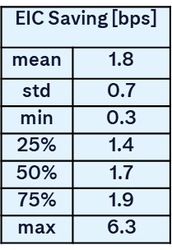
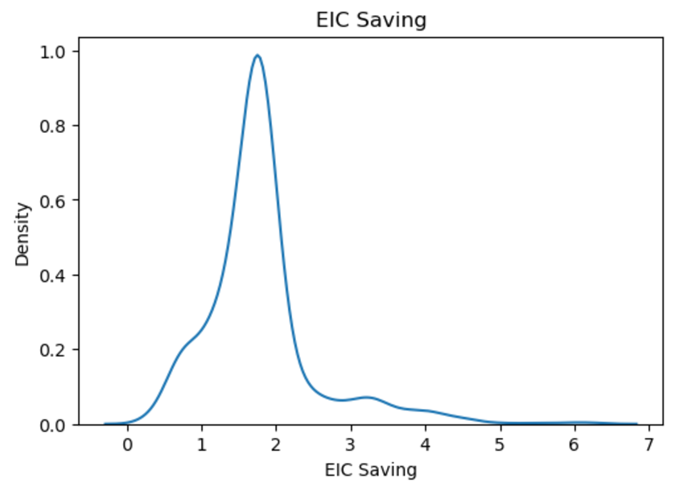
Main Drivers of Algo Performance
Performance is primarily a function of internalization, smarts and speed.
Internalization
For a 10bps EIC order, assuming 40% internalization, we expect savings – 1.8bps average and 1.7bps median
For many wheels, the performance delta to Top is < 1bps
speed
internalization
smarts
Smarts
Optimal Schedule or Instantaneous p-rate
Tolerance Bands
Child Order Placement Logic
Routing Logic and Micro Tactics
Algo Dynamics
Data Analysis (Lenses) + Simulations + Cont’ Iteration
Speed
The speed of the algo engine and platform overall is a key component to be able to be competitive.
The difference between 1 micro and 1 milli is same as between 1 second and 15 minutes!

Slide 5
Main Components of the “Smarts”
Q
Optimal Trajectory
Benchmark and State Dependent
Propagator Model both Arrival and Close in Production Globally
Open/Continuous/Close Optimization
Real Time Signals and Events (e.g., Fair value Model, News/Sentiment)
Enhanced Analytics (e.g., New Volume and Volatility Curves)
Pounce and Sweep Logic
Dynamic Participation Rate and Aggression Controller
Step Ahead Allocation Logic - When and how much to Allocate at Dark and Conditional Venues?
t
t_start
t_end
Q
Tolerance Bands Logic
Optimal bands that are market microstructure specific
Leeway Model – Calculate the optimal tolerance bands scientifically
Risk Adjusted Fair Price Model
Dynamics of the bands
Additional factors to control the dynamics
CMAB/TMR to be discussed later
UT_{t}
T_{t}
LT_{t}
t_start
t
t_end

Slide 6

Main Components of the “Smarts”
Child Order Placement
When to place outside/improve/touch/dark
Spread capture
Leverage as much as possible Liquidity Hub/CitiONE and top liquidity venues
Risk Adjusted Fair Value/Price
Aggression depending where we are in the Schedule and Bands
Dynamic of the Algos
Optimal parameters at start
What events trigger us to update our parameters?
Signals
Historical Flow Characteristics
Different flows have different characteristics
Mechanics to update the params

Slide 7

Algo Dynamics
Previously
Current
Orders
Algos
Orders
Algos
State
Dynamics
Parameter
Matrix
input
process
output
State:
Order Characteristics - Size, Time of day, Aggressiveness
Instrument Characteristics - Type of Stock, ETFs, etc.
Real-time Market Conditions - Δ$σ,$ ΔV, TOB
Client Characteristics
Parameters:
Schedule Shape / Participation Rate
Tolerance Bands
Reaction to Signals, Indicators and Events
Child order placements and other Tactics
Routing Policies

Slide 8




Looking at the World with Different Lenses
visible
ultraviolet
ultraviolet
visible
infrared
Similarly, we can change how we look at Algo Performance
Q
Q
t
t
t_start
t_end
t_start
t_end

Slide 9
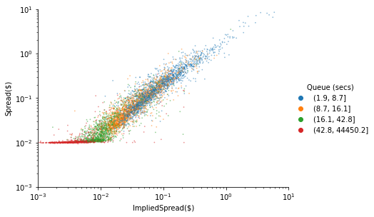
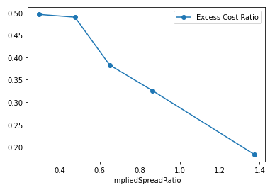
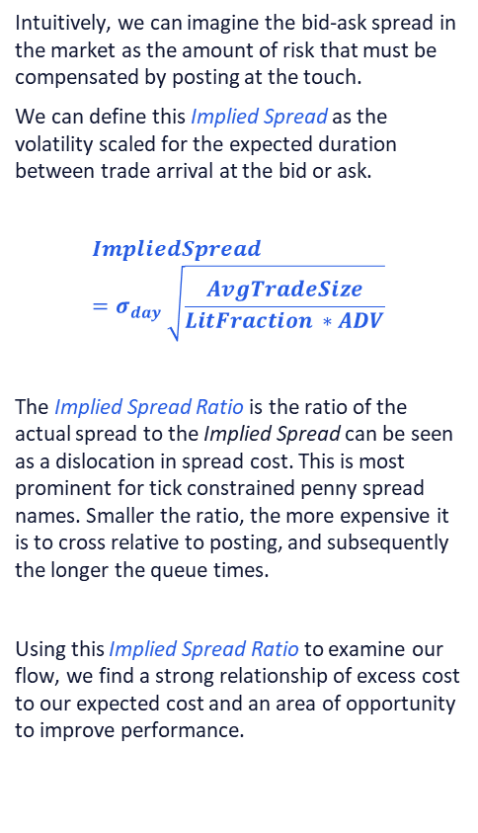
Implied Spread Lens for Performance
Using a Measure of Implied Spread to Reveal a Pocket of Underperformance
The metric of implied spread versus the actual spread reveals a factor that steers toward an opportunity for improvement.
Intuitively, we can imagine the bid-ask spread in the market as the amount of risk that must be compensated by posting at the touch.
We can define this Implied Spread as the volatility scaled for the expected duration between trade arrival at the bid or ask.
$$ImpliedSpread=σ_{day} \sqrt{\frac{AvgTradeSize}{LitFraction ∗ADV}}$$
The Implied Spread Ratio is the ratio of the actual spread to the Implied Spread can be seen as a dislocation in spread cost. This is most prominent for tick constrained penny spread names. Smaller the ratio, the more expensive it is to cross relative to posting, and subsequently the longer the queue times.
Using this Implied Spread Ratio to examine our flow, we find a strong relationship of excess cost to our expected cost and an area of opportunity to improve performance.
Implied Spread Ratio | Excess Cost Ratio (Higher is Worse)
0.3 | 0.5
0.48 | 0.49
0.65 | 0.38
0.87 | 0.33
1.37 | 0.18

Slide 10

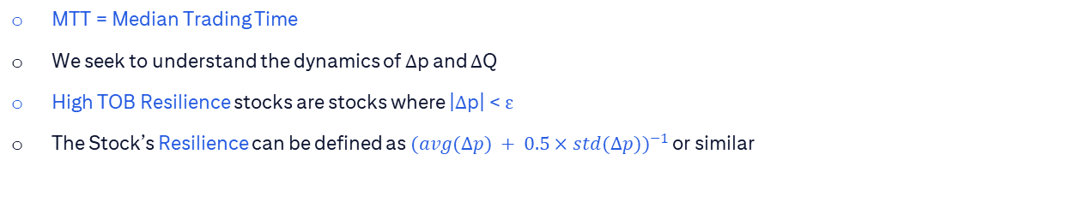
TOB Resilience
Q
ΔQ
t=0
p
more resilient
more resilient
*
t=0⁺
Δp
^
Q
less resilient
less resilient
t=N x MTT
^
p
*Conditioning on trades that clean the TOB
$$∆p ={\frac{(\hat{p}−p)}{sprd}}$$
MTT = Median Trading Time
We seek to understand the dynamics of Δp and ΔQ
High TOB Resilience stocks are stocks where |Δp| < ε
The Stock’s Resilience can be defined as ${(avg(Δp) + 0.5×std(Δp))}^{−1}$ or similar

Slide 11
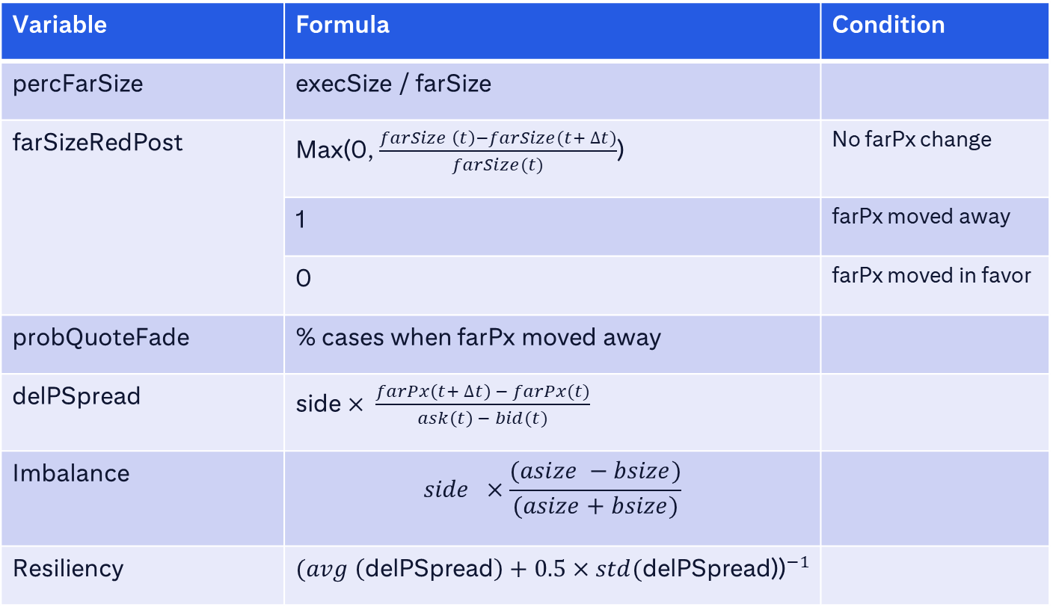
Glossary
Variable | Formula | Condition
percFarSize | execSize / farSize
farSizeRedPost | Max(0, $\frac{farSize \left(t\right)−farSize(t+ ∆t)}{farSize(t)}$) | No farPx change
 | 1 | farPx moved away
 | 0 | farPx moved in favor
probQuoteFade | % cases when farPx moved away
delPSpread | side $× \frac{farPx\left(t+ ∆t\right) − farPx(t)}{ask\left(t\right) − bid(t)}$
Imbalance | $$side ×\frac{(asize −bsize)}{(asize+bsize)}$$
Resiliency | $${(avg \left(\text{delPSpread}\right)+0.5×std(\text{delPSpread}\text{)}\text{)}}^{−1}$$

Slide 12
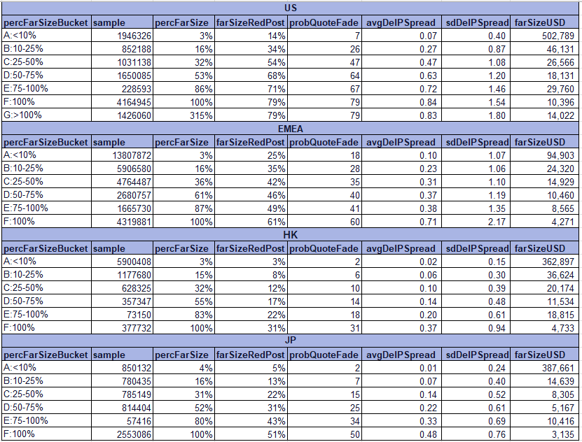
Summary Result by % Far Size buckets

Slide 13
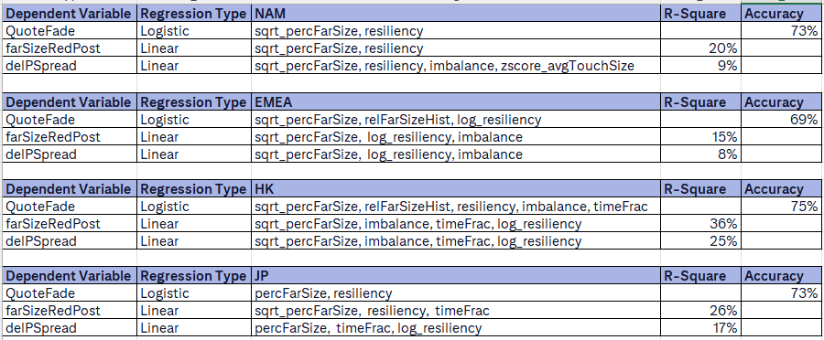
Top features and Model Performance
Important Features Globally:
sqrt_percFarSize or percFarSize
resiliency or log_resiliency
Imbalance (EMEA, HK)
timeFrac (HK)
relFarSizeHist (EMEA, HK – QuoteFade model)

Slide 14
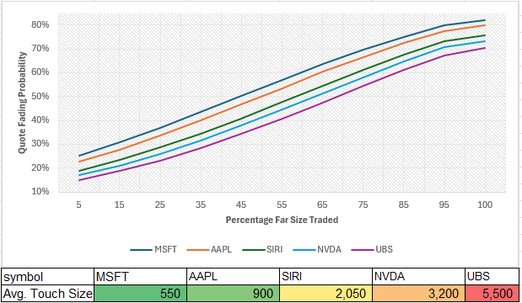
Quote Fading Stats

Slide 15
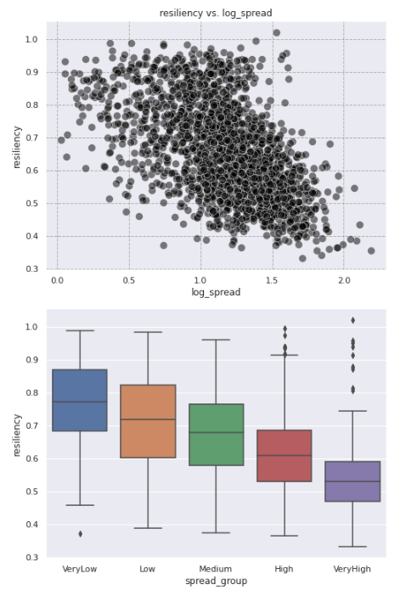
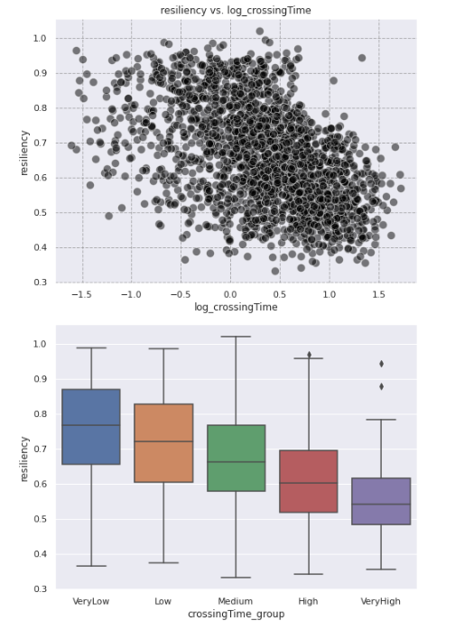
Resiliency vs. Other Features

Slide 16
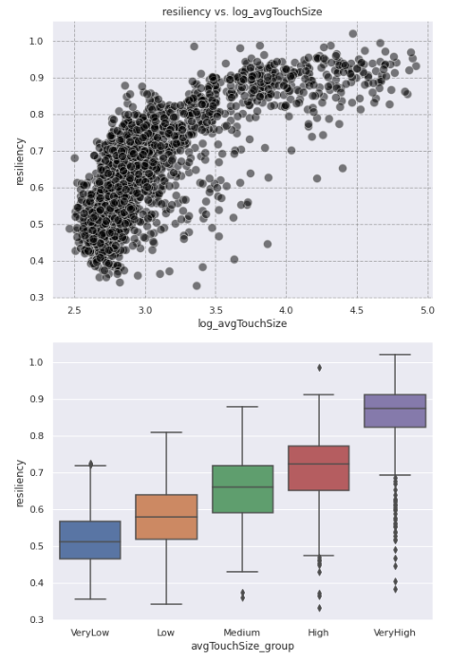
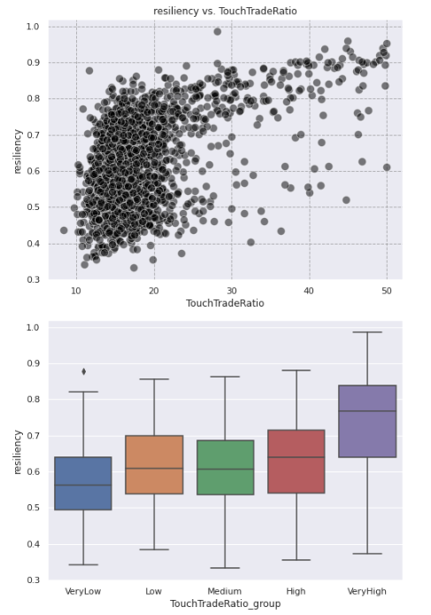
Resiliency vs. Other Features

Slide 17
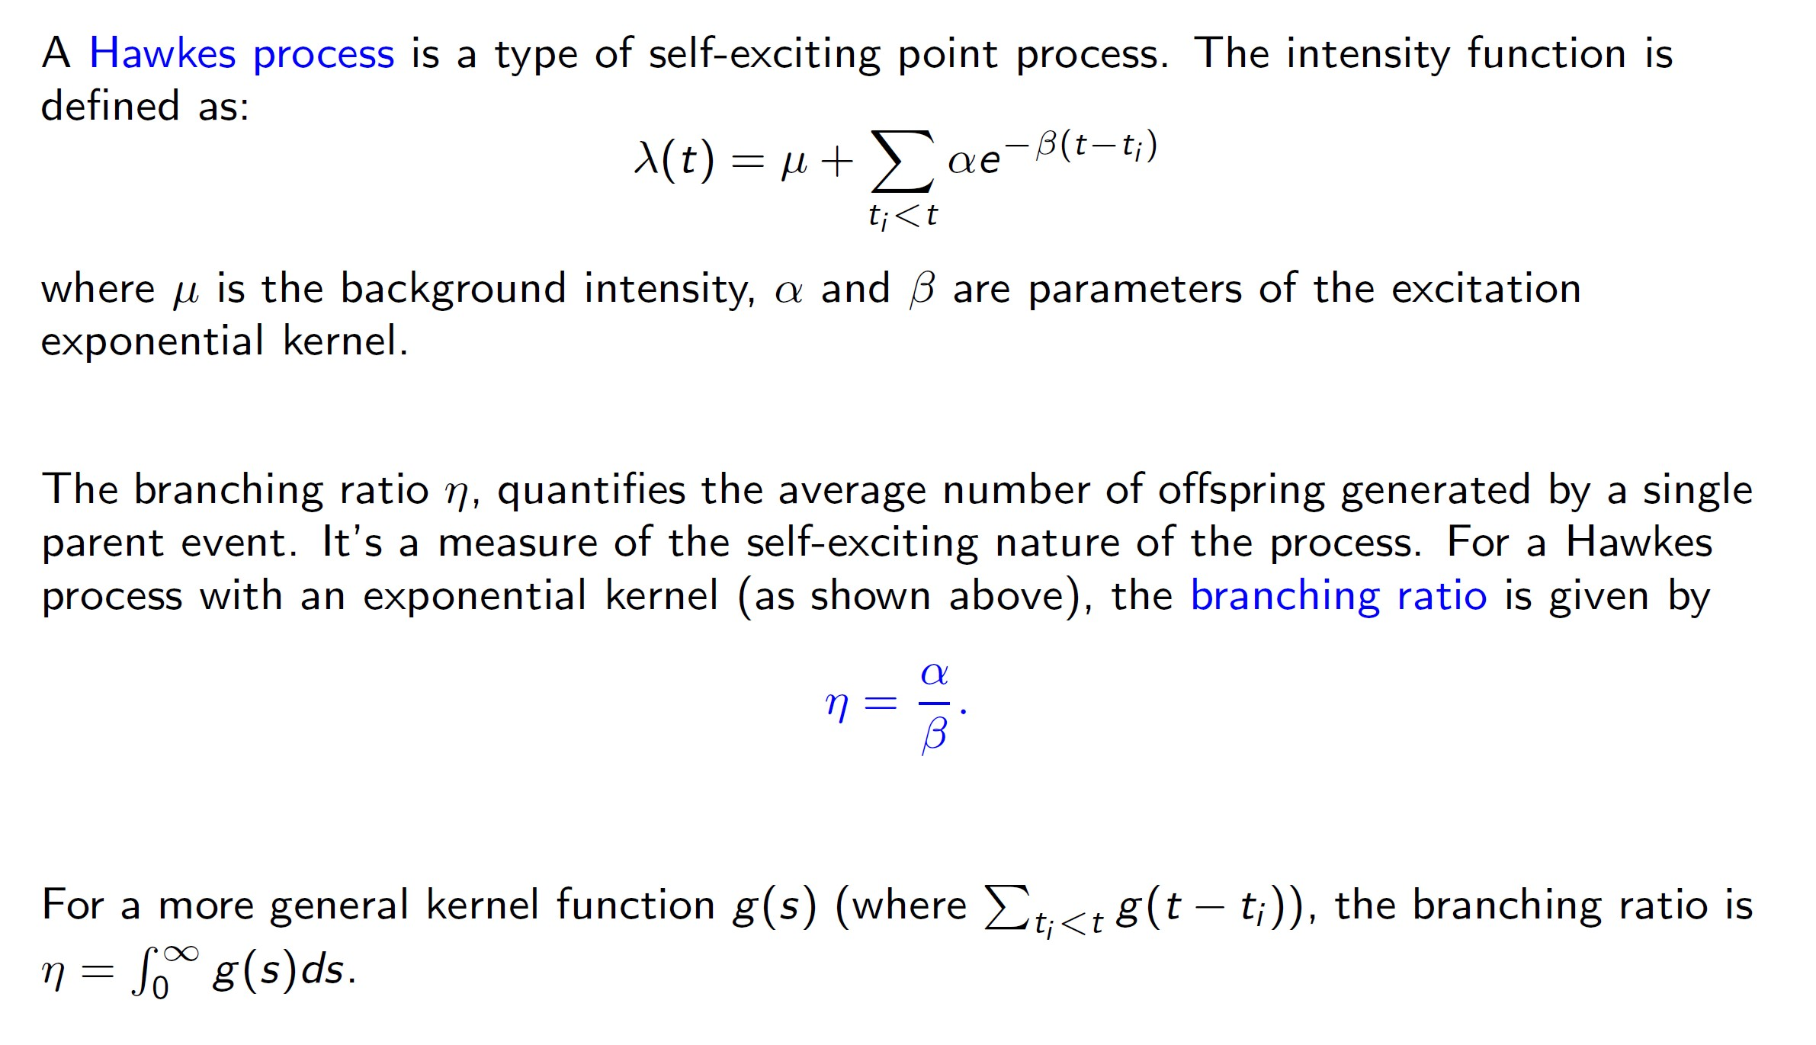
Review of Hawkes Process

Slide 18
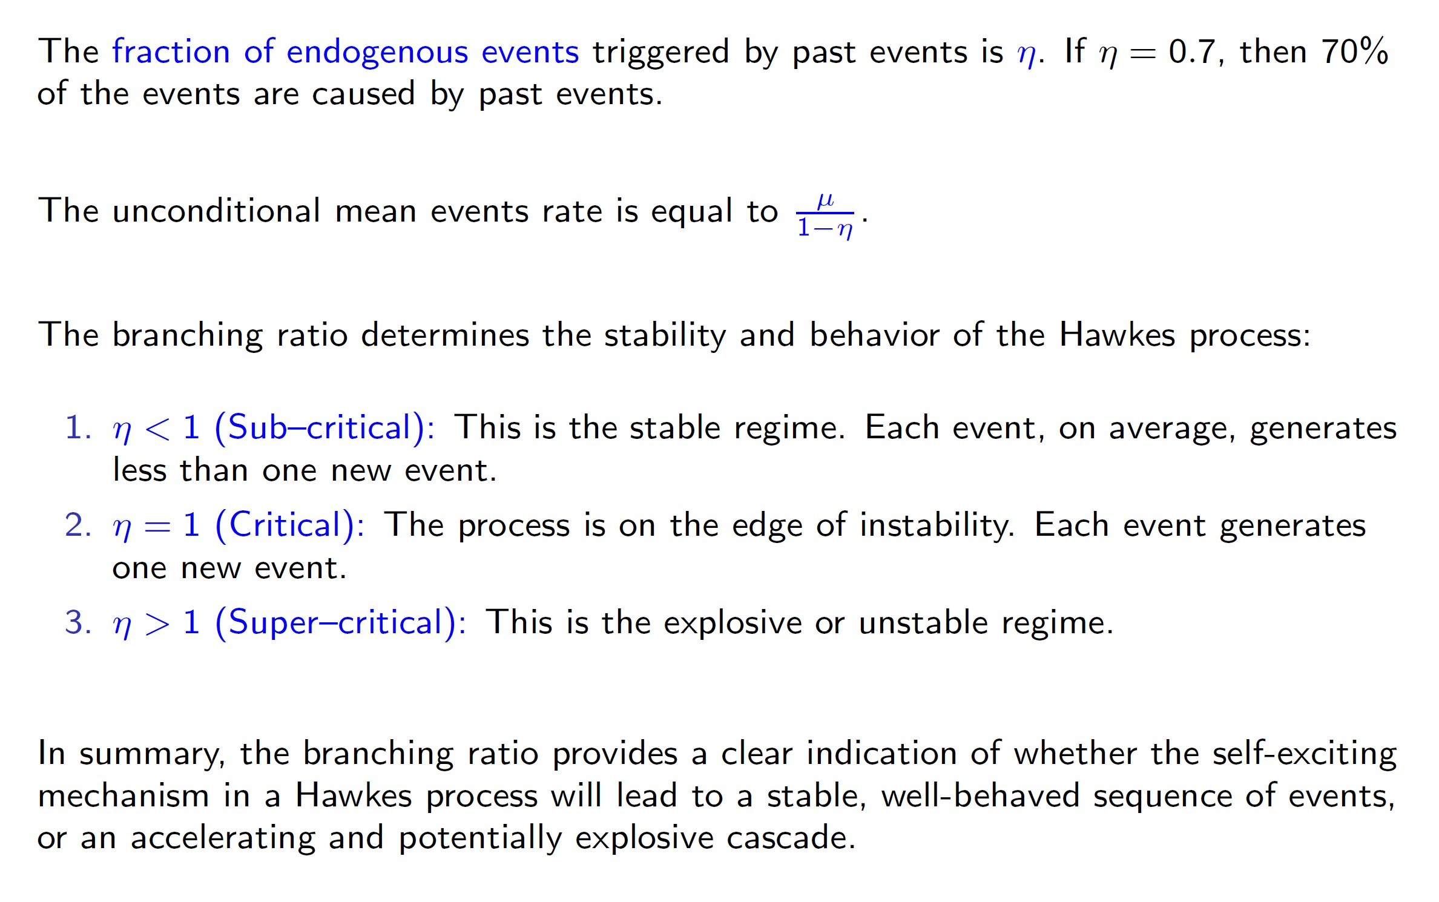
Review of Hawkes Process

Slide 19
Correlation Matrix for Top Features
 | Resiliency | Quote Fade | Branching Ratio | Log Volatility | Log Spread | Log Touch Size | Log ADV | Log Crossing Time | Log Resiliency
Resiliency | 100% | -33% | -48% | -32% | -52% | 71% | 54% | -36% | 99%
Quote Fade | -33% | 100% | 31% | 0% | 27% | -25% | -24% | 30% | -30%
mu | 23% | -24% | -15% | 19% | -39% | 24% | 61% | -58% | 21%
alpha | 45% | -29% | -26% | 25% | -25% | 40% | 68% | -46% | 42%
beta | 61% | -40% | -81% | 6% | -32% | 63% | 57% | -40% | 56%
Branching Ratio | -48% | 31% | 100% | 4% | 24% | -44% | -27% | 23% | -45%
Touch Trade Ratio | 13% | 11% | -1% | -32% | -12% | 27% | 9% | 10% | 11%
Rel Touch Size | 15% | 9% | 6% | -49% | -14% | 38% | 2% | 20% | 13%
Log ADV USD | 1% | 2% | 7% | 3% | -53% | 10% | 59% | -61% | 0%
Log Touch Size USD | 35% | -5% | -20% | -50% | -57% | 69% | 39% | -25% | 30%
Log Volatility | -32% | 0% | 4% | 100% | 48% | -31% | 15% | -19% | -32%
Log Spread | -52% | 27% | 24% | 48% | 100% | -46% | -54% | 77% | -53%
Log Touch Size | 71% | -25% | -44% | -31% | -46% | 100% | 64% | -27% | 65%
Log ADV | 54% | -24% | -27% | 15% | -54% | 64% | 100% | -70% | 50%
Log Crossing Time | -36% | 30% | 23% | -19% | 77% | -27% | -70% | 100% | -36%
Log mu | 46% | -27% | -20% | 19% | -57% | 44% | 90% | -79% | 44%
Log Resiliency | 99% | -30% | -45% | -32% | -53% | 65% | 50% | -36% | 100%

Slide 20
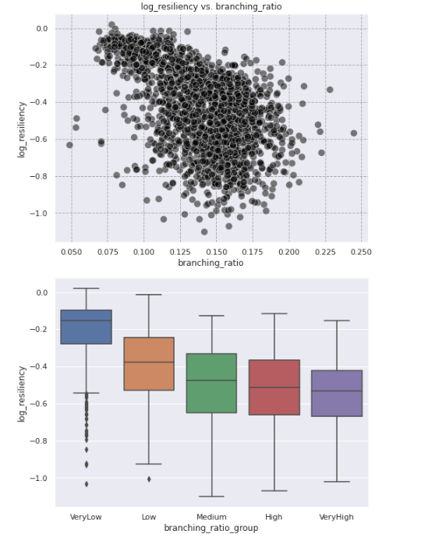
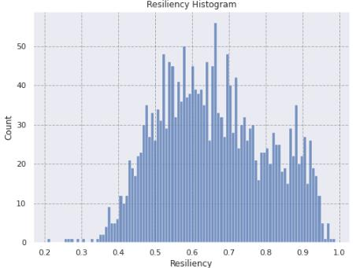
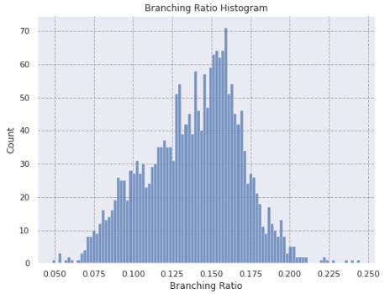
Resiliency and Branching Ratio Stats

Slide 21
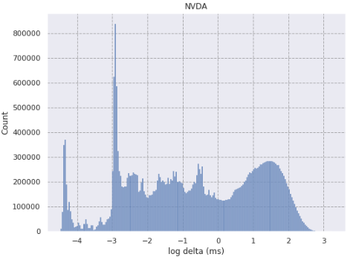
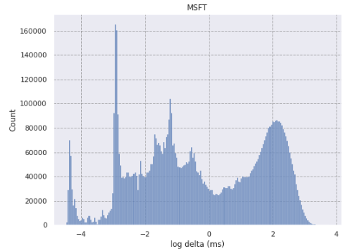
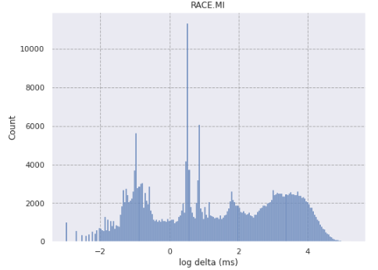
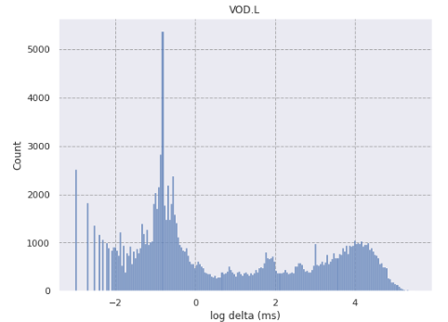
Time Between Trades Distribution

Slide 22
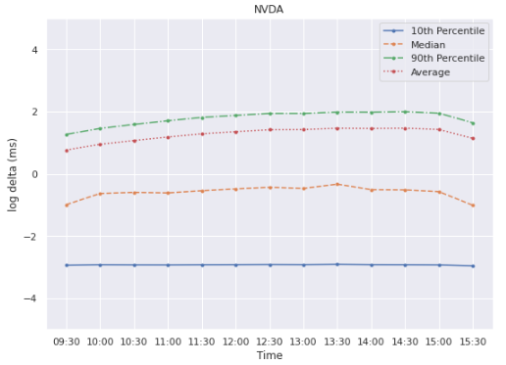
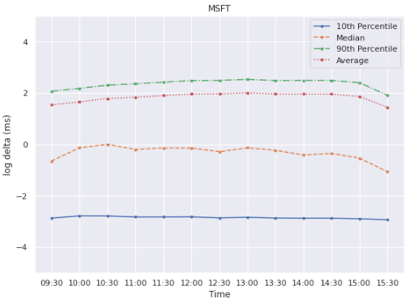
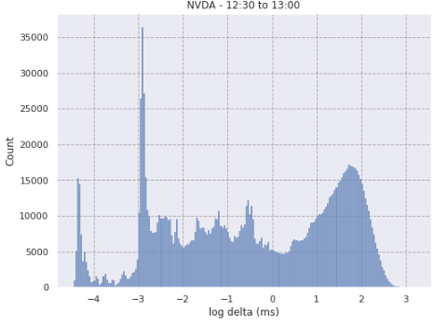
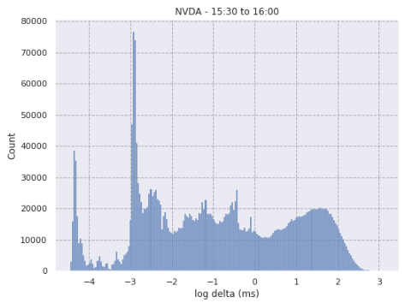
Average, Median 10th and 90th Percentile by Time of Day

Slide 23
Correlation Matrix with Trading Activity Speed
NVDA | Log avg delta | Log Trade Size | Log Touch Size | Log hl ret | Spread | Is Odd Lot | Is Dark
Log avg delta | 100% | -15% | -11% | -11% | -2% | 6% | 69%
Log Trade Size | -15% | 100% | 1% | -1% | -4% | -57% | -16%
Log Touch Size | -11% | 1% | 100% | -27% | -20% | -2% | -5%
Log hl ret | -11% | -1% | -27% | 100% | 30% | 2% | -8%
Spread | -2% | -4% | -20% | 30% | 100% | 4% | -2%
Is Odd Lot | 6% | -57% | -2% | 2% | 4% | 100% | 7%
Is Dark | 69% | -16% | -5% | -8% | -2% | 7% | 100%
MSFT | Log avg delta | Log Trade Size | Log Touch Size | Log hl ret | Spread | Is Odd Lot | Is Dark
Log avg delta | 100% | -25% | 3% | -18% | 10% | 7% | 64%
Log Trade Size | -25% | 100% | 1% | 4% | -9% | -52% | -24%
Log Touch Size | 3% | 1% | 100% | -1% | -3% | -1% | 3%
Log hl ret | -18% | 4% | -1% | 100% | 40% | -2% | -9%
Spread | 10% | -9% | -3% | 40% | 100% | 5% | 14%
Is Odd Lot | 7% | -52% | -1% | -2% | 5% | 100% | 3%
Is Dark | 64% | -24% | 3% | -9% | 14% | 3% | 100%
VOD.L | Log avg delta | Log Trade Size | Log Touch Size | Log hl ret | Spread | Is Periodic | Is Dark
Log avg delta | 100% | -6% | 0% | -26% | 15% | 32% | 0%
Log Trade Size | -6% | 100% | 12% | 5% | 0% | -1% | 5%
Log Touch Size | 0% | 12% | 100% | -16% | 4% | 11% | -1%
Log hl ret | -26% | 5% | -16% | 100% | 16% | -13% | -3%
Spread | 15% | 0% | 4% | 16% | 100% | 18% | 7%
Is Periodic | 32% | -1% | 11% | -13% | 18% | 100% | -12%
Is Dark | 0% | 5% | -1% | -3% | 7% | -12% | 100%

Slide 24
More General Lenses
We are trying to predict y using M(x). The bigger the dispersion the more we need to do something different
M(x)
predicted ( x, M(x) )
observed ( x, y )
Lenses: Dispersion with different Metrics
D₁ = y – M(x)
D₂= y / M(x)
D₃ =log ( y / M(x) )
D_{n}= f ( y – M(x) ) or g ( y / M(x) )
x
large dispersion
good model fit
large dispersion
Instead of the classical approach of looking at performance conditioned on y
We look at performance conditioned on the dispersion D(y, M(x)) = D(y, E(y))
It’s the second order moment of performance!

Slide 25



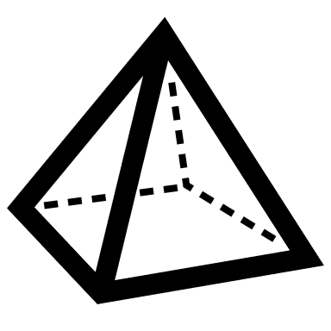






Utility Based Routing Logic
Conditional Pools
SDPs/SIs
Ask
LH/FF
$$(Q, \overline{o}, Urgency)$$
FF/Trajectory
XSOR CitiSmart
Bid
$$\overline{o}=offset$$
Citi-ONE
Dark Pools
$$\left\{±i, M\right\} i=0, 1, …, n$$
Lit Venues

Slide 26

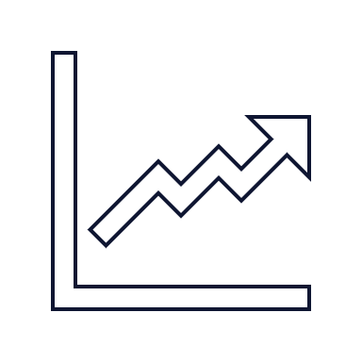






Utility Based Routing Logic
Real Time and Historical Fill Rates
IOI (“Full Fill”) / Abacus / Signal Detection Mechanism
Cost / Rebates – Cost + Clients or Internal Flow
Post Trade Markouts / Quality of Execution
Market Share per venue symbol pair
Spread Capture and Opportunity Cost
$$\sum{q_{i}=Q}$$
Allocation $→ {\left\{(q_{i},v_{i})\right\}}_{i=1}^{n}$
such that
Factors in the Utility
$$V=\left\{v_{1}, …,v_{n}\right\} venue list$$
$$\overline{o}=offset$$
$$U_{i}\left(Q,\overline{o}, Urgency, v_{i}\right)=u_{i}$$
V₁
V₂
V₃
…
V_{n}
$q_{i}$ are determined by solving an optimization
This approach solves
Dark Routing
Post Improve & Post Outside
Post at the Touch
XSOR
CitiSmart
There is an initial allocation logic
The original Venue List could be trimmed further by sorting the Utility values in descending order
We need to consider constraints on allocation (e.g. odd lots. min/max fill quantity considerations
We need to consider events that trigger a reallocation:
Timer
Full or Partial Fill at a Venue
Others
We need to keep a copy of previous allocation/state to not reallocate unnecessarily or lose queue priority

Slide 27
Conclusions and Key Takeaways
To recap, we've journeyed through the “Lenses” framework, exploring how a multi-dimensional approach to algo performance analysis provides unparalleled clarity. We saw how:
The Implied Spread, TOB Resilience Lenses and Quote Fading uncover critical microstructure insights, revealing costs and opportunities.
Hawkes Process modeling provides a scientific foundation for understanding event dynamics, enhancing our predictive capabilities.
How to use Lenses for adaptive, real-time optimization against evolving market conditions.
And finally, how these insights culminate in Utility-Based Routing, driving smarter, more informed decisions in order routing logic.
The “Lenses” framework fundamentally shifts how we evaluate, improve, and innovate in algorithmic execution. It moves us beyond simplistic metrics to a holistic understanding, enabling us to continuously adapt and excel in ever-changing markets.
This is not the end of the journey; it's an ongoing evolution.
Notes:
In today's complex, fast-moving markets, relying on static measures or classical/standard factors is no longer enough. Algos are intricate, adapting to countless variables, and their performance needs to be understood through multiple perspectives. That's why we developed “Lenses” – an Algo Performance Framework.
The framework isn't just about tweaking parameters; it's about providing a sophisticated, scientifically rigorous way to dissect, understand, and ultimately enhance how our algorithms operate in real-time.
A new way of thinking about algo performance that I hope will challenge your current perspectives and offer actionable strategies for improving algo performance.
This is not the end of the journey; it's an ongoing evolution. We continue to refine these lenses, integrate new data sources, and explore advanced analytical techniques to push the boundaries of what's possible in quantitative execution.

Slide 28
Appendix

Slide 29

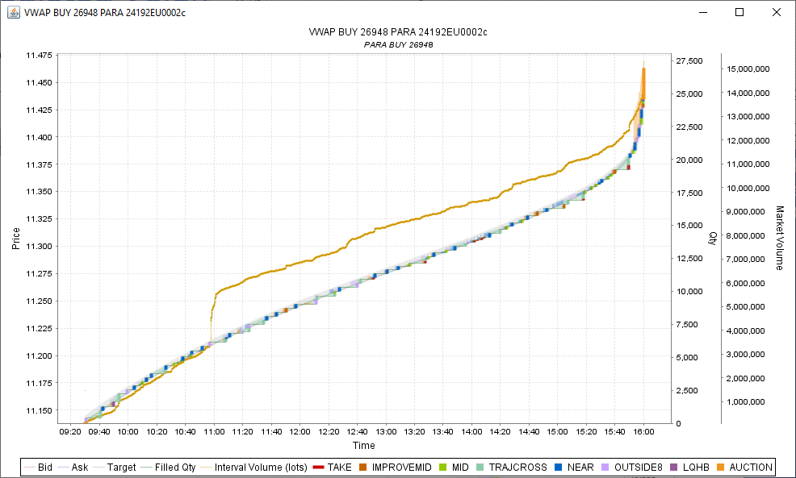
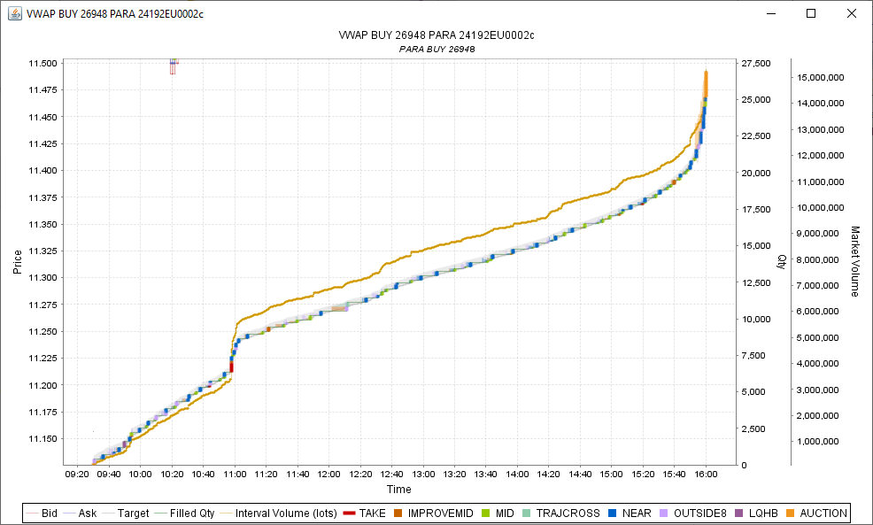
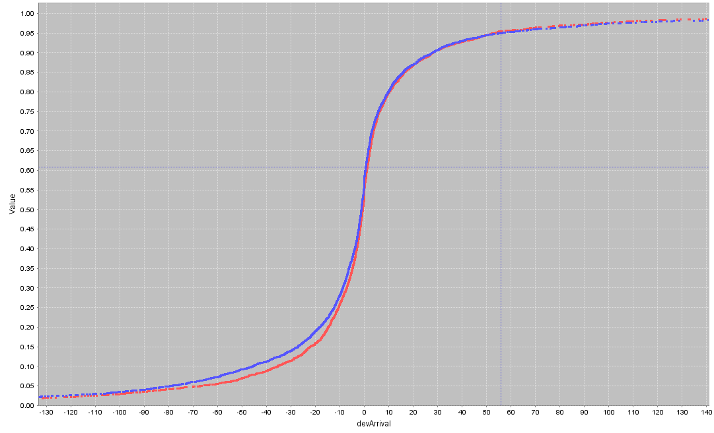

Dynamic VWAP
Standard VWAP algos will follow a static volume schedule, not adapting to changes in the market. Dynamic VWAP trades using the realized volume and a realtime volume prediction effectively following the realized VWAP trajectory.
Use Realtime Volume to Realize Better Performance with Dynamic VWAP
Standard VWAP
Dynamic VWAP
Traditional broker VWAP algorithms compute a static schedule to predict volume and trade the same trajectory throughout the order lifetime, irrespective of changing market conditions. However, the goal of a VWAP is not to trade relative to the predicted volume, but relative to the actual volume of the day.
Dynamic VWAP follows actual volume instead of the static prediction by targeting the realized volume elapsed in proportion to a realtime prediction of what volume remains over time.
At each time $t$, Dynamic VWAP will target the total quantity $Q_{t}$ based on the proportion of realized volume $V_{real}\left(0,t\right)$ to a realtime prediction of what remains $V_{pred}\left(t,end\right)$.
$$Q_{t}=Q_{end}∗\left(\frac{V_{real}\left(0,t\right)}{V_{real}\left(0,t\right)+V_{pred}\left(t,end\right)}\right)$$
The prediction will account for volume surprises and
This allows Dynamic VWAP to adapt to volume surprises on the day, reducing slippage just when markets become turbulent.
Reduced VWAP Slippage Reduces Negative Outliers
Adhering to the actual VWAP schedule reduces VWAP benchmark risk, but also Arrival Shortfall performance. By using the realized volume fraction as the trading target instead the predicted VWAP target, Dynamic VWAP will better track the actual realized volume curve. This reduces price deviation when volume spikes, which is just when markets are most volatile.

Slide 30
New Smart Close and Opportunistic Close
The closing price is a key reference price for Equity markets which combined with tighter spread and lower volatility has led to significant growth in volume traded near and at the market closing auction. We developed a new version of Smart Close algorithm that emphasizes opportunistic trading and flexibility of benchmark selection for more arrival cost sensitive trading near market close – Opportunistic Close

Slide 31
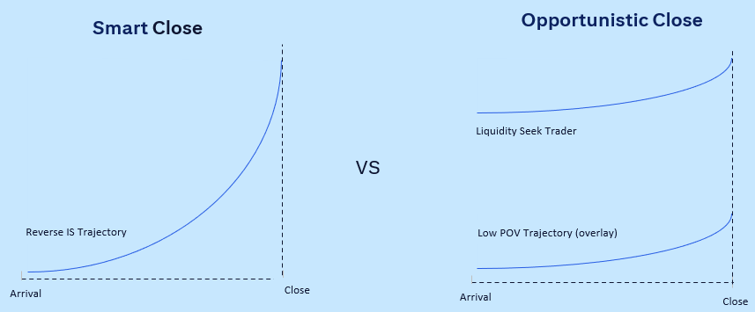
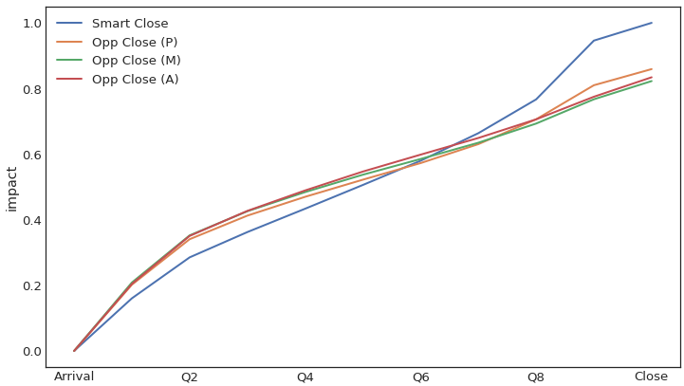
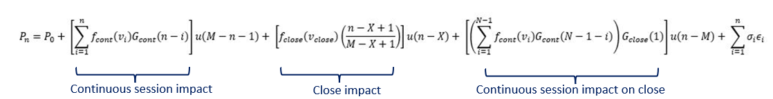
New Smart Close and Opportunistic Close
Our Model considers the cumulative instantaneous impact and reversion of trading during continuous session, close impact cost for close slice, microstructure variables, real time information (e.g., imbalance, volume surprise), and the risk aversion parameter to compute the optimal schedule. As trading progresses, and new information is received, the algo dynamically recomputes the curve and adjusts the close portion. A directional view can also be applied using alpha profiles.
The shape of trading is computed to minimize the cumulative impact of all child slices for given the risk aversion to the close benchmark. The expected result of this is lower impact on the close price due to trading in the day session.
The Opportunistic Close can be configured to be sensitive to arrival benchmark and close benchmark both. The sensitivity is defined by the Trading style parameter which can be selected as Aggressive, Moderate or Passive.

