Slide 1
Time series forecasting in Quantitative Finance
Example of Gas Supply and Demand
Wafaa Schiefler
October 2025
The statements, views and opinions expressed in this article are my own and do not necessarily reflect those of my employer, JPMorgan Chase & Co., its affiliates, other employees or clients.

Slide 2
Time series forecasting in Quantitative Finance
Introduction
Time series analysis
Traditional time series forecasting
Time series forecasting using Machine Learning

Slide 3
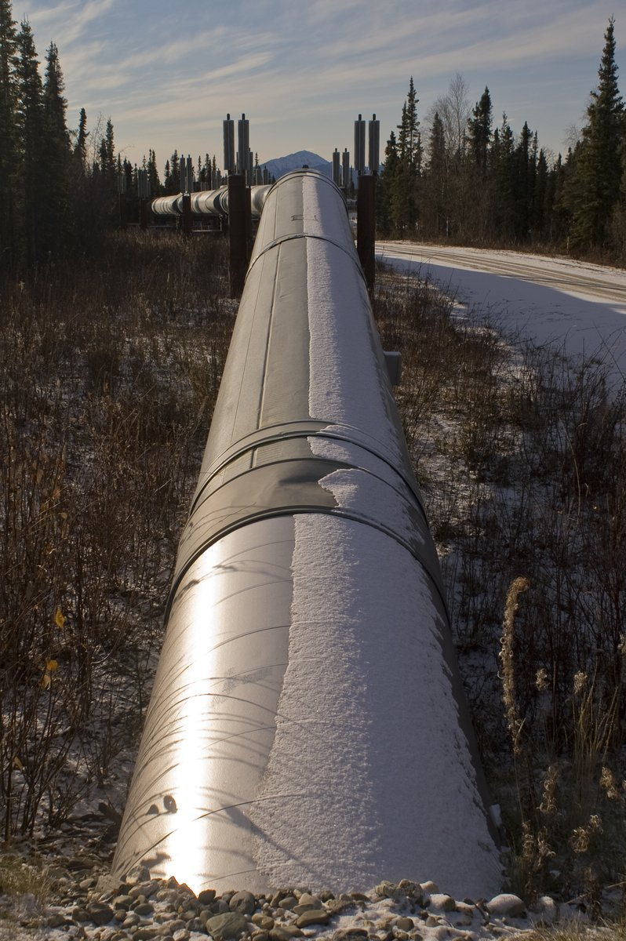
Introduction
Objective: Gas fundamentals forecasting
Gas balance: Gas Supply, Gas Demand, Gas Storage
Gas Demand | Gas Supply
LDZ (Local Distribution Zone) consumption Gas for Power Industrial Demand | Local production Gas imports (pipelines) LNG imports

Slide 4
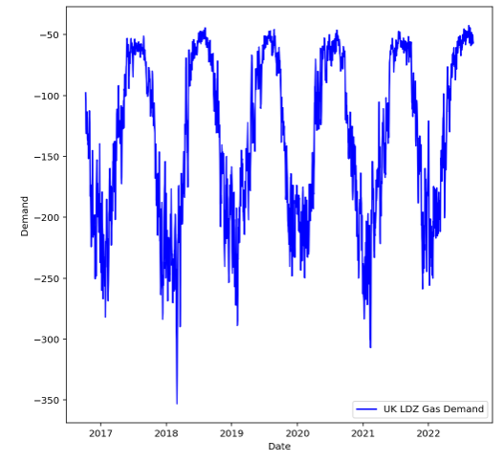
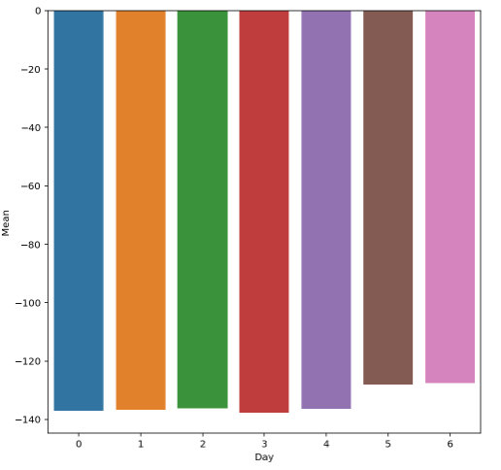

Time series analysis – the data
Example: LDZ Gas Demand in the United Kingdom
Notes:
a. Convention: Negative values
b. Low demand in summer and high demand in winter
c. Strong yearly seasonality ; no trend
Lower consumption on weekends
Figure: Gas Demand – United Kingdom – LDZ
Source:
Figure: Mean Gas Demand per week day – United Kingdom – LDZ
Source:

Slide 5
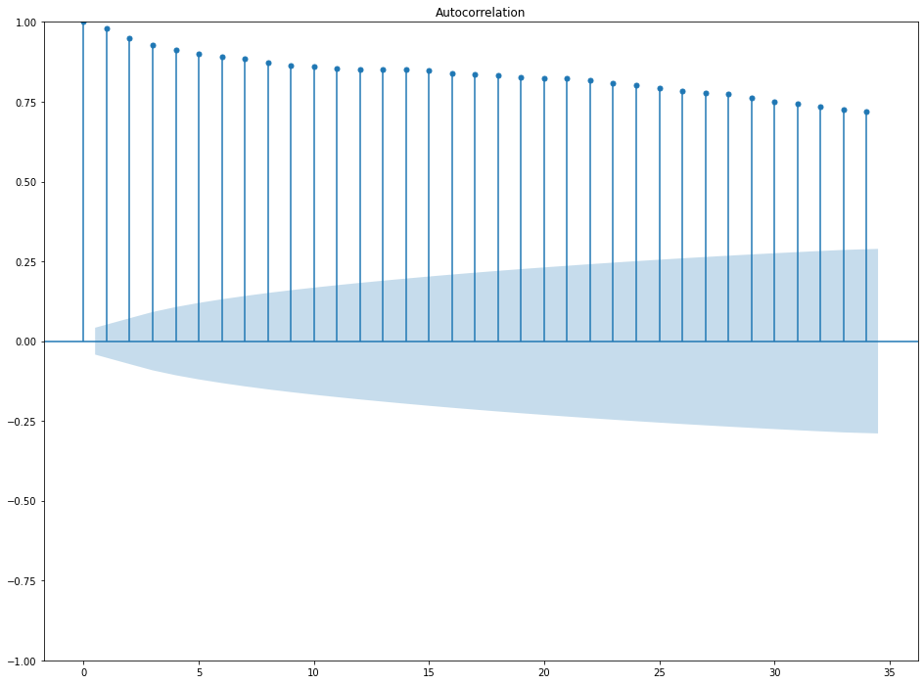
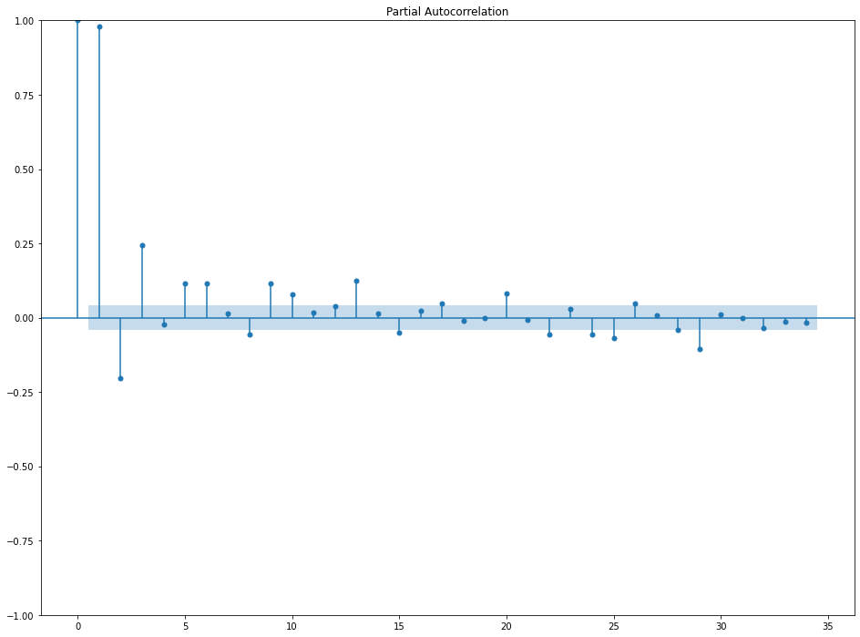
Time series analysis – autocorrelation

Slide 6
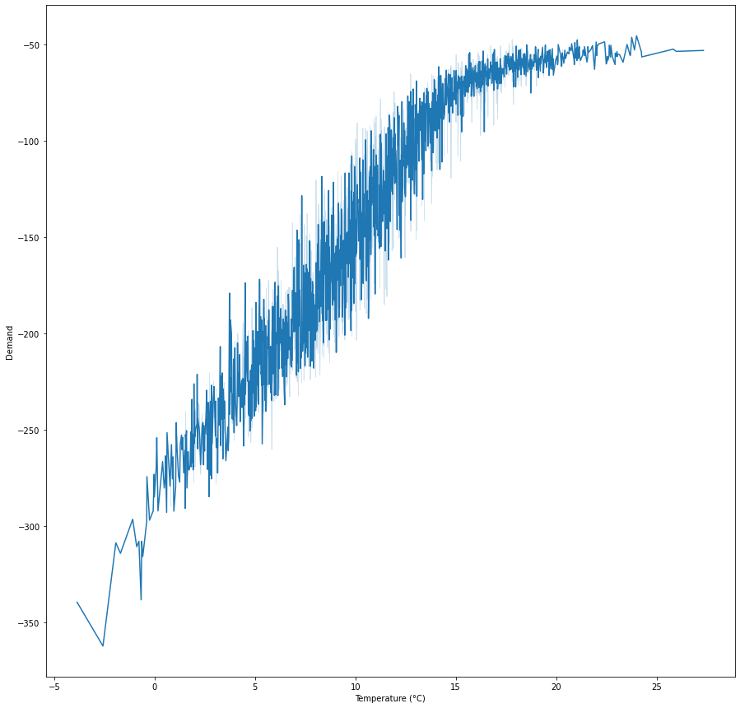
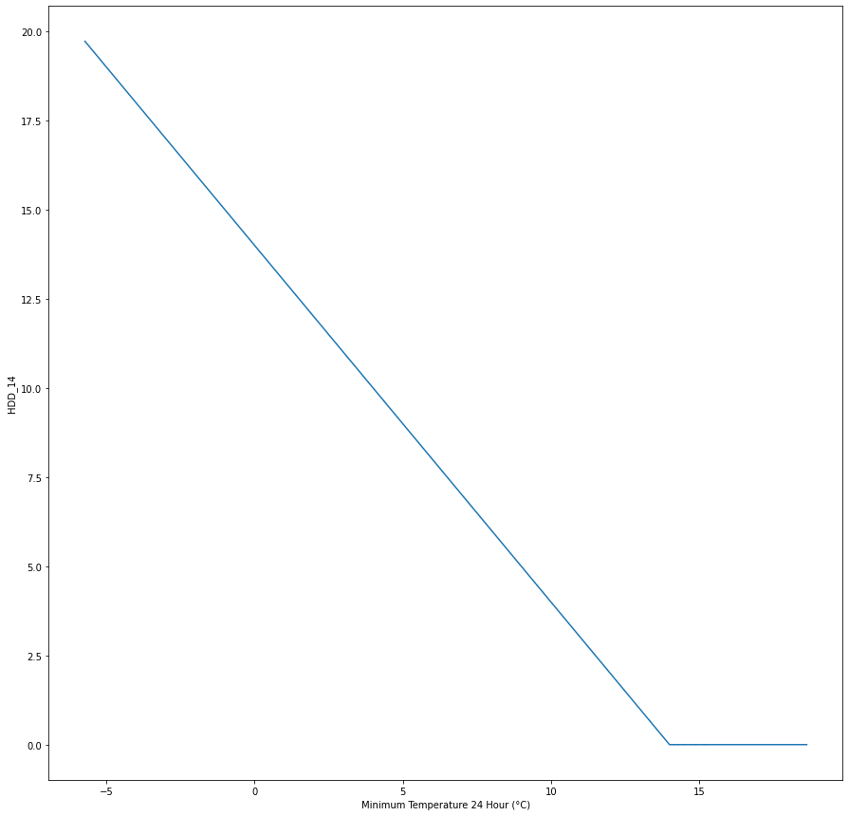
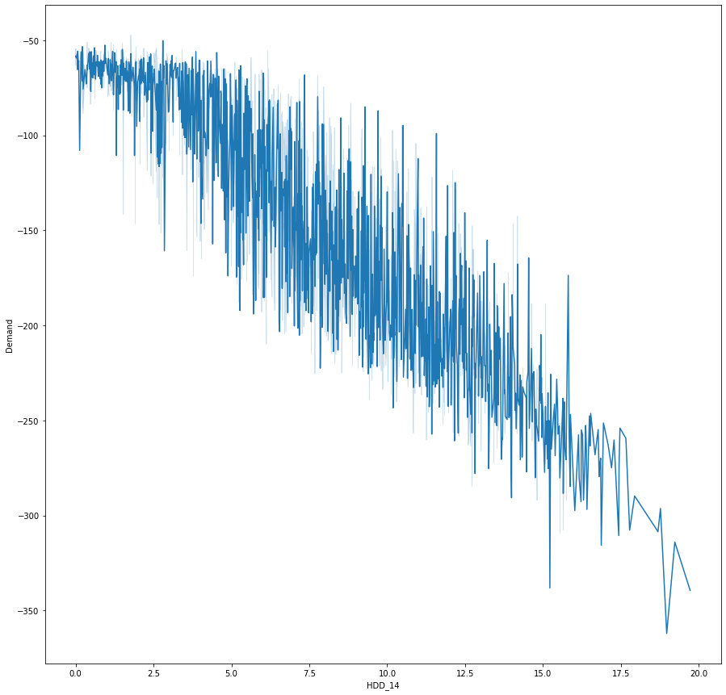
Time series analysis – weather
Strong correlation with Temperature ~0.94 (country-level temperature, population weighted)
Relationship less linear at higher temperatures
Heating Degree Days (HDD)

Slide 7
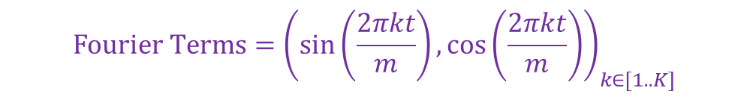
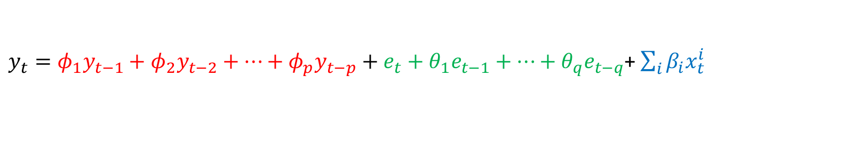

Traditional Time Series Forecasting
Key components of modelling approach:
Autoregressive nature
Seasonal nature e.g. demand different summer vs winter; annual seasonality
Idiosyncratic behaviours e.g. Bank Holidays & Weekends behave differently compared to weekdays
Exogeneous weather variables: temperature, wind speed, cloud cover…
SARIMAX models used:
$y_{t}=φ_{1}y_{t−1}+φ_{2}y_{t−2}+…+φ_{p}y_{t−p}+e_{t}+θ_{1}e_{t−1}+…+θ_{q}e_{t−q}$+ $\sum_{i}{β_{i}x_{t}^{i}}$
$$+ \text{W}\text{.}\text{Fourier} \text{Terms} \text{+ }ε_{t}$$
AR
MA
X
$${\text{Fourier} \text{Terms}=\left(\sin\left(\frac{2πkt}{m}\right),\cos\left(\frac{2πkt}{m}\right)\right)}_{k∈[1..K]}$$

Slide 8
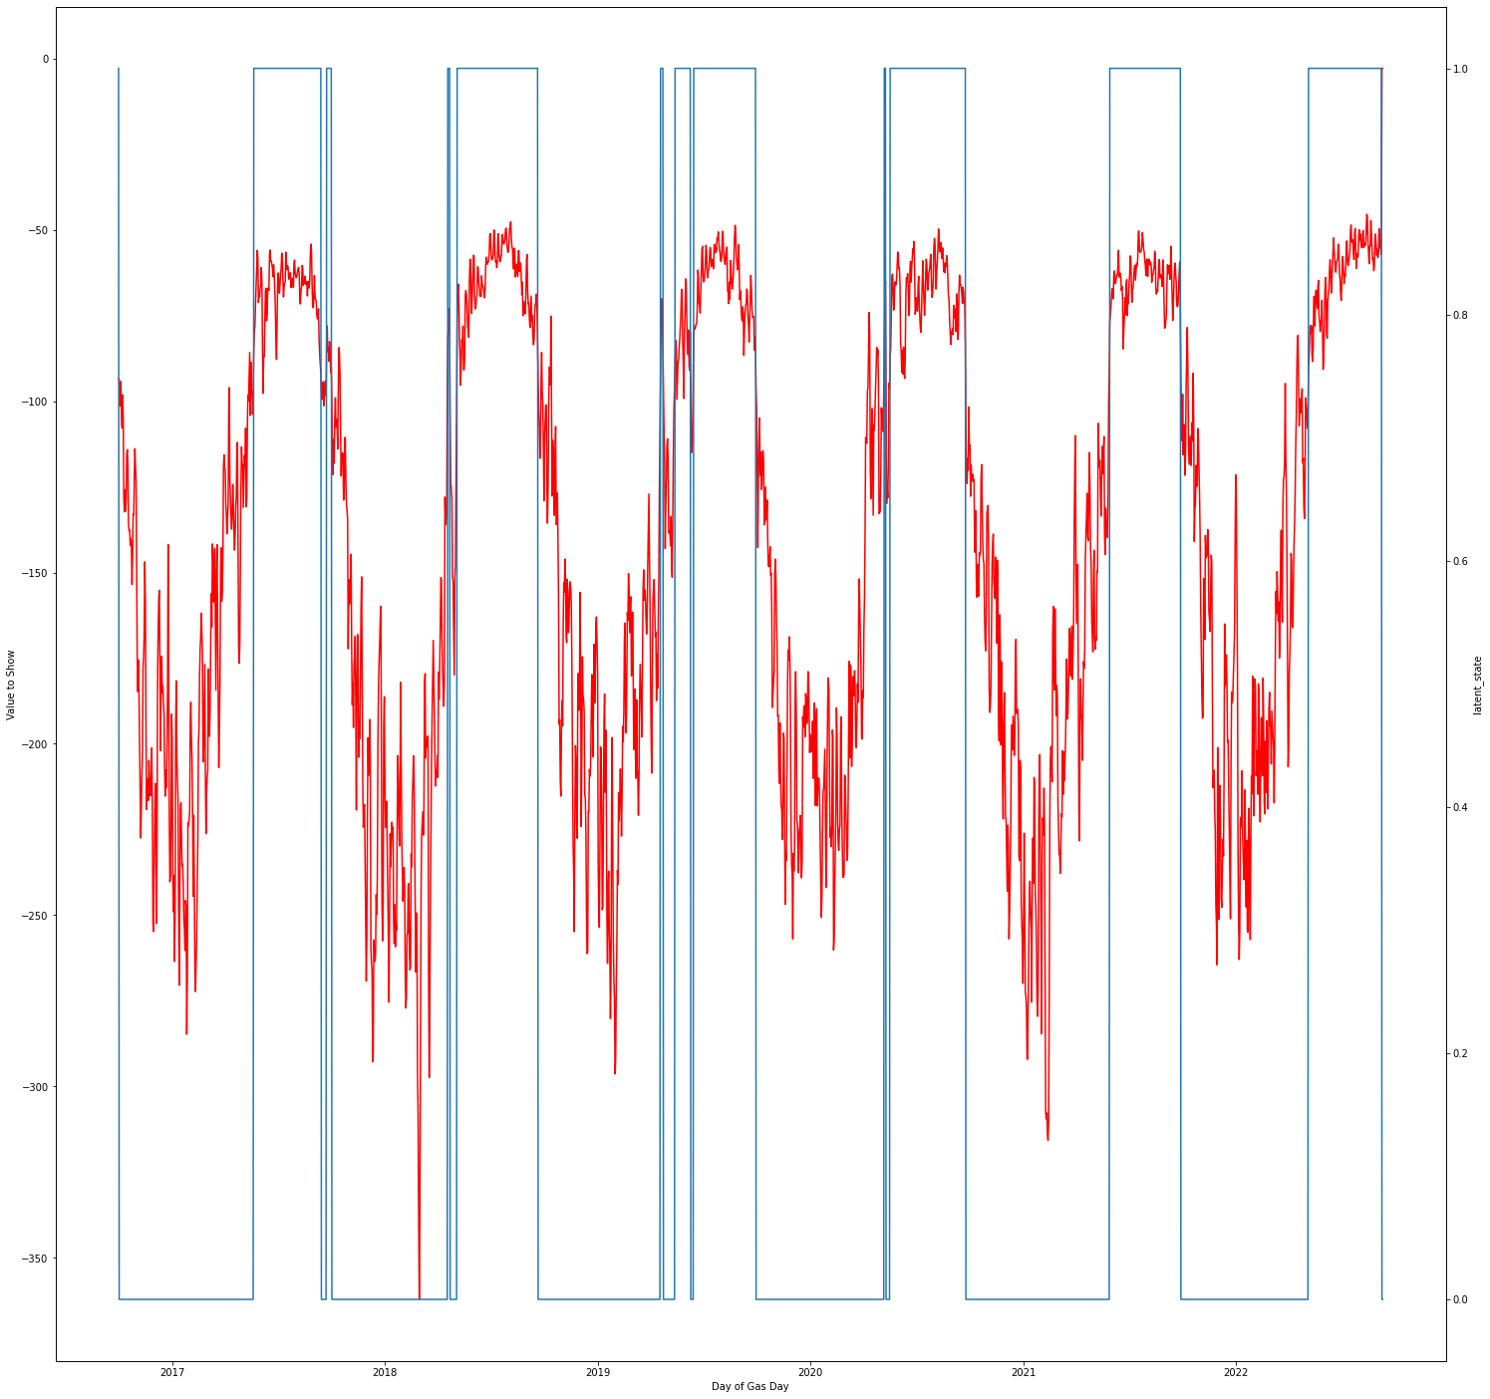
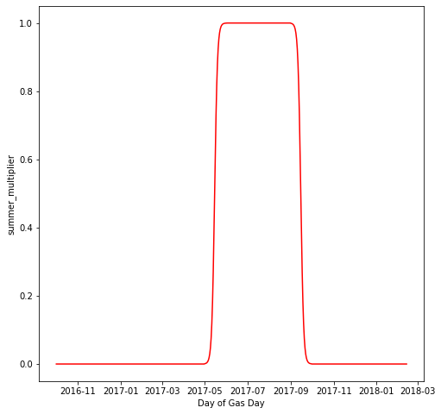
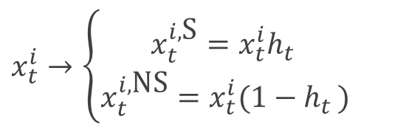
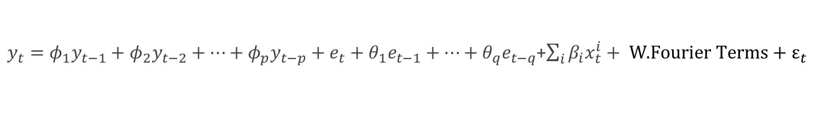
Traditional Time Series Forecasting
$y_{t}=φ_{1}y_{t−1}+φ_{2}y_{t−2}+…+φ_{p}y_{t−p}+e_{t}+θ_{1}e_{t−1}+…+θ_{q}e_{t−q}$+$\sum_{i}{β_{i}x_{t}^{i}}+ \text{W}\text{.}\text{Fourier} \text{Terms}\text{ + }ε_{t}$
HMM with 2 hidden states clearly identifies the 2 distinct states as relating to summer and winter.
Winter parameters vs Summer parameters
$$x_{t}^{i}→\left\{\begin{aligned}x_{t}^{i,\text{S}}=x_{t}^{i}h_{t } \\ x_{t}^{i,\text{NS}}=x_{t}^{i}(1−h_{t })\end{aligned}\right.$$

Slide 9
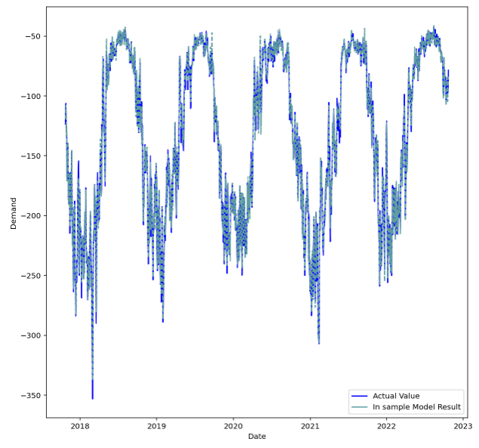
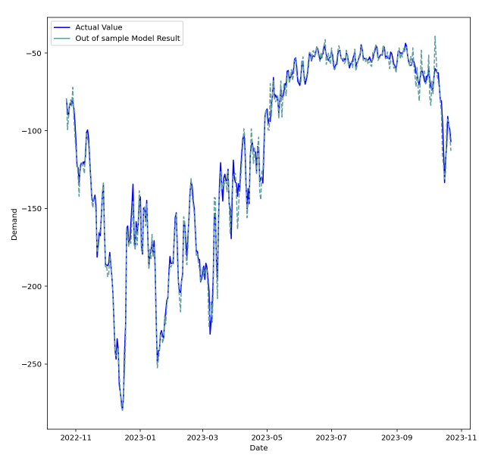
Traditional Time Series Forecasting
SARIMAX(AR=3,I=0,MA=3) ; HDDs ; HDDWs ; Wind ; Lagged temperatures ; Holidays/Weekend
Trained on 23-Oct-2017 to 22-Oct-2022 ; tested on 23-Oct-2022 to 22-Oct-2023
Day ahead predictions – MAE = 3.5 / 4
Note: this considers that the weather is known in advance!

Slide 10
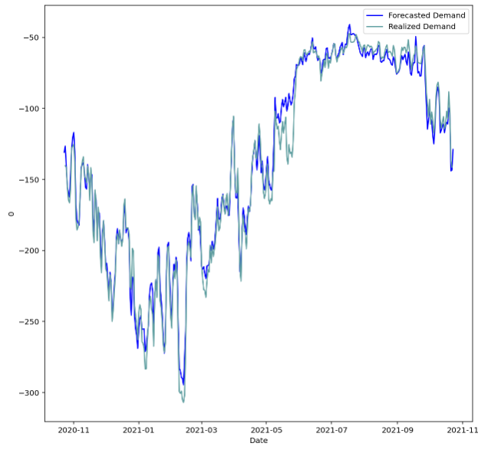
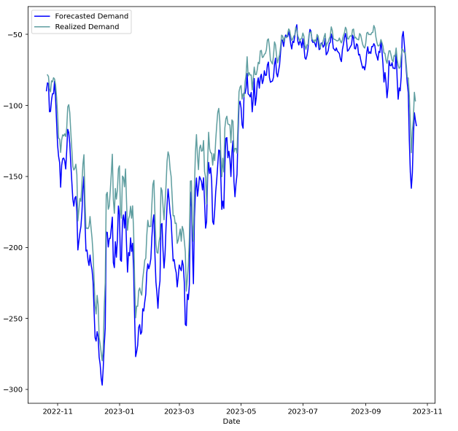
Traditional Time Series Forecasting
Forecasting as of 23-Oct-2020 for the year ahead
Forecasting as of 21-Oct-2022 for the year ahead
Note: this considers that the weather is known in advance!
Over-estimation of demand: Demand destruction in 2022

Slide 11
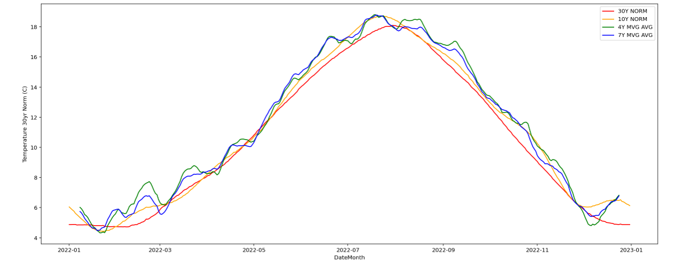
Traditional Time Series Forecasting
Weather forecast for 14 days → ✓
Weather forecasts for a few weeks / months → ~
Weather forecasts for 1 year → Weather norms?
Higher temperatures?
Figure: Temperature in the UK (population weighted)
Source: CommodityWX

Slide 12
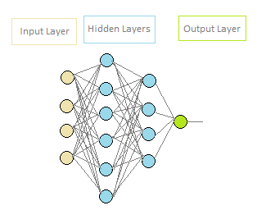
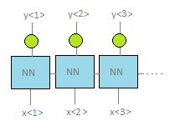
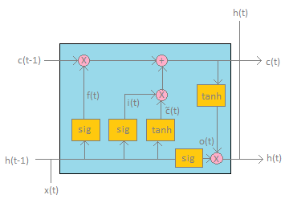

Time series forecasting using ML
Deep Neural Network
Recurrent Neural Network (RNN)
LSTM (Long Short Term Memory)

Slide 13
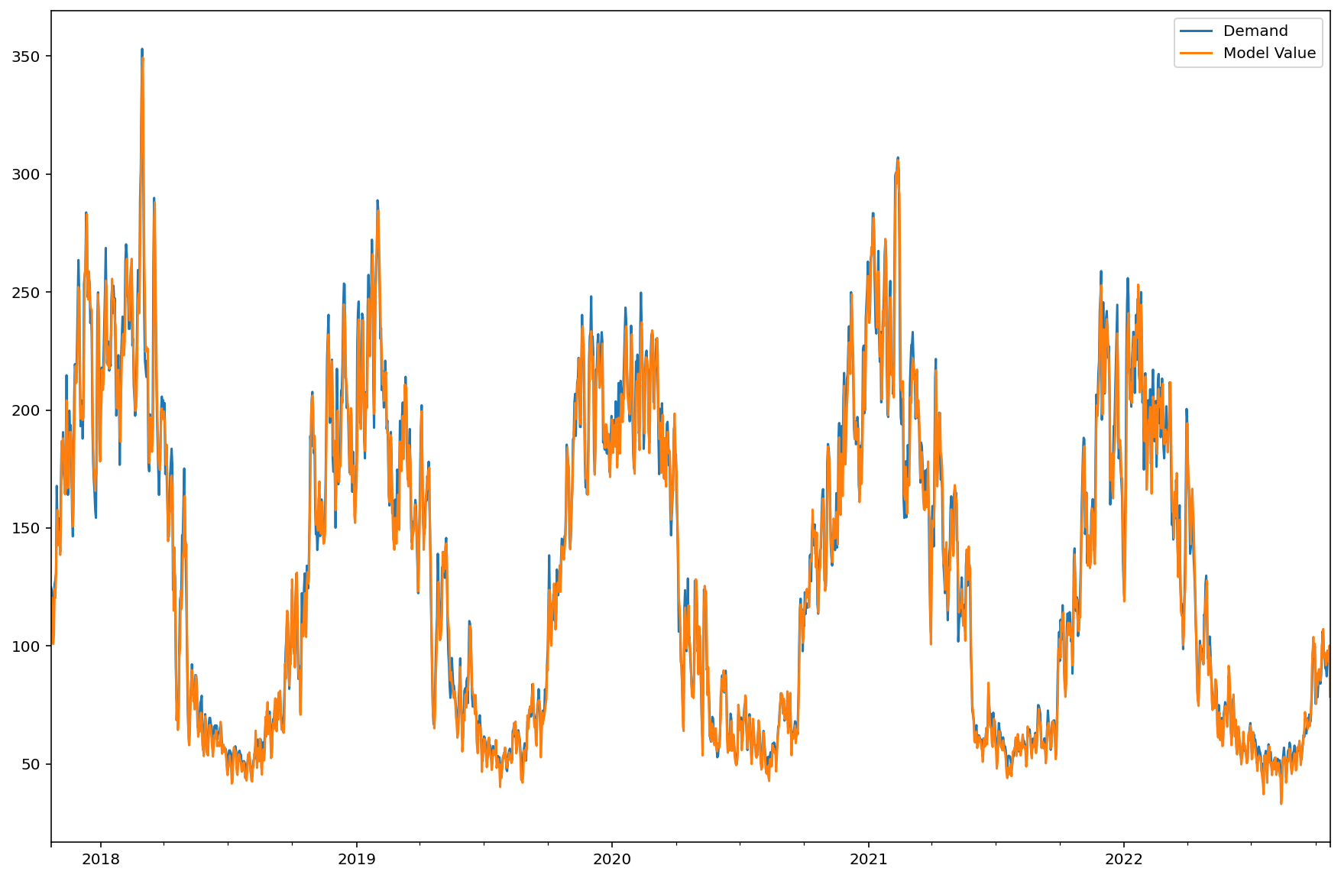
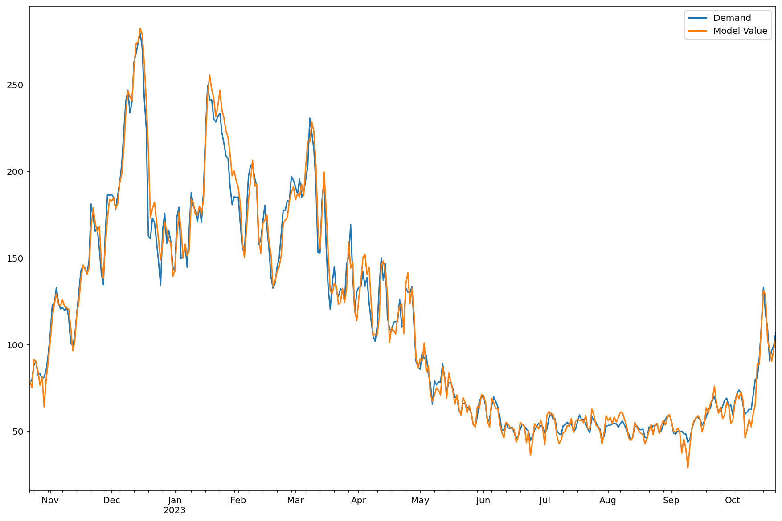
Time series forecasting using ML
Simple example: 1 LSTM + 1 NN (1 neuron)
Trained on 23-Oct-2017 to 22-Oct-2022 ; tested on 23-Oct-2022 to 22-Oct-2023
Day ahead predictions – MAE = 4.2 / 4.3
Note: no pre-processing of weather data

Slide 14
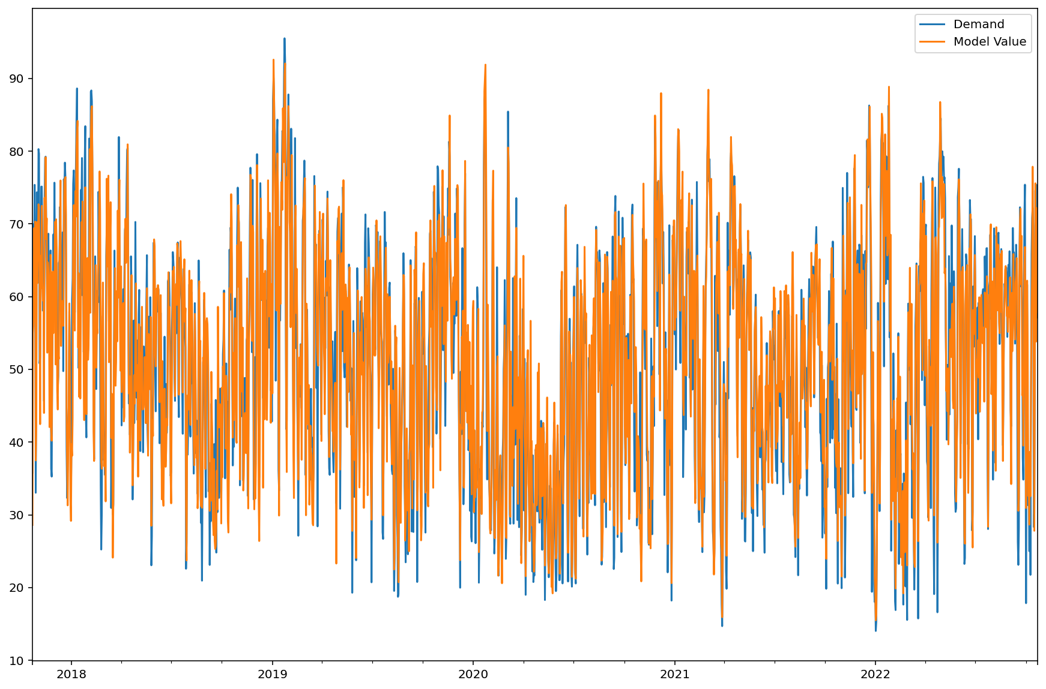
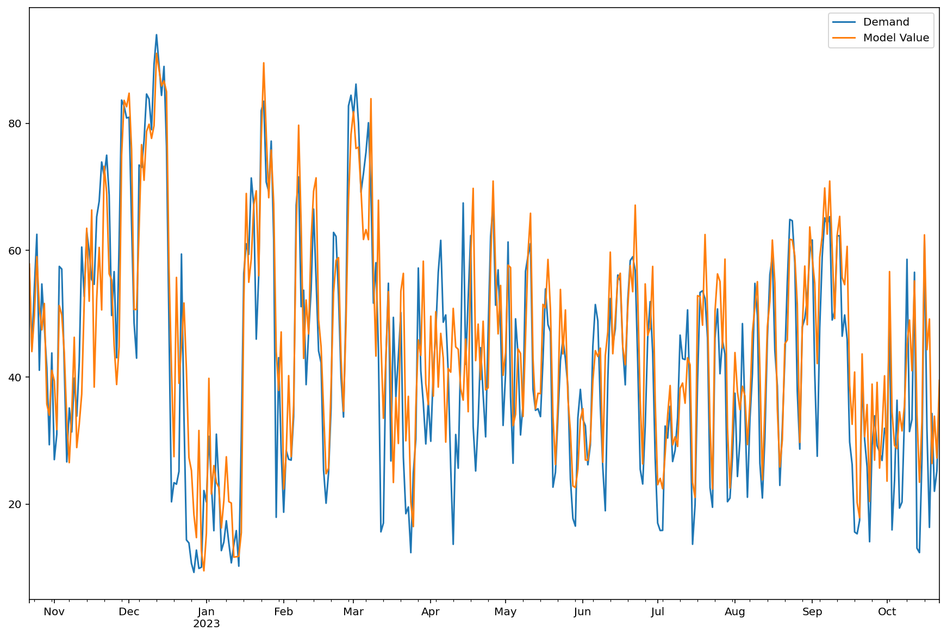
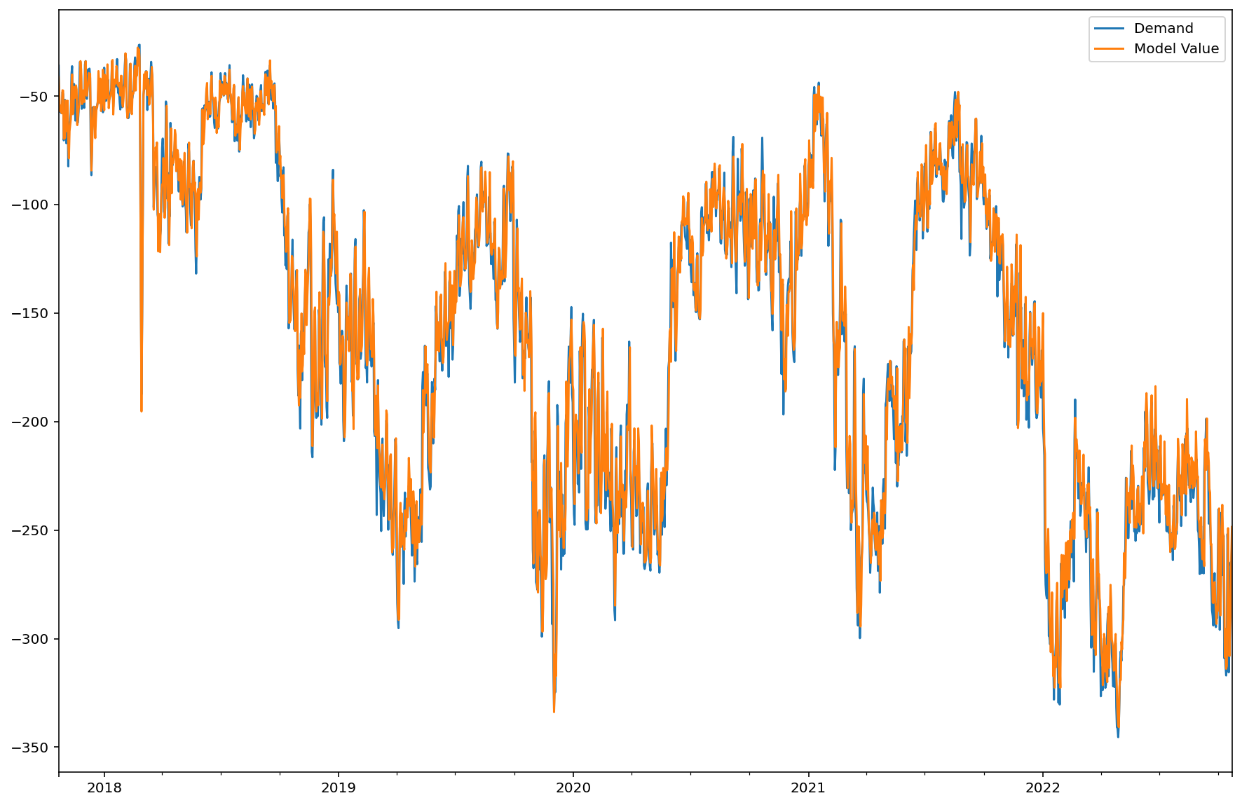
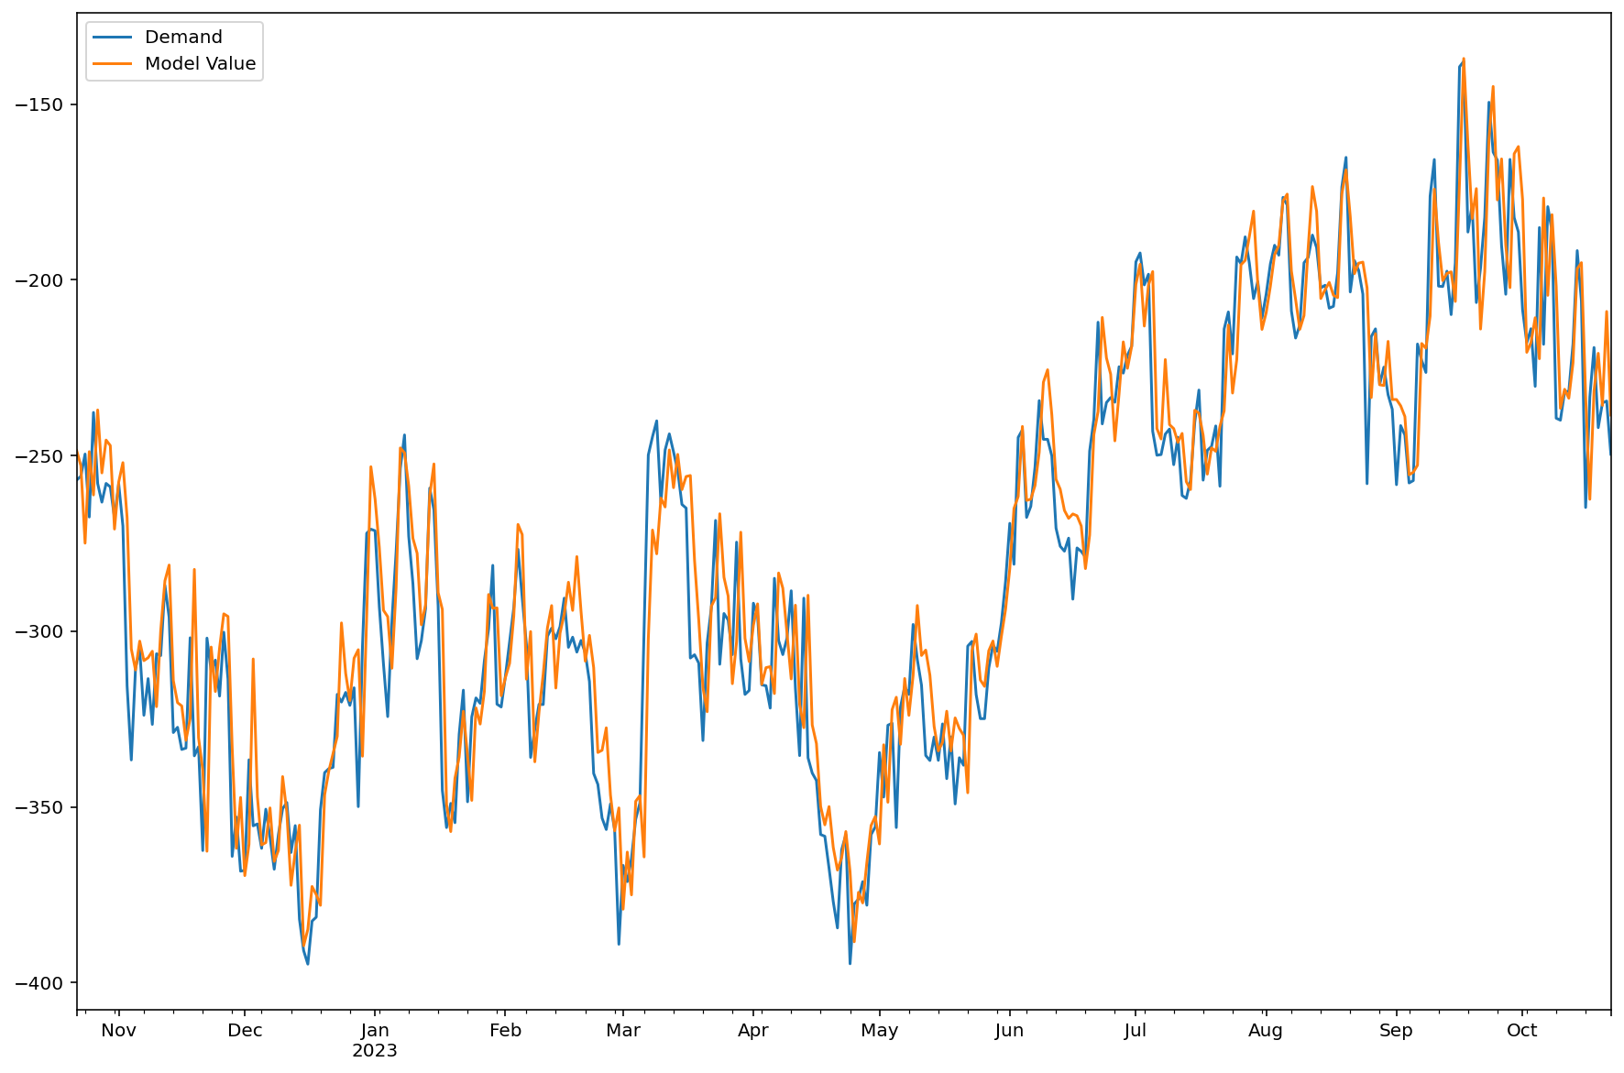
Time series forecasting using ML
Component | In-sample | Out-of-sample
UK Gas for Power (demand)
UK LNG imports (Supply)
Convolution
3 LSTM
1 Deep NN (4 layers, 64 neurons)
Activations = ReLu
Drop-out
Better results than SARIMAX

Slide 15
Summary
Good fit with both approaches
Similar challenges (weather forecasts & demand-destruction)
Easily extended to other Gas Supply and Demand components and other regions/countries
 | Time Series Analysis | Neural Networks
Fit quality | Good | Good
Pre-processing (transformations) | Substantial | Minimal
Complexity - Number of params | Small | Large
Fitting Speed (*) | 9s | 76s
Generalizable | Yes – to a certain extent | Yes – more flexible
(*) On our example – UK Gas Demand LDZ fitted on Oct17-Oct22 and tested on Oct22-Oct23
The statements, views and opinions expressed in this article are my own and do not necessarily reflect those of my employer, JPMorgan Chase & Co., its affiliates, other employees or clients.

Slide 16
Time series forecasting using ML
Encoder Decoder models
Transformers
Non-NN based machine learning models
LLM style approach

