Slide 1


q) select lastPx:last price,...
Algorithmic Trading and Execution
with Deep Learning & Time-Series Analytics
Presented by
Rohit Sharma
Sr Vice President, Market Surveillance
Bank of New York
Quant Starts EU 2025
London | Day 1 | 14 October
2:30 PM
model = tf.keras.Sequential([...])

Slide 2






Agenda
1. Time-Series Modeling of Order Flow Using Deep Learning
Demonstrating how deep learning models enhance short-term price forecasting and execution decision-making when applied to high-frequency data in kdb+/q
2. Combining Domain Knowledge with Neural Architectures
Discussing how deep learning complements traditional signal processing in kdb+/q, addressing interpretability, robustness, and latency trade-offs
3. Real-Time Execution Analytics at Scale
Presenting techniques for efficient venue benchmarking, slippage monitoring, and dynamic strategy refinement using kdb+/q

Slide 3
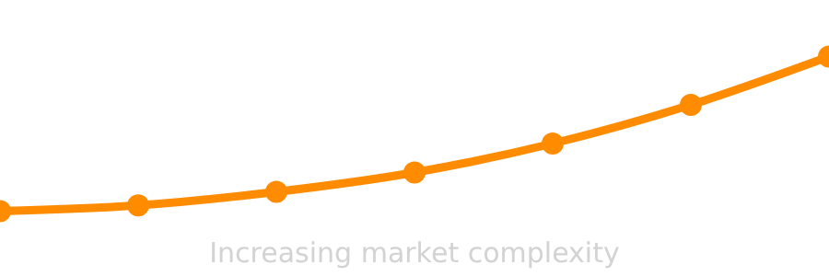










The Modern Execution Challenge
Algorithmic trading has become increasingly complex, with traditional models struggling to keep pace with market dynamics.
Data Velocity
Market Fragmentation
Model Limitations
Unprecedented data volume and speed require advanced analytical capabilities to extract meaningful signals.
Traditional models struggle with market evolution, leading to suboptimal execution and increased slippage.
Markets are increasingly fragmented, requiring strategies that can navigate complex liquidity landscapes.
Milliseconds for decision-making
Multiple venues, diverse assets
Fixed parameters, rigid logic
Result: Suboptimal execution, increased slippage, and missed opportunities in dynamic market conditions.

Slide 4








Our Approach: The kdb+/Python Synergy
kdb+
Python
High-speed, real-time time-series data management
Rich ecosystem for deep learning
Efficient storage and query of massive market data
Sophisticated predictive modeling capabilities
Synergy
Adaptive algorithms for changing market conditions
Optimized for capturing and processing market data
Optimal Solution for Execution Pipelines
This hybrid technology stack creates an optimal solution for building robust and adaptive execution pipelines:
Facilitates continuous learning and adaptation to market changes
Combines kdb+'s time-series data management with Python's predictive modeling
Creates a comprehensive framework for algorithmic trading
Enables real-time analysis of vast market data volumes

Slide 5





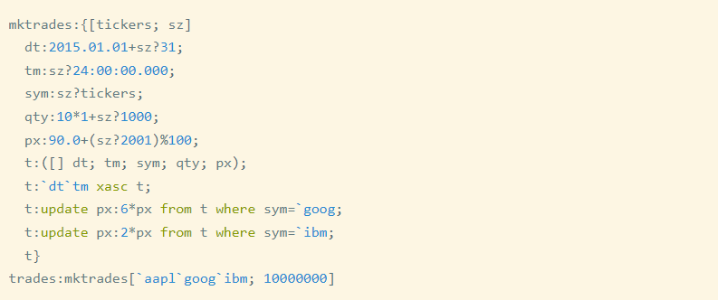

High-Frequency Data in kdb+
kdb+ for Time-Series Data
kdb+/q Code Example
Optimized architecture for capturing, storing, and querying massive volumes of market data
// Create sample trade data
qsyms
:
100
?
`$read0 `:stocks.txt
;
Unparalleled capabilities for high-speed, real-time time-series data management
n
:
20000000
;
day
:
2025.01.01
;
trade
:([]
time
:
asc
(
timestamp
$
day
) +
n
?24:00:00;
Ideal for real-time analytics and historical backtesting
sym
:
n
?
syms
;
p
00f;
:
?1000)
:
Efficiently handles structured time-series data in financial markets
// Partition data by date and symbol
homeDir
:
getenv
[
`HOME
];
dbDir
:
homeDir
,
"/data"
;
dbPath
:
hsym
$
dbDir
;
.Q.dpft
[
dbPath
;
day
;
`sym
;
`trade
]
// Saves partitioned table
This code creates 10 million trade records and partitions them by date and symbol for efficient querying.

Slide 6















Deep Learning for Price Forecasting
Capturing temporal dependencies and patterns in order flow data
Long Short-Term Memory (LSTM)
Convolutional Neural Networks (CNNs)
Recurrent neural network that processes sequential data, retaining long-term memory of past observations. Excels at capturing trends and dependencies over extended time horizons in price series.
Identifies local patterns and features within time-series data, such as specific price movements or order book imbalances. Effective for detecting short-term patterns and anomalies.
Hybrid Models (CNN-LSTM)
CLAM (CNN-LSTM-Attention)
Combines CNNs and LSTMs to extract both spatial features (patterns) and temporal dependencies from data. Creates more robust and accurate predictions by leveraging strengths of both approaches.
Advanced hybrid model that incorporates an attention mechanism, enabling it to focus on the most relevant historical patterns for forecasting. Further enhances prediction accuracy by prioritizing important data points.
Key Benefits for Price Forecasting
Real-time pattern detection
Long-term dependency modeling
Robust prediction

Slide 7
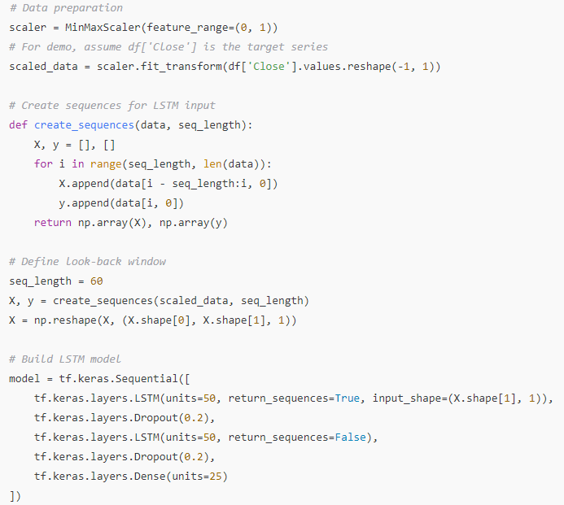
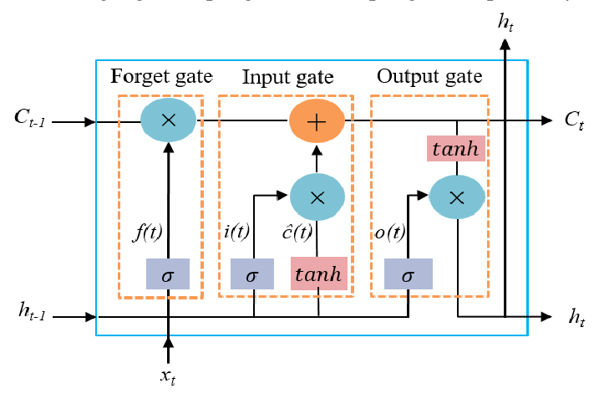
DEMO: Predictive Modeling in Action
Python-based LSTM model for price prediction
Key Components
Data Preparation: Normalizing data using MinMaxScaler
Sequence Creation: Creating 60-timestep sequences for LSTM input
Model Architecture: Two LSTM layers with dropout regularization
Compilation: Using Adam optimizer and MSE loss function
LSTM Model Architecture

Slide 8

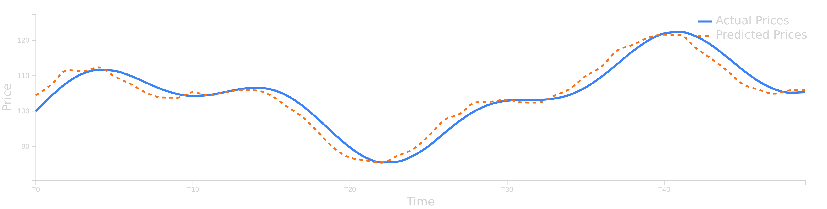




Predicted vs. Actual Price Movements
Key Insights
Model Performance
The model demonstrates strong ability to capture overall market trends
Actual: Blue line represents real market prices
Predicted: Orange line shows model's forecast
Predicted prices (orange line) closely align with actual market prices (blue line)
The LSTM model has been trained on historical order flow data
The model captures both the direction and magnitude of price movements
The model shows particular effectiveness in capturing turning points and changes in market direction

Slide 9














Beyond the Black Box
Challenges of Deep Learning in Financial Environments
Black Box
Glass Box
Deep learning models often function like opaque algorithms, making it difficult to understand their decision-making processes.
Transparent and explainable AI provides insights into decision-making processes, enhancing trust and regulatory compliance.
Interpretability
Model Robustness
Latency Trade-offs
Understanding why a model makes a particular decision is crucial for risk management and regulatory compliance in high-stakes financial environments.
Financial markets are prone to sudden regime shifts that can render previously effective models obsolete, requiring continuous validation.
The computational complexity of deep learning models can introduce latency, a critical consideration in real-time execution pipelines.
Solution: Multi-model approaches like multi-model anomaly detection systems that aggregate outputs from multiple ML models

Slide 10














Conceptual Hybrid Architecture
Real-time Market Data
kdb+ Data Engine
Traditional Signal
High-Frequency Ingestion & Query
Processing (VWAP, Spread)
Order Flow, Trades
Feature Engineering
Deep Learning Model
Execution Strategy
kdb+ & Python
LSTM, CNN-LSTM
Order Routing, Sizing, Timing
Domain Knowledge Integration
Price Prediction, Anomaly Detection
Feedback Loop
Performance Monitoring, Model Retraining

Slide 11









Live Analytics with kdb+
High-fidelity real-time analytics for algorithmic trading
Venue Benchmarking
Slippage Monitoring
Fill-Rate Analysis
Real-time comparison of execution quality across different trading venues to identify optimal liquidity sources and minimize transaction costs.
Continuous tracking of the difference between expected and actual execution prices, benchmarked against metrics like Volume-Weighted Average Price (VWAP).
Monitoring the percentage of orders that are successfully executed. High fill rates indicate effective order routing and sufficient liquidity.
Analyzes fill rates, price improvement, and latency
Evaluates execution efficiency against VWAP
Low rates signal issues with venue selection
Example: VWAP Calculation in kdb+/q
q) // Volume-weighted average price (VWAP) by 15-minute intervals
q) select lastPx:last price,
q) vwapPx:size wavg price
q) by date, 15 xbar time.minute
q) from trade
q) where sym=symbol
This code calculates VWAP by 15-minute intervals for a specific symbol, comparing actual execution prices against the benchmark.

Slide 12







Dynamic Strategy Refinement
Real-time Feedback
Live market microstructure insights (slippage, venue performance) continuously inform and adapt execution strategies
Anomaly Detection
Identification of "outlier trades" flags poor execution for immediate review and triggers parameter adjustments
Continuous Learning
Strategies continuously learn and adapt to maintain optimization and responsiveness to evolving market conditions
Enhanced trading efficiency and risk management through adaptive strategies

Slide 13








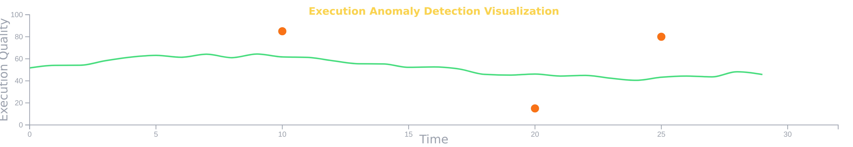



Case Study: Anomaly Detection in Market Execution
The Bank of New York's patented anomaly detection system demonstrates how our hybrid approach integrates multiple ML models with domain expertise to identify outlier trades and execution anomalies.
Data Collection
Multi-model Detection
Score Aggregation
Immediate Response
High-fidelity market data from kdb+ enables real-time monitoring of execution quality.
Multiple ML models detect different behavioral patterns in execution data.
Anomaly scores are aggregated to enhance robustness and reduce false positives.
Strategic adjustments triggered by both data insights and domain expertise.
Enhanced Robustness
Balanced Approach
Multi-model approach provides layered defense against market anomalies.
Decisions informed by both data-driven insights and established financial expertise.

Slide 14









Key Takeaways
Synergistic Power of kdb+ and Python
Leveraging kdb+ for high-performance time-series data management and Python for advanced deep learning models creates a robust and efficient algorithmic trading ecosystem.
Integrating Deep Learning with Domain Knowledge
Successful algorithmic trading requires combining sophisticated neural architectures with traditional financial signal processing and expert domain knowledge to ensure interpretability, robustness, and optimal latency.
Necessity of Real-Time Analytics
Continuous, real-time execution analytics are crucial for monitoring performance, identifying anomalies, and dynamically refining trading strategies in response to evolving market microstructure.
"The future of algorithmic trading lies at the intersection of advanced analytics and domain expertise."

Slide 15









Thank You & Connect
Thank you for your time and attention at Quant Starts EU 2025
Email
Phone
rhtsharma1111@gmail.com
+91 8802233726
Company
Event
Bank of New York
Quant Starts EU 2025
Scan to connect on LinkedIn
Market Surveillance
London | Day 1 | 14 October
Committed to pushing the boundaries of algorithmic trading and execution through innovative technology and data-driven insights

