Slide 1


Portfolio optimization and back testing with discrete constraints
Dr. Robert Luce
Principal Developer
luce@gurobi.com
Notes:
- Speaker introduction

Slide 2

Better decisions start here
Agility
Know with certainty how to respond to changing business conditions, as they happen.
Efficiency
Align your resources and forecasted demand in an uncertain business market.
Resilience
Explore what-if scenarios and evaluate long-term risks and opportunities.
The Gurobi Difference
With Gurobi, you can identify the optimal way to achieve your objectives, in seconds.
Notes:
Gurobi is decision intelligence software
based on mathematical optimization
- Industry agnostic: supply chain, manufacturing, airline crew scheduling, etc.
- Common to all: Make optimal decisions (should I ship here or there? Should I ramp up this generator or the other? Etc.
- Our technology advantage: Leading mathematical optimization solver

Slide 3


































The World’s Most-Trusted Brands Run on Gurobi
Serving
80%
Of the World’s Leading Enterprises
1,200+
Global Customers
40+
Industries
“Every day, we depend on the Gurobi Optimizer to deliver optimal systematic fixed-income portfolios for our private and institutional investors.”
Mathieu van Roon, Portfolio Manager, Robeco
VIEW CASE STUDIES
Notes:
- Gurobi is trusted by leading companies across sectors and countries
- Trust reflected by rapid growth in past seven years from 25 to 180+ employees
- Backed by highly professional scientists, developers and experts

Slide 4








You’re in good company
ASSET MANAGEMENT
Portfolio Optimisation
Collateral Allocation
Portfolio Replication
Bond Management
Hedging Strategies
Debt Management
Credit Swap Management
Trade Settlement
Asset-Liability Management
Payment Netting
Systemic Risk Management
Notes:
- Generality of our tools should not scare you away
- Financial services sector important to Gurobi
- Grateful to speak here about decision intelligence for PO

Slide 5
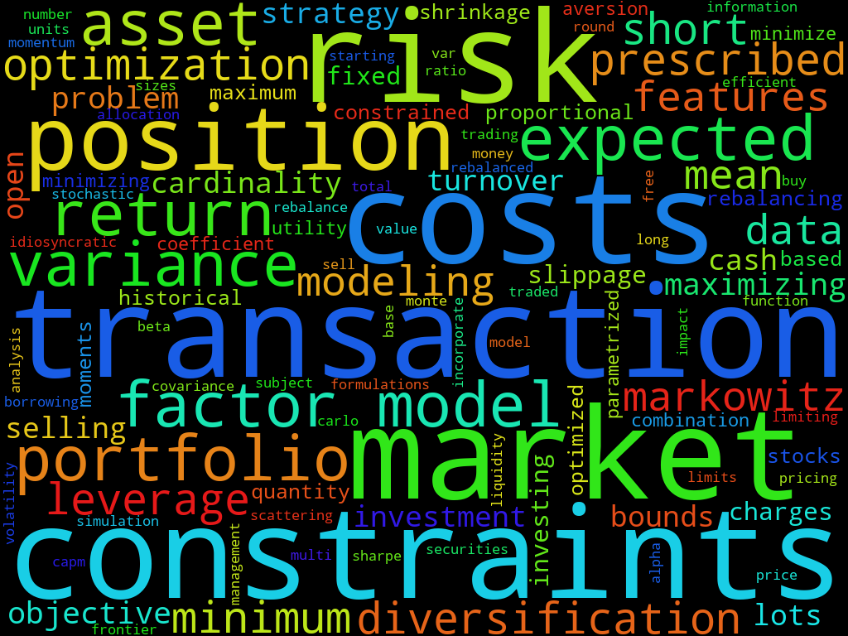
Mean Variance Portfolio Optimisation
… with discrete constraints
© 2025 Gurobi Optimization, LLC. Confidential, All Rights Reserved | 5
Notes:
- Technical view into our product
- Classical and widely adapted model in the field
- Classical theory: No additional constraints
- The MIP advantage: Incorate decision intelligence into MV-PO

Slide 6

Mean-Variance PO
Return is a random variable
Using estimates of first and second moment:
Compute optimal compromise between estimated return and risk
Enforce full investment
Classical continuous optimisation problem
What if we have discrete constraints on the investment?
Notes:
- Continous model features: bounds, relative concentration bounds, etc.
- Of course Gurobi can solve this problem too
- But there is more!

Slide 7
What’s a discrete decision?
Holding minimum size
Trade count
Trade volume minimum size
Turnover with limited cardinality
Piecewise linear market slippage
Fixed-charge transaction costs
Diversification by risk classes
Diversification by market sectors
Lot selection for tax optimisation
You-name-it
Notes:
- Discrete constraint translate to mixed-integer optimization problems
- Gurobi is the leading solver for these

Slide 8
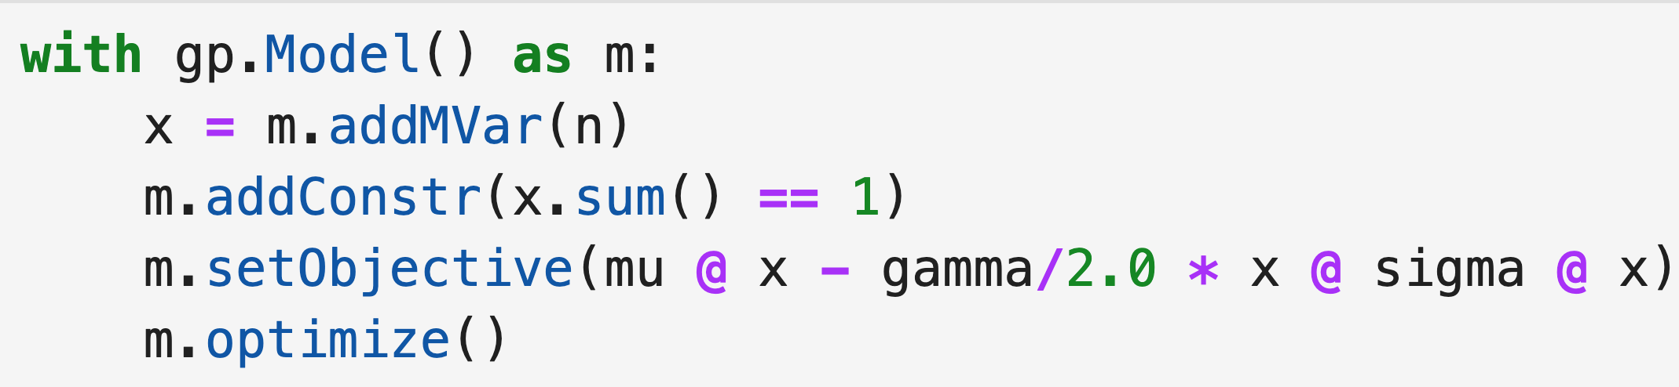
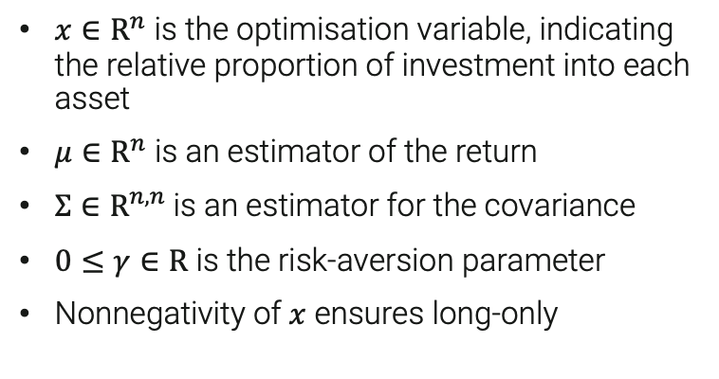
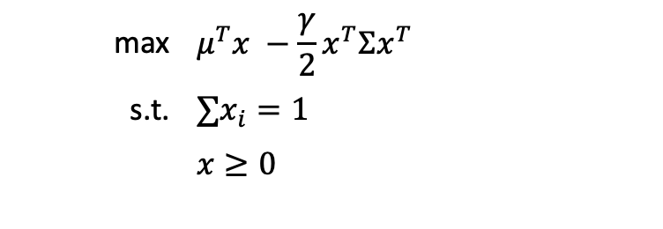

The classical Markowitz model
max | $$μ^{T}x −{\frac{γ}{2}x}^{T}Σx^{T}$$
s.t. | $$∑x_{i}=1$$
 | $$x≥0$$
$x∈R^{n}$ is the optimisation variable, indicating the relative proportion of investment into each asset
$μ∈R^{n}$ is an estimator of the return
$Σ∈R^{n,n}$is an estimator for the covariance
$0≤γ∈R$ is the risk-aversion parameter
Nonnegativity of $x$ ensures long-only
$μ∈R^{n}:$ NumPy 1D ndarray
$Σ∈R^{n,n} :$ NumPy 2D ndarray

Slide 9
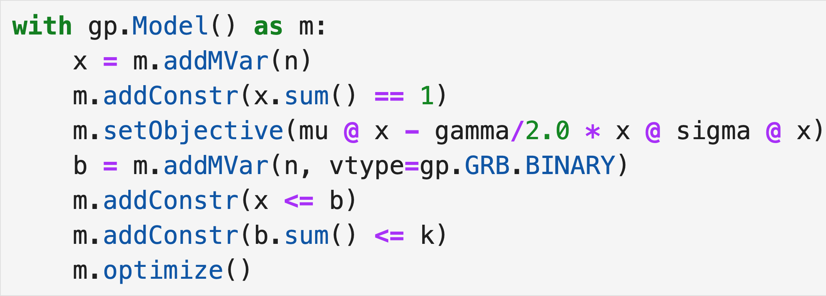
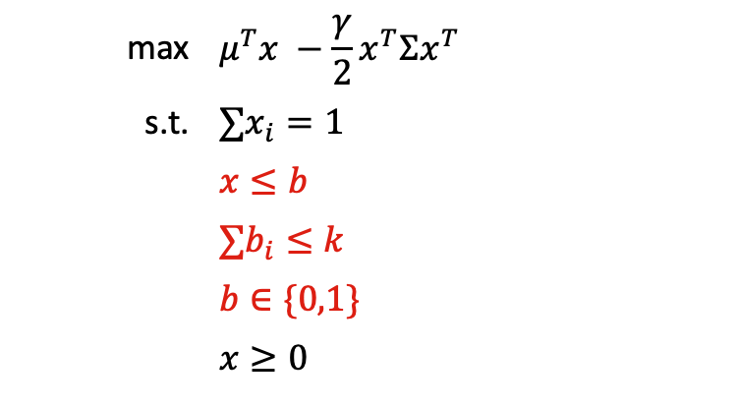
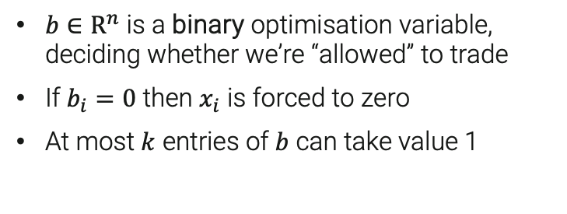
Adding a cardinality constraint
max | $$μ^{T}x −{\frac{γ}{2}x}^{T}Σx^{T}$$
s.t. | $$∑x_{i}=1$$
 | $$x≤b$$
 | $$∑b_{i}≤k$$
 | $$b∈\{0,1\}$$
 | $$x≥0$$
$b∈R^{n}$ is a binary optimisation variable, deciding whether we’re “allowed” to trade
If $b_{i}=0$ then $x_{i}$ is forced to zero
At most $k$ entries of $b$ can take value 1
Notes:
- Nothing special to PO, generic math.opt. API

Slide 10
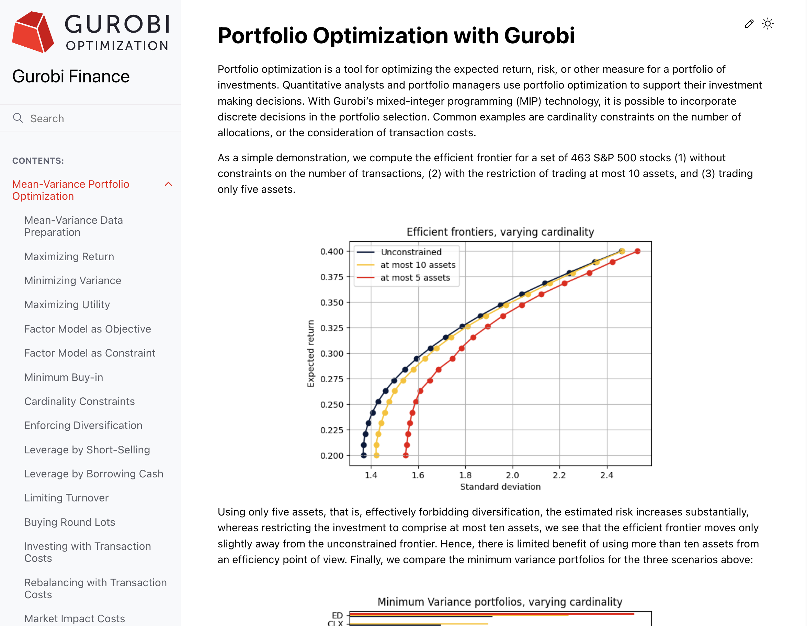

Meet Gurobi Finance
https://gurobi-finance.readthedocs.io
Notes:
- All these different constraint classes spelled out, ready to use
- Screenshot is a link

Slide 11
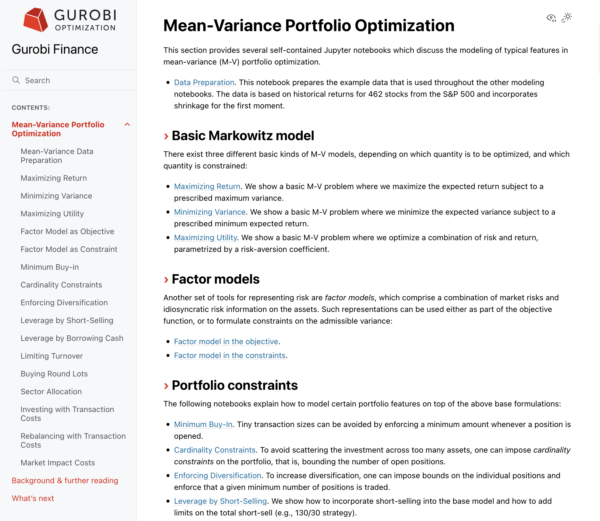
Basic modeling
Using factor models
Portfolio features

Slide 12
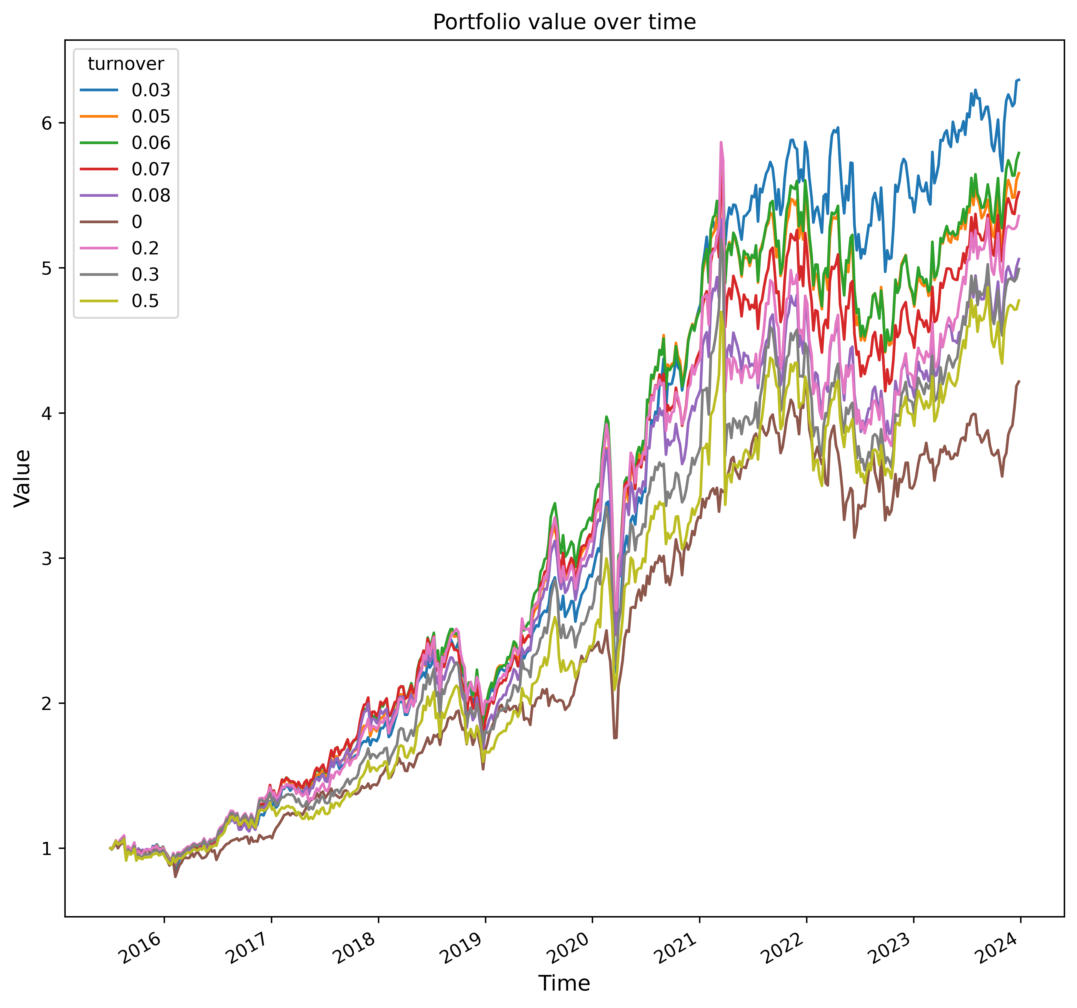
Backtesting trading strategies
Common scenario: I’ve got a new trading strategy, how does it perform on past data?
Shorter backtesting time means more strategies can be tested, means more alpha
Performance is Gurobi’s greatest strength
Our example:
Portfolio with turnover constraints on volume
Transaction costs
Minimum position size
Minimum trade size
Time span 10 years
Backtesting parameters: rebalancing frequency, risk aversion, turnover volume
Total backtesting time: 778 seconds (on a laptop)
Notes:
0 corresponds to "buy and hold"

Slide 13
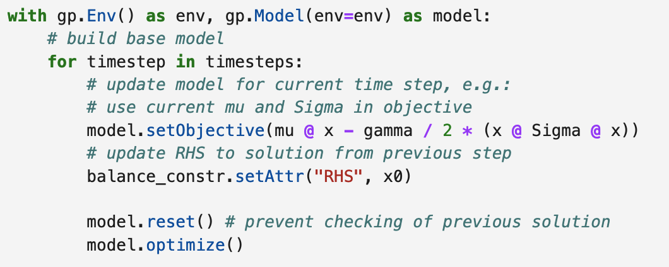
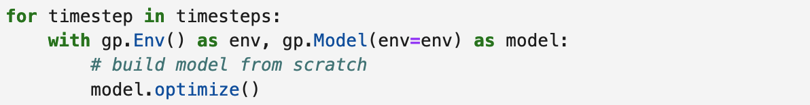
Modeling: Rebuilding vs. updating the model
Typical scenario: Solve same model over a range of different data (here: different time steps)
Re-building the optimisation model at every step is not needed
Instead update the optimisation model
Start solution useful?
34% overall speedup in our test
Notes:
Solving takes longer when updating the model because the useless MIP start from the previous iteration is tested. Reset prevents this.

Slide 14
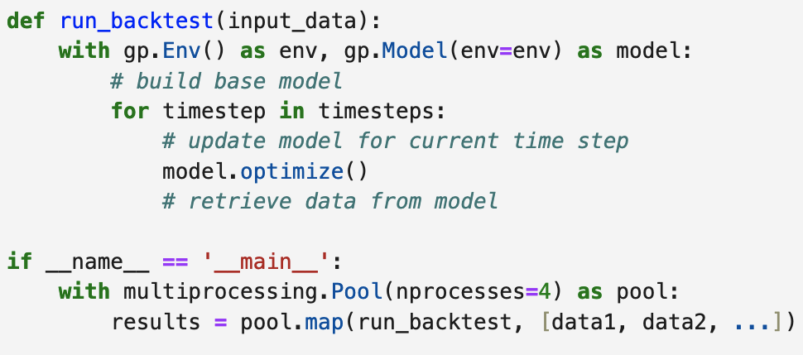
Parallelism
Gurobi is parallelized internally
Useful for long-running problems
Individual portfolio solves typically very light
Gain parallel speedup via subprocess or threading pattern
For example: Run different risk aversion parameters in parallel
Using 4 processes over 1: 3X speedup even on a laptop
gurobipy integrates nicely in Python’s parallelism paradigms

Slide 15

Takeaways
Gurobi is a state-of-the art mathematical programming software
Our mixed-integer optimisation technology allows solving portfolio optimization problems with real-world, discrete constraints
Performance is key in backtesting
Convenient and intuitive Python API (but you can use C#, Java, C++, Matlab, R, too!)

Slide 16


Thank You
For more information: gurobi.com
See me at the Gurobi stand!
Dr. Robert Luce
Principal Developer
luce@gurobi.com
© 2025 Gurobi Optimization, LLC. Confidential, All Rights Reserved | 16

