Slide 1
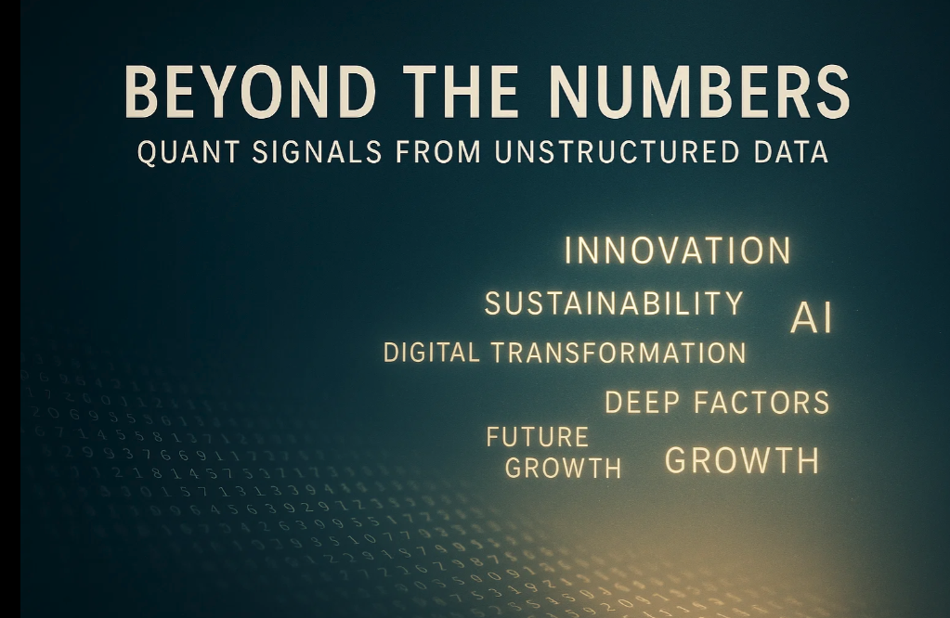


Slide 2

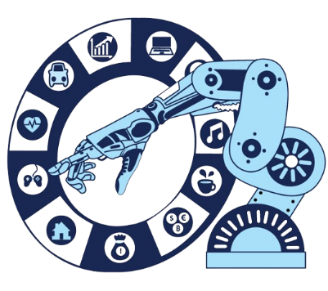

What We Deliver: AI-Generated Datasets for Quant and Thematic Investing
Daily updated signals and company-level datasets across three investment domains
Performance
Alpha signals from text data — quant-ready, point-in-time, and globally consistent.
Trends & Themes
Company-level theme exposures — ready for ETF and systematic strategies.
Sustainability & Impact
Comprehensive ESG and SDG scores — institutional-grade, audit-proof.
Innovation strength
Corporate culture
Market position
Health
Mobility
Energy
UN SDG revenue alignment
Sustainable technologies
Peer relationships
Competition links
AI/Robotics
Aging population
Cybersecurity
Agriculture
Biodiversity
Impact investing
Private markets
Delivered as: datasets & signals via API • covering 10 000+ companies • 47 markets • 21 languages • 20+ years history

Slide 3
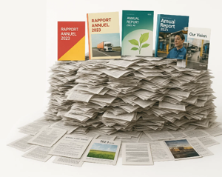





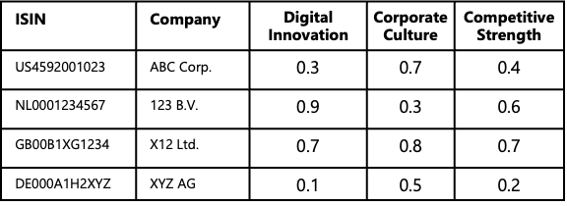










Turning Global Information Chaos into Quant-Ready Data
AI engine for multilingual document processing
Unstructured global documents — 21 languages, all formats, 20+ years history
Daily AI processing of thousands of unstructured pages — multilingual, multi-format, and fully auditable.
Global document universe → AI processing → Quant-ready data for 10,000 companies
कंपनी की वार्षिक रिपोर्ट प्रसंस्करण
स्वचालित निष्कर्षण और…
…ระบบวิเคราะห์ข้อมูลอัจฉริยะ
การประมวลผลรายงานประจำปีของบริษัท
السنوية للشركات…
تقنية الاستخراج والتصنيف التلقائي
公司年度报告文本处理
Unstructured global documents — 21 languages, all formats, 20+ years history
Daily multilingual document processing — fully automated, auditable.
Structured signals for 10,000 global companies, updated daily
Every day we process new information across 47 markets — multilingual, structured, auditable.

Slide 4
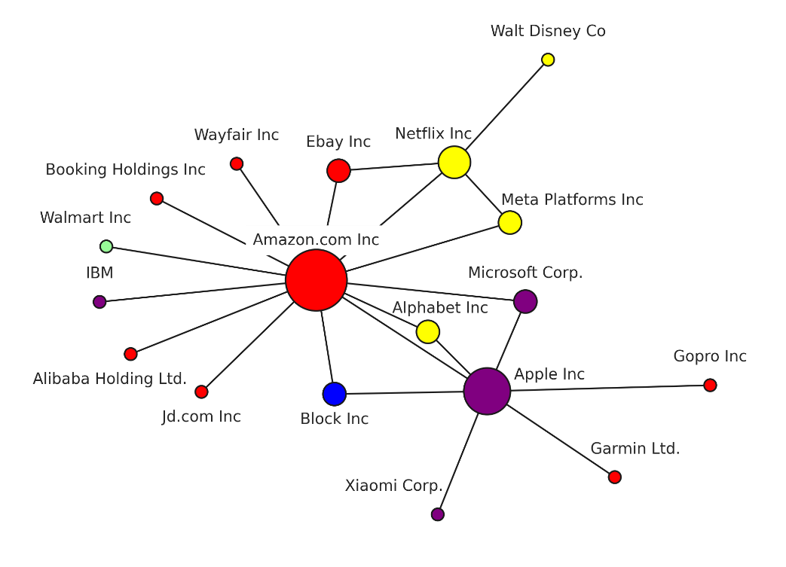
Peer Networks (TNIC) Beat Static Industry Codes
Generate alpha with text-based peers instead of GICS/ICB buckets
Text-based peer mapping: each company’s “industry group” is defined by its closest business peers
Captures competitive and product similarity that static codes miss
Enables more precise momentum and value strategies across sectors
Amazon and Netflix: different sectors, same battlefield — TNIC sees what GICS can’t.
Netflix Inc
Amazon.com Inc
*Academic research
Text Network Industry Classification (TNIC) Hoberg and Phillips, 2016, 2018

Slide 5
Peer Networks (TNIC) Beat Static Industry Codes
Generate alpha with text-based peers instead of GICS/ICB buckets
Text-based peer mapping: each company’s “industry group” is defined by its closest business peers
Captures competitive and product similarity that static codes miss
Enables more precise momentum and value strategies across sectors
Amazon and Netflix: different sectors, same battlefield — TNIC sees what GICS can’t.
Netflix Inc
Amazon.com Inc
Expect a performance upgrade: replace industry buckets with TNIC peers → uncorrelated alpha and lower drawdowns
*Academic research
Text Network Industry Classification (TNIC) Hoberg and Phillips, 2016, 2018

Slide 6

Digital Innovators
Quantifying digital innovation —
a cross-industry alpha signal
Captures innovation beyond the tech sector — across all industries and regions
Point-in-time definitions prevent forward-looking bias
AI compares company disclosures to historical “digital innovation” terminology
Reveals under-the-radar innovators, creating an uncorrelated alpha factor
*Academic research
Drechsler, Müller, & Wagner, 2021

Slide 7
See you at booth A1!

