Slide 1
Levelling Up Eurex Dynamics
>100 Columns of Volume, Notional, Open Interest, and Market Concentration for 1,000’s of Instruments
Stefan Schlamp

Slide 2
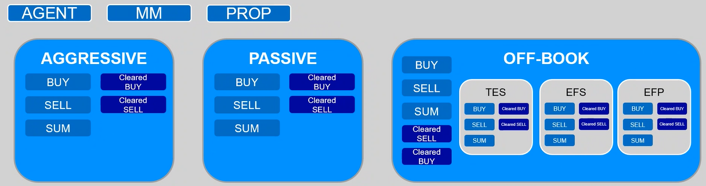
2024: Xetra “Dynamics” → 2025: Eurex “Dynamics” A Uniform Dataset across Venues and KPIs
HHI
HHI
OI
OI
HHI
HHI
HHI
OI
OI
OI
HHI
OI
Flows: based on TradingCapacity on order entry
Cleared Flows: based on clearing data up to midnight T+0
Open Interest: based on clearing data up to noon T+1
HHI (Herfindahl-Hirschman Index): market concentration by business unit
Flows & HHI also for Xetra.
Xetra: AGGRESSIVE/PASSIVE/AUCTIONS breakdown.
Sensible censoring, but: guaranteed release T+3.
Coverage: all equities on Xetra, (almost) all instruments on Eurex (except FX & single-stock futures).

Slide 3
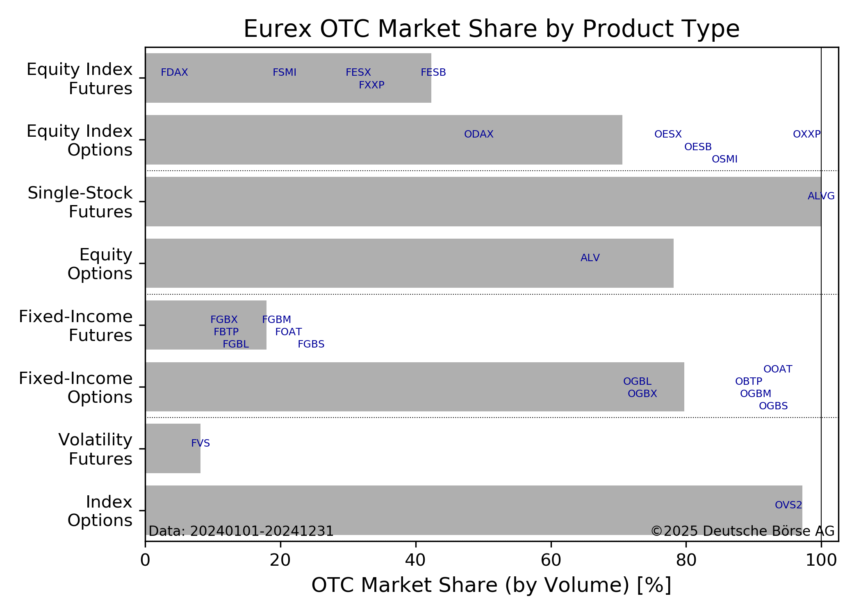
Eurex Off-Book ≈ Xetra Auctions
TES: T7 Entry Service
→ Off-Book / On-Exchange
Large TES market share:
10% for Bund future (FGBL)
30% for Euro STOXX index future (FESX)
80% for Euro STOXX index options (OESX)
80% for single-stock options
TES
TES

Slide 4
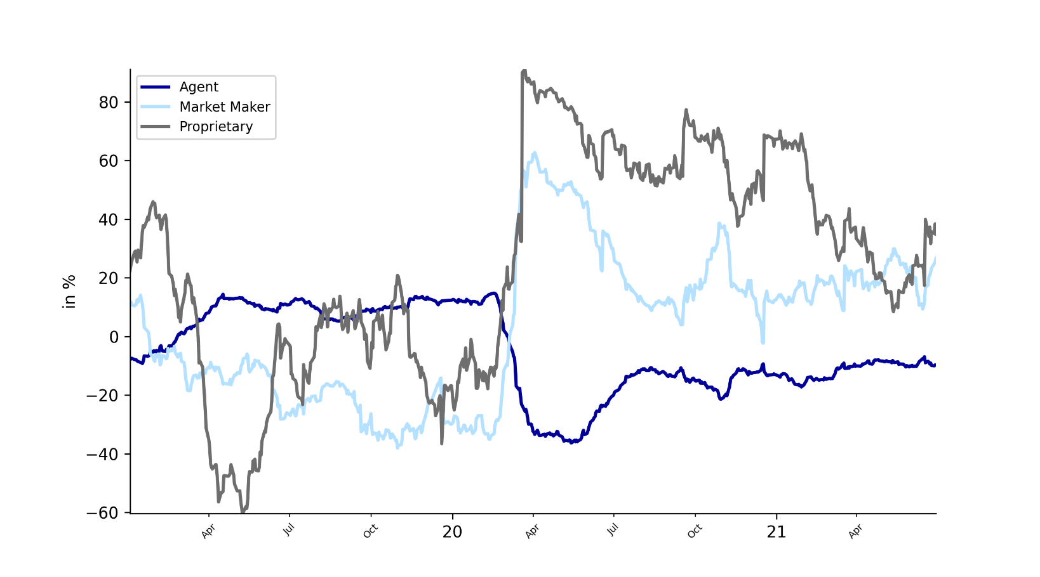
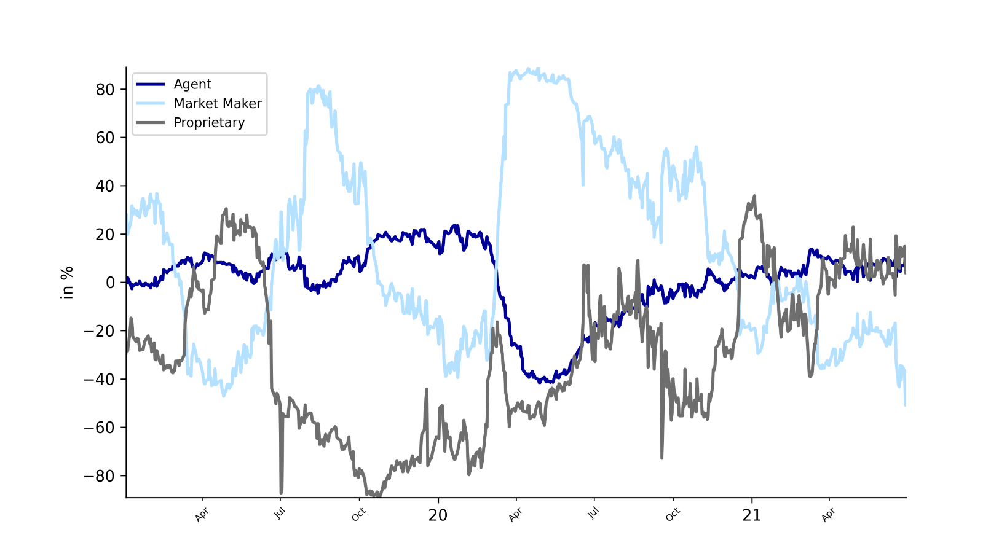
Net Exposure (%)
The reported net traded flow occasionally lags behind the actual flow. This is due to temporary violations of the filter conditions
At release times of the information the data represents the true breakdown
Analyse relative shifts in positioning and sudden changes in underlying commitment
Proprietary participants went “all-in” during the covid crash with their net exposure reaching >80% of gross in long positions for the FESX
FESX
FDAX
Source: Eurex Open Interest Dynamics

Slide 5
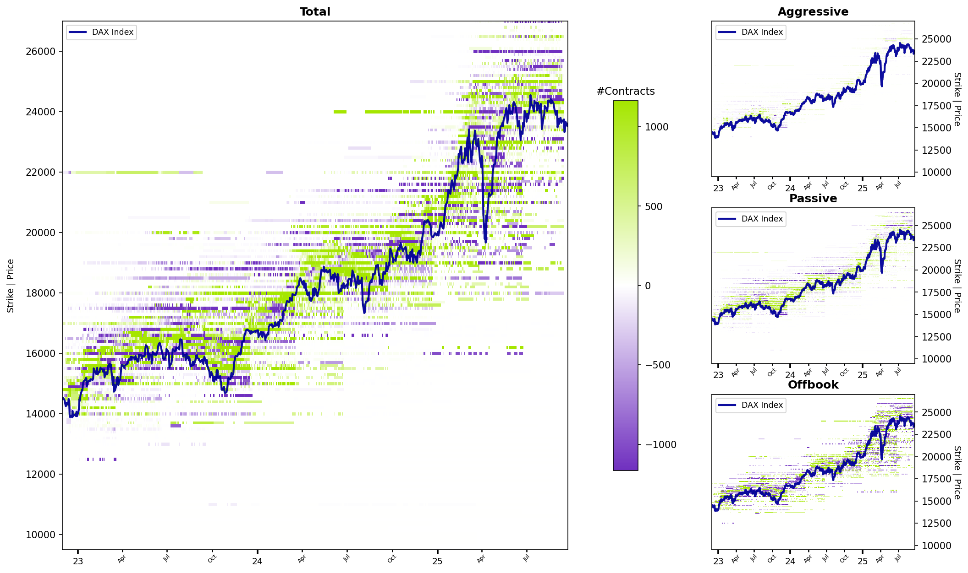
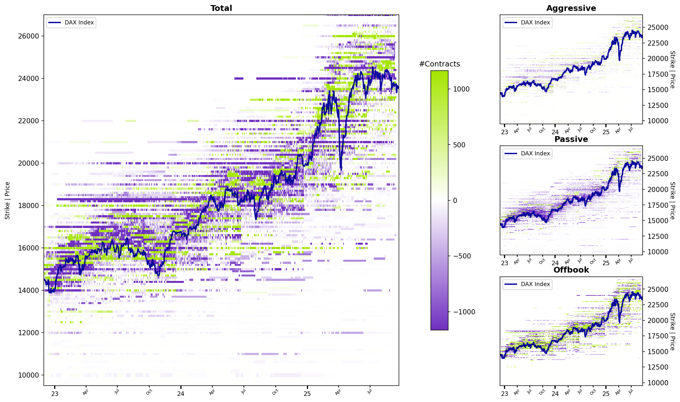
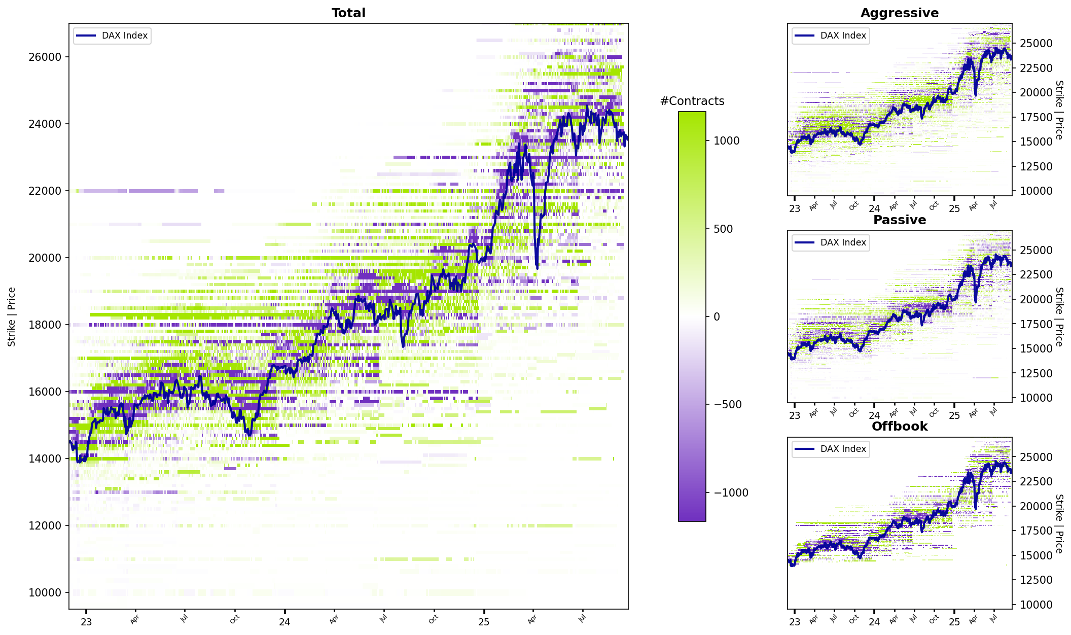
Participant activity on traded flows by Strike for DAX Call options
Agent
Proprietary
Market Maker
Source: Eurex Flow Dynamics

Slide 6
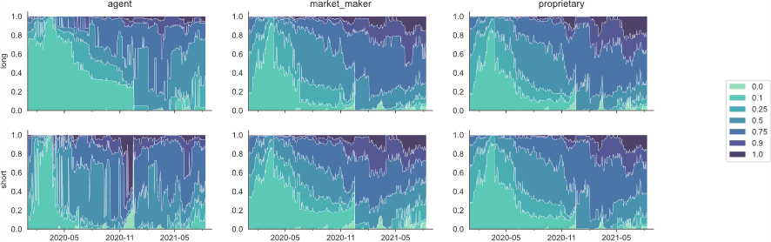
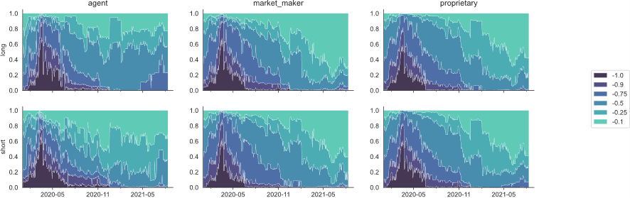
Delve into option greek positionings
The reported net traded flow occasionally lags behind the actual flow. This is due to temporary violations of the filter conditions
At release times of the information the data represents the true breakdown
Leverage the official settlement prices to calibrate Greek flows by participant type
Pivot across multiple maturities and strikes or opt for high level aggregations to gauge overall market sentiment
Delta Distributions on Single Stock Options
Delta
Calls
Delta
Puts
Source: Eurex Open Interest Dynamics

Slide 7
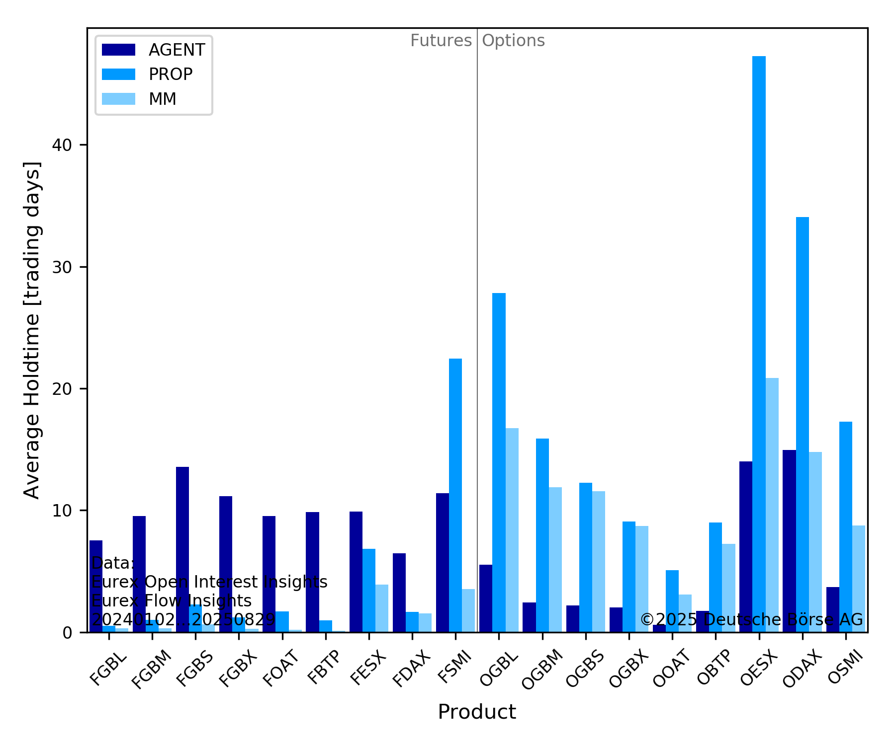
Average Holdtimes
Open Interest ≈ Position
Flows → Volume
Cleared Flows → Expiry + Exercises
→ Average Holdtimes (day resolution)

Slide 8
Disclaimer
© Deutsche Börse Group 2023
This publication is for informational purposes only. None of the information in this publication constitutes investment advice and does not constitute an offer to sell or a solicitation of an offer to purchase any contract, share or other financial instrument. This publication is not intended for solicitation purposes but only for use as general information. All descriptions, examples and calculations contained in this publication are for illustrative purposes only.
Deutsche Börse AG, Frankfurter Wertpapierbörse (FWB®, the Frankfurt Stock Exchange), Eurex Frankfurt AG, Eurex Deutschland and Eurex Clearing AG do not represent that the information in this publication is comprehensive, complete or accurate and exclude liability for any consequence resulting from acting upon the contents of this or another publication, in so far as no wilful violation of obligations took place or, as the case may be, no injury to life, health or body arises or claims resulting from the Product Liability Act are affected.
Securities traded on the Frankfurt Stock Exchange and Eurex derivatives (other than EURO STOXX 50® Index Futures contracts, EURO STOXX® Select Dividend 30 Index Futures contracts, STOXX® Europe 50 Index Futures contracts, STOXX® Europe 600 Index Futures contracts, STOXX® Europe Large/Mid/Small 200 Index Futures contracts, EURO STOXX® Banks Sector Futures contracts, STOXX® Europe 600 Banks/Industrial Goods & Services/Insurance/Media/Personal & Household Goods/Travel & Leisure/Utilities Futures contracts, Dow Jones Global Titans 50 IndexSM Futures contracts, DAX® Futures contracts, MDAX® Futures contracts, TecDAX® Futures contracts, SMIM® Futures contracts, SLI Swiss Leader Index® Futures contracts, RDXxt® USD - RDX Extended Index Futures contracts, Eurex inflation/commodity/weather/property and interest rate derivatives) are currently not available for offer, sale or trading in the United States nor may they be offered, sold or traded by persons to whom US tax laws apply.The fund shares listed in XTF Exchange Traded Funds® are admitted for trading on the Frankfurt Stock Exchange. Users of this information service who legally reside outside Germany are herewith advised that sale of the fund shares listed in XTF Exchange Traded Funds may not be permitted in their country of residence. The user makes use of the information at their own risk.
Legal validity of this disclaimer
In the event that individual parts of or formulations contained in this text are not, or are no longer, legally valid (either in whole or in part), the content and validity of the remaining parts of the document are not affected.
Trademarks
The following names and designations are registered trademarks of Deutsche Börse AG or an affiliate of Deutsche Börse Group:
1585®; A7®; Buxl®; C7®; CDAX®; CEF®; CEF alpha®; CEF ultra®; CFF®; Classic All Share®; Clearstream®; CX®; D7®; DAX®; DAXglobal®; DAXplus®; DB1 Ventures®; DBIX Deutsche Börse India Index®, Deutsche Börse®; Deutsche Börse Capital Markets Partner®; Deutsche Börse Commodities®; Deutsche Börse Venture Network®; Deutsches Eigenkapitalforum®; DivDAX®; eb.rexx®; eb.rexX Jumbo Pfandbriefe®; ERS®; eTriParty®; Eurex®; Eurex Bonds®; Eurex Clearing Prisma®; Eurex Improve®; Eurex Repo®; Euro GC®; ExServes®; EXTF®; F7®; FDAX®; FWB®; GC Pooling®; GCPI®; GEX®; Global Emission Markets Access – GEMA®; HDAX®; iNAV®; L-DAX®; L-MDAX®; L-SDAX®; L-TecDAX®; M7®; MDAX®; N7®; ODAX®; ÖkoDAX®;PROPRIS®; REX®; RX REIT Index®; SCHATZ-FUTURE®; SDAX®; ShortDAX®; StatistiX®; T7®; TecDAX®; Technology All Share®; TRICE®; USD GC Pooling®; VDAX®; VDAX-NEW®; Vestima®; Xcreen®, Xemac®; Xentric®, Xetra®; Xetra-Gold®; Xpect®; Xpider®; XTF®; XTF Exchange Traded Funds®; We make markets work®
The names and trademarks listed above do not represent a complete list and, as well as all other trademarks and protected rights mentioned in this publication, are subject unreservedly to the applicable trademark law in each case and are not permitted to be used without the express permission of the registered owner. The simple fact that this publication mentions them does not imply that trademarks are not protected by the rights of third parties.
The STOXX® indices, the data included therein and the trademarks used in the index names are the intellectual property of STOXX Ltd., Zug, Switzerland and/or its licensors. Eurex' derivatives based on the STOXX indices are in no way sponsored, endorsed, sold or promoted by STOXX and its licensors and neither STOXX nor its licensors shall have any liability with respect thereto.
STOXX iSTUDIO® is a registered trademark of STOXX Ltd., Zug, Switzerland.
TRADEGATE® is a registered trademark of Tradegate AG Wertpapierhandelsbank.
EEX® is a registered trademark of European Energy Exchange AG.
Flexible is better.® is a registered trademark of Axioma, Inc.

Slide 9
Stefan Schlamp
Head of Quantitative Analytics
Deutsche Börse AG Mergenthalerallee 61 65760 Eschborn
Phone +49 69 21116833 E-mail stefan.schlamp@deutsche-boerse.com

