Slide 1
DDN: The World's Leading Data Intelligence Platform for AI
Michael Chazot: DDN VP FSI

Slide 2






700,000+
GPUs deployed
11,000+
Customers
10+
Technology Centers
1100+ | 600+
Employees | Engineers
1998-2008
2008-2018
2018-2023
2024-Present
Leadership in High Performance Computing
Expansion in Enterprise Markets & Technological Innovation
Leadership in AI Analytics, LLM Training & Gen AI
Go-To Leading Force in AI Data Intelligence

Slide 3









DDN Powers More AI Across More Markets Than Anyone Else
NCP & AI Cloud Providers
Autonomous Driving
AI Chatbots & Assistants
Healthcare
Financial Services
Manufacturing
Financial Services
Energy
Defense
Public Sector & Research

Slide 4



“NVIDIA Is Powered By DDN
…Without DDN, NVIDIA Supercomputers Wouldn’t Be Possible.”
Jensen Huang – NVIDIA CEO
Jensen Huang, CEO of Nvidia, and Alex Bouzari, CEO of DDN, at DDN Beyond Artificial, February 20, 2025

Slide 5
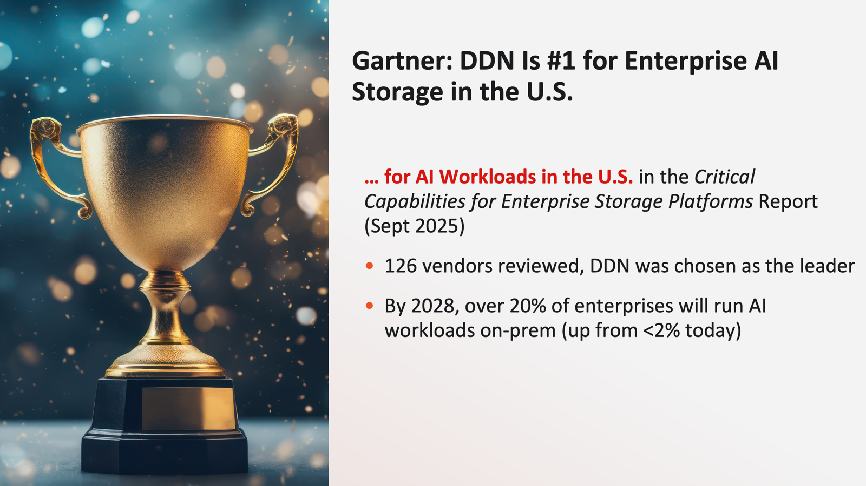


Referenceability in the Data Intensive Industry
AI and HPC Workloads Demand Highest Performance Data – DDN is the Undisputed Leader on IO500
11x better performance. 7 of the top 10 scores. DDN leads the way for AI & HPC data platforms.
DDN Recognized as #1 in the U.S. for Gartner® Use Case: AI in the Gartner Critical Capabilities for Enterprise Storage Platforms

Slide 6
DDN Optimizes GPU Usage and Improves Customer ROI by 30%
CONFIDENTIAL
Checkpoint
Model Load
Data Load
Checkpoint
Model Load
Higher Utilization with Lower Load Times
Data Load
+30% Training
Training
Training
NVIDIA GPU Utilization
NVIDIA GPU + DDN Utilization
DDN helps to free up valuable GPU resources by
Optimizing data movement
Accelerating checkpoint and model load operations
Notes:
By investing in DDN’s data intelligence platform customers unlock scalability and efficiency in their gpu data centers and clouds, at significantly higher performance to cost ratios than traditional approaches
As you scale up your gpu infrastructure, DDN delivers exponentially better performance (larger and larger datasets), significantly lower cost of operation (economies of scale), much smaller data center footprint and power consumption for a given data set
DDN platforms unlock GPU cycles at the 30% level, which in an iterative LLM model where you continuously retrains delivers the Warren Buffet compound interest benefit– ie invest for the long term but get exponential benefits in the short term due to compounding and the nature of LLM continuous retraining cycles
Basically adding $1 of DDN data intelligence platform, frees up 30 cents in GPU cycles, which iterated 100 times in an LLM results in $30 of savings, which is a 30x benefit

Slide 7



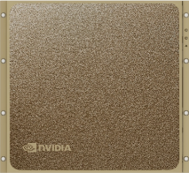
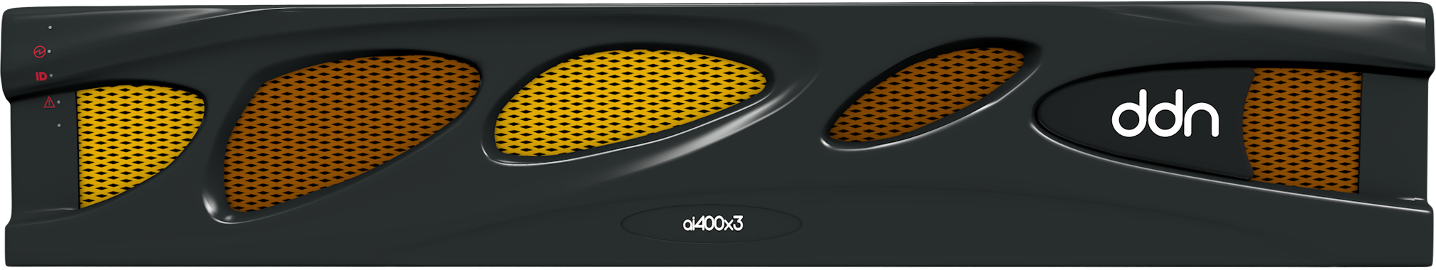
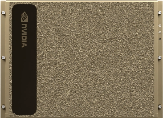

DDN Data Intelligence Platform: EXAScaler and Infinia
DDN EXAScaler solves the challenges of
Extreme scale
Maximum BW and IOPs
High Power efficiency
Best for GPU Training
DDN Infinia solves the challenges of
Application integration
Multi Protocol and Multi-Tenancy
Data Distribution and Governance
Best for GPU Inference

Slide 8


Encouraging Quantitative Analysts to Operate Independently With Parallel Processing
CHALLENGES
While decentralizing the management of approaches their quantitative analysts take provides a strategic advantage in the firm’s ability to outpace competition, it makes enforcing efficient IO near impossible. As a result, to make this strategy work, Jump required a robust and highly efficient compute infrastructure capable of handling diverse workloads concurrently and with little to no processing latency.
SOLUTION
BENEFITS
DDN 400NVX2 QLC systems
Simple NVME-oF backend
Decreased processing latency by 10x
Parallel protocol enabled concurrent diverse workloads across a high number of nodes
Instant results upon deployment
“DDN QLC systems are a really important part of that environment to get IO to our researchers as quickly as possible.”
Alex Davies | Chief Technology Officer, Jump Trading

Slide 9




Let’s discuss how we will supercharge your business outcomes enabled by AI on premises and in multiclouds.

